Slide 1
Hudson River Environmental Society
The State of Hudson River Science Symposium
April 24, 2013
Providing Science in Support of Continuing Stewardship of the Hudson River:
Are we up to the Challenge?
Dennis Suszkowski
Quang Huynh
Hudson River Foundation

Slide 2
Science for the Hudson River
An “Adequate” Supply of Science
  Financial capital
  Intellectual capacity
High Quality Science
  Reliable data
  Products/publications that are widely accepted
  Respected investigators
Relevant Science
  Managerial useful –relate to goals of the River
  Scientifically relevant
  Conducted in appropriate timeframes – short- vs. long-term investments
Desired attributes for sustainable science associated with stewardship

Slide 3
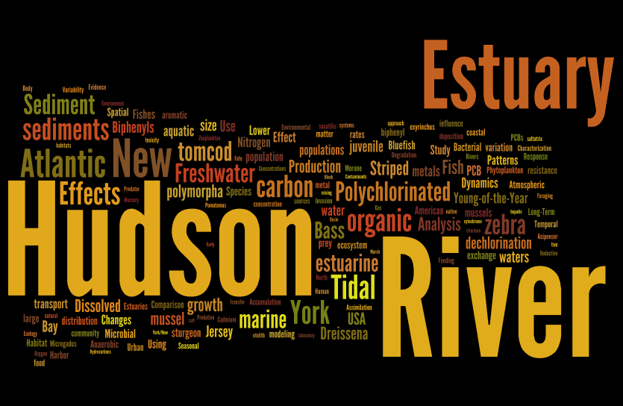

Slide 4
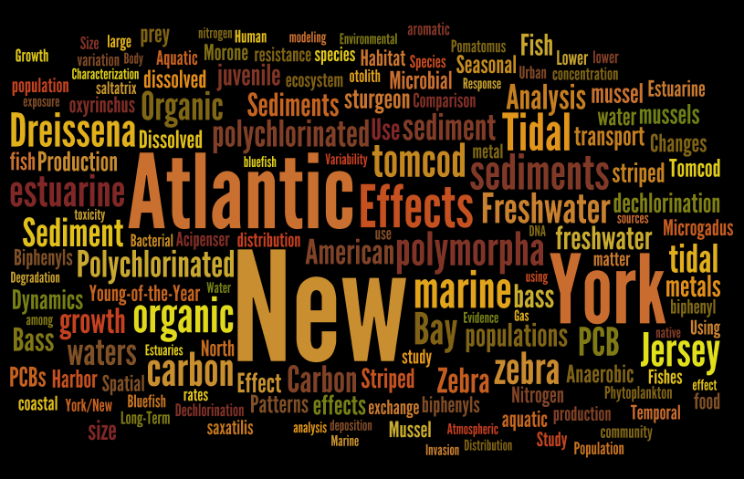
Notes:
Word cloud – from publications

Slide 5
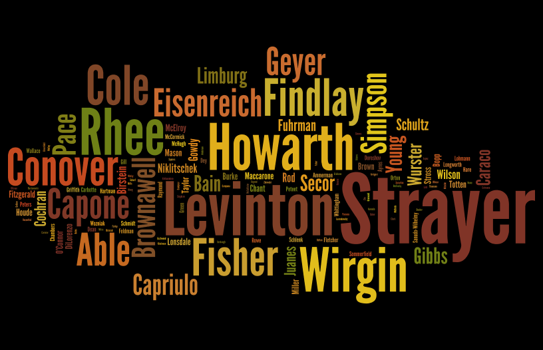
Notes:
Authors - # of publications

Slide 6
Quantity of Hudson River Scientific Research

Slide 8
Comparison of Research Funding Sources
Hudson River vs. Chesapeake Bay
Average Yearly Funding Amounts
1990-2000

Slide 9
Quality of Research Products
Publications from HRF support….
546 publications in 148 peer-refereed journals from research grants
HRF-supported publications cited more than 30,000 times
  Very high H-index of 81 = 81 publications have been cited 81 times or more ( A rating of 45 or higher = potential membership in US National Academy of Science for a scientist)
  Most highly cited publication cited 2826 times
  97% of HRF-sponsored publications have been cited at least once
Notes:
9

Slide 10
Hudson River Monitoring (Includes Assessments, Inventories, Surveys and Data Management)
by Funding Source: 1990-2000
Total ~ $117 million (~$10.6M/yr)
Total science in HR ~ $13M/yr

Slide 11
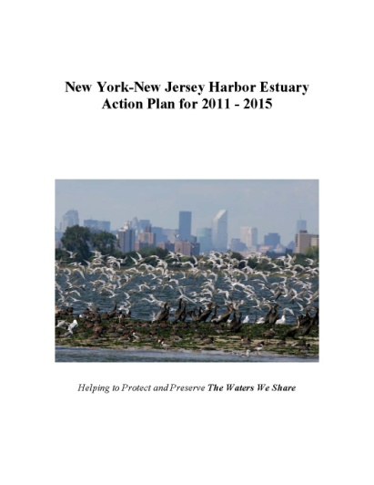
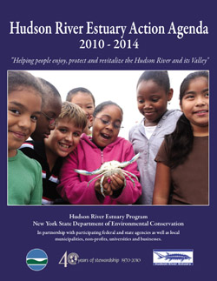
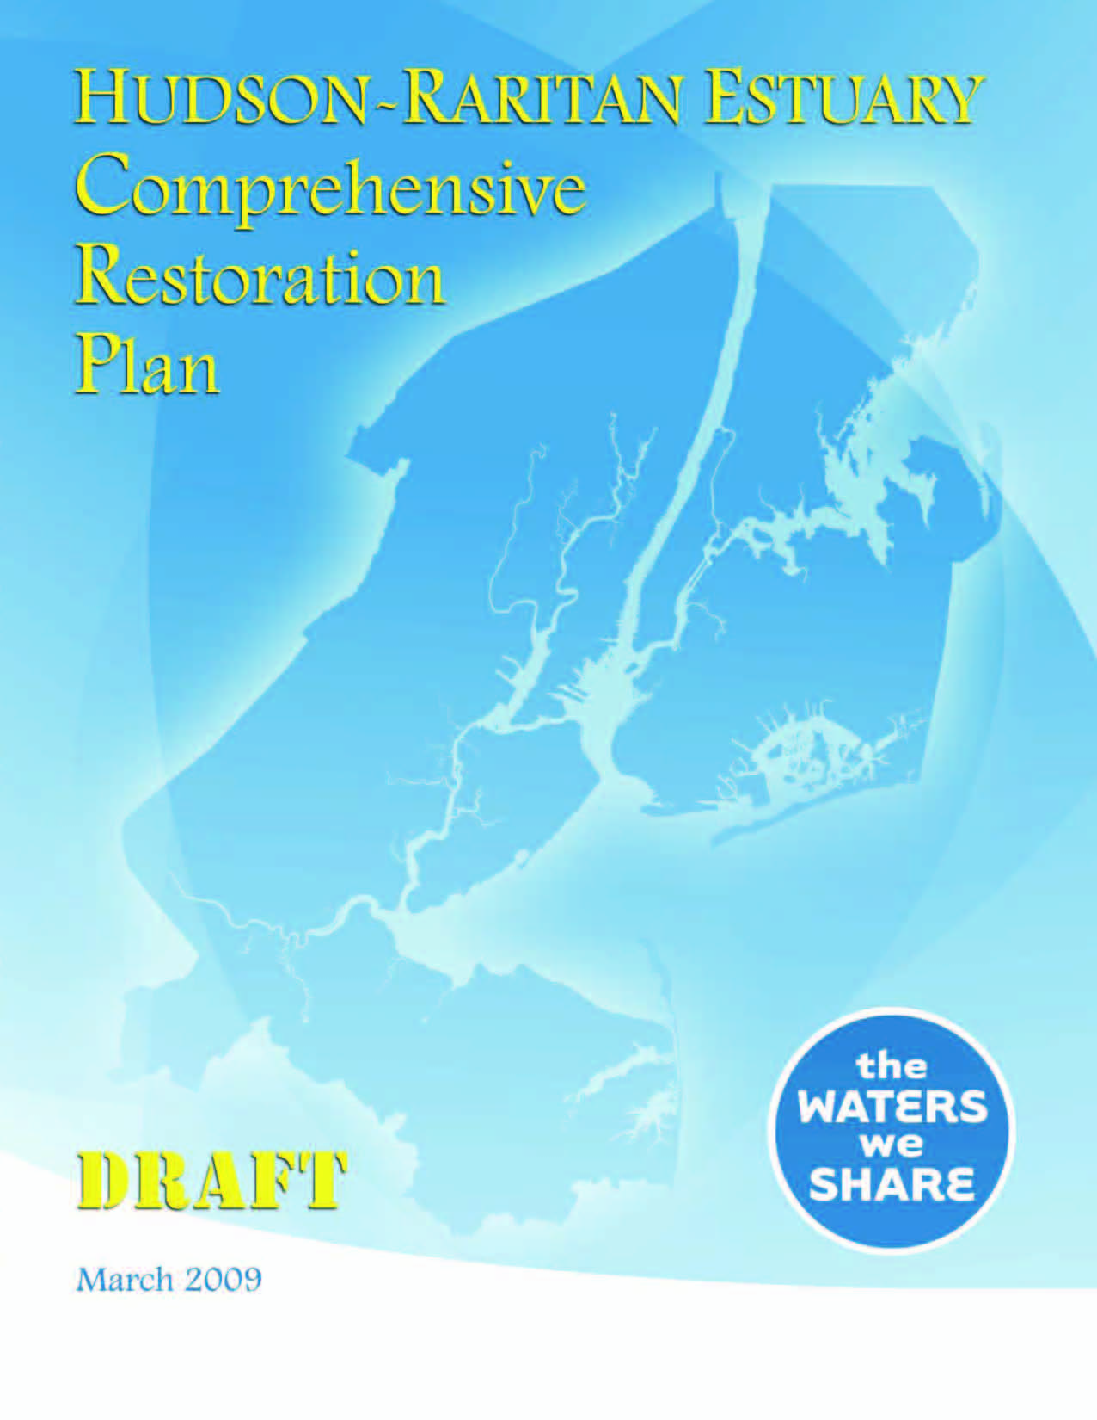
Relevance - Goals for Future Stewardship of the Hudson
Hudson River Estuary Program
NY/NJ Harbor & Estuary Program
Hudson-Raritan Estuary Comprehensive Restoration Plan

Slide 12
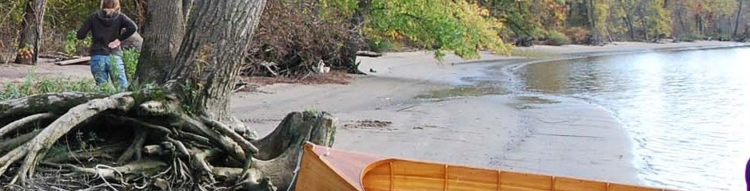
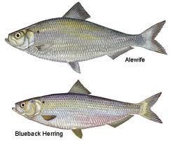
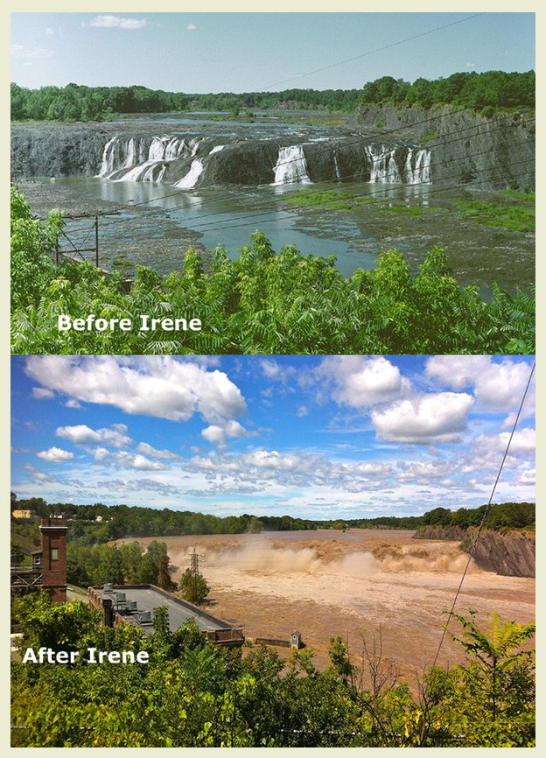

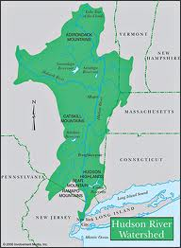
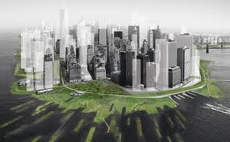
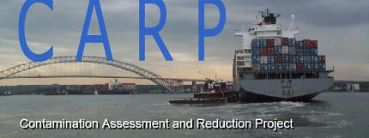
The Mid-Term Future (i.e., 5 – 10 years)
7 Focus Areas of HRF for Hudson River Science
Restore signature fisheries
Restore and improve habitats
Understand the watershed and its influence on river processes
Evaluate climate change impacts and implications (including extreme events)
Understand human use and interaction
Understand existing and emerging contaminants
Evaluate ecosystem services and value

Slide 13
Sustainable Stewardship
Monitoring
Research
Modeling
Public Interest
Management Framework
Science
Stewardship
Responsible planning & management of resources, including restoration

Slide 14
Contributors of Science
Advocates for funding and projects plus participation
Nudge (through regulation), assess & monitor
Science
“Champions”
Managers
Research Community (funders & academics)
Science
Research Community (funders & academics)

Slide 15
Partnering and Leveraging
Ecosystem Restoration Research: Leveraging of Funds
HRF funds of $570K leveraged an additional $2M in research and staff support between 2007 and 2012.
DEC Grant to Levinton: Oysters in Haverstraw Bay, $250K
HRF Grant: Levinton , Oysters, $220K
NFWF grant to HRF: Oyster sustainability in Jamaica Bay, $200K
HRF grant to Levinton; Oysters in Jamaica Bay $75K
NFWF grant to Levinton/Doall: Oysters in Jamaica Bay
$150K
US FWS : Oysters in Jamaica Bay
$75K
HRF grant to HydroQual: Modeling oyster transport, $60K
NYCDEP Oyster modeling to HydroQual
$100K
HRF grant: Bain, Habitat
$50K
TEC development: PA contracts to HRF
$350K
HRF grants for Oyster Reef Assessments,
$300k
Oyster Research Partnership
$1.2M
PA & HEP funds for Experimental Reef Construction
$450k
Research & Monitoring infrastructure
$350
ORRP Phase 2: Restoration Research
NOAA/WCS/HEP/HS
$350K
HRF grants to Bain :TEC research, $95K
Oyster Partners in-kind services
$450K

Slide 16
Challenges to Continued Stewardship
Major issues, like climate change, require new scientific insights
A troubled economic climate
  Public and private levels of funding for science not likely to increase in near term
  Curtailment of geographically-specific federal funding (i.e., earmarks)
Promotion and maintenance of partnerships
Development of shared understanding of the contributions and limitations of science in advancing stewardship
  Short-term gratification vs. long-term benefit
Continuation of some science programs may be in jeopardy
  Utilities’ biological monitoring program, CARP , USGS sediment monitoring

Slide 17
Opportunities for Continued Stewardship
Strong and growing public interest
  Extreme events, climate change, restoration and public access/recreation
Talented scientific community with long track record
  Success can attract new $
Likely funding from traditional sources
  Increases unlikely in near term
Frameworks are in place that encourage partnerships
  Leveraging will be essential
Future settlements may provide new sources of funding for science

