Slide 1
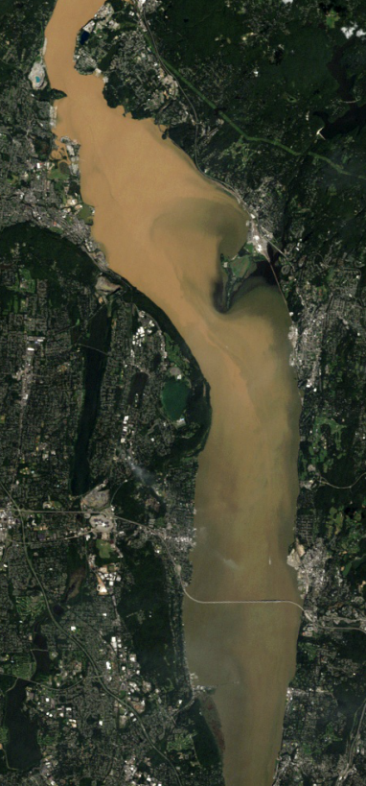


Sediment transport and deposition:
salinity fronts and storm events
David Ralston, Rocky Geyer,
John Warner, Gary Wall
Hudson River Science Symposium
SUNY New Paltz – April 24, 2013
LANDSAT
Aug 31, 2011

Slide 2
Estuaries efficiently trap sediment
→ High sediment concentrations and deposition rates, efficient trapping
estuarine circulation
seaward flow
stratified
unstratified
Ocean
River
ETM
1 psu
Fluvial
sediment
30 psu
15 psu
Marine
sediment
deposition
How does the Hudson compare with this cartoon?

Slide 3
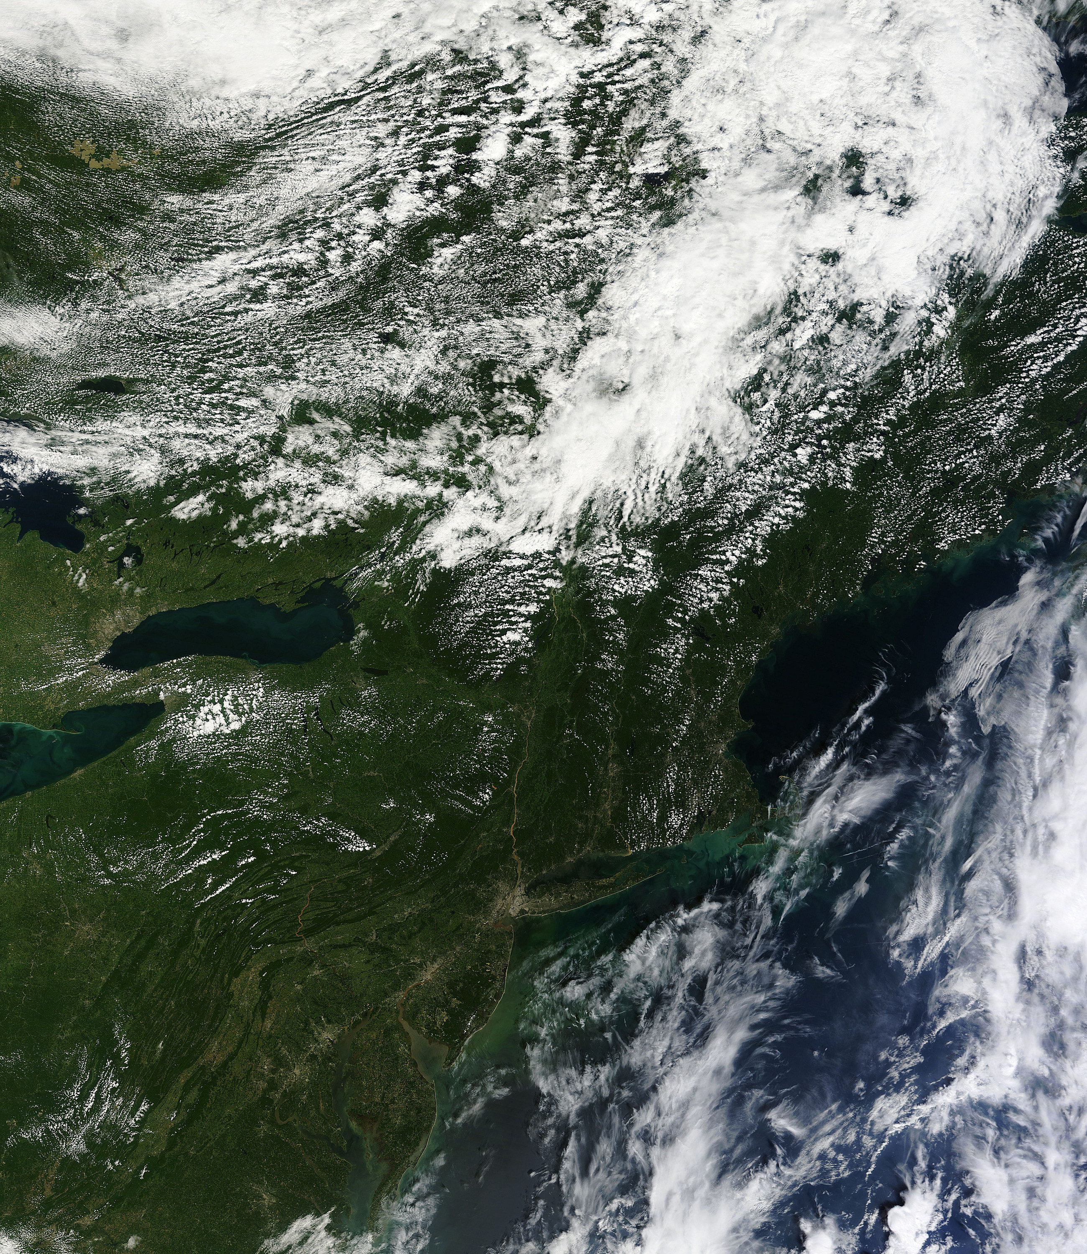
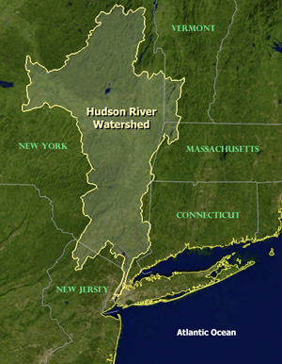
Hudson River estuary
Poughkeepsie
120 km
Salinity intrusion at low Q_{r}
Newburgh Bay
95 km
Haverstraw Bay
60 km
Tappan Zee
45 km
High Q_{r}
GW Bridge
18 km
Battery
0 km
Average sediment input ~0.5 Mtons/yr

Slide 4
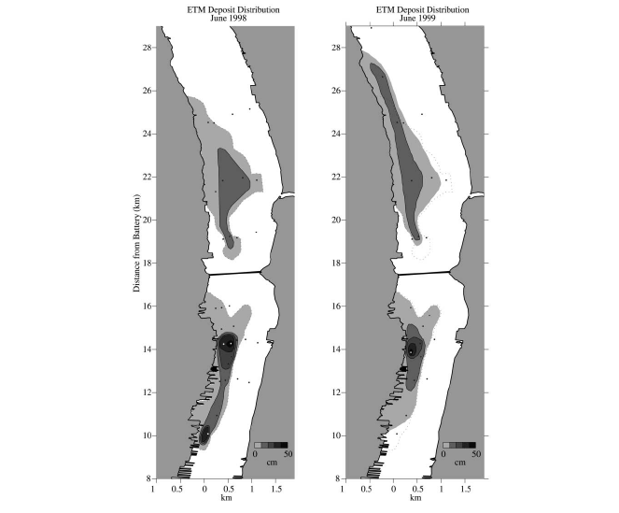
Lower Hudson ETM: near GW Bridge
high deposition rates
June 1998
June 1999
NYC
0 50 cm
Woodruff et al. 2001
Atlantic
Ocean

Slide 5
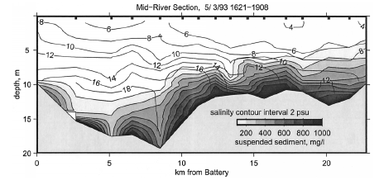
Lower Hudson ETM: near GW Bridge
high deposition rates
high sediment concentrations (>1 g/L)
BUT, at intermediate salinities, not at salinity limit
Geyer et al. 2001
Atlantic
Ocean

Slide 6
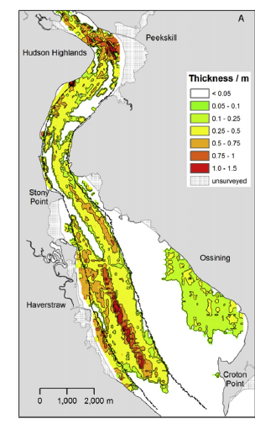
Upper Hudson ETM? Haverstraw Bay
High deposition rates in Haverstraw;
frequent dredging
NYC
Nitsche et al., 2010
Atlantic
Ocean

Slide 7
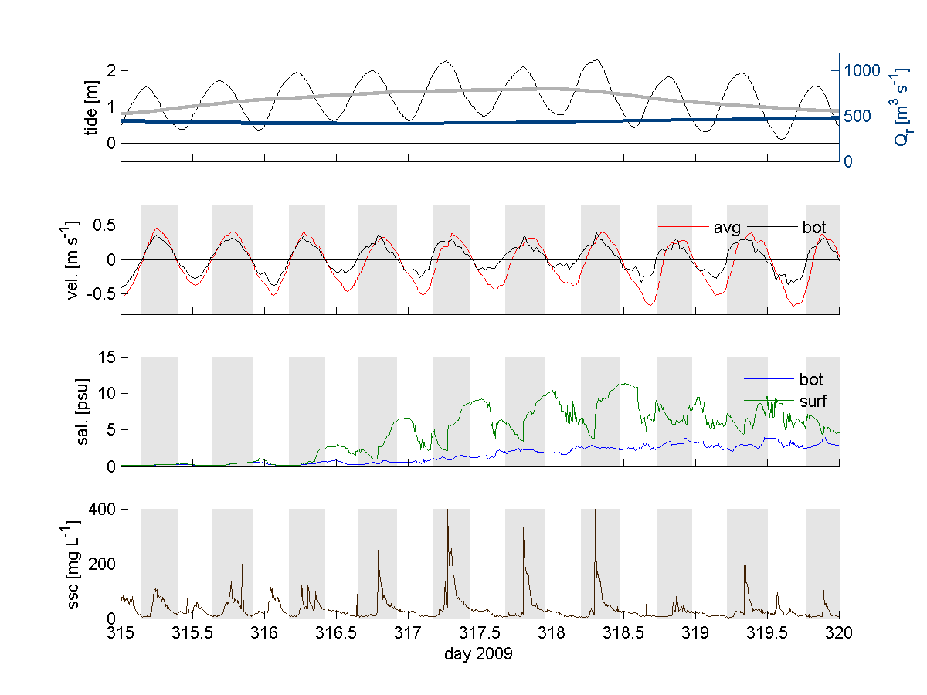
Upper Hudson ETM: Haverstraw Bay
High sediment concentrations observed at flood tide salinity fronts
Suspended sediment concentration
Salinity
Ralston et al., 2012

Slide 8
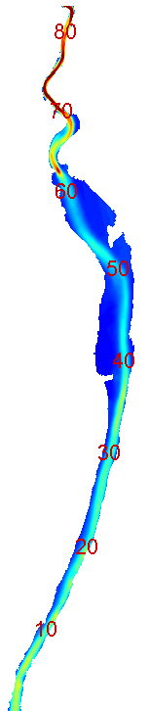
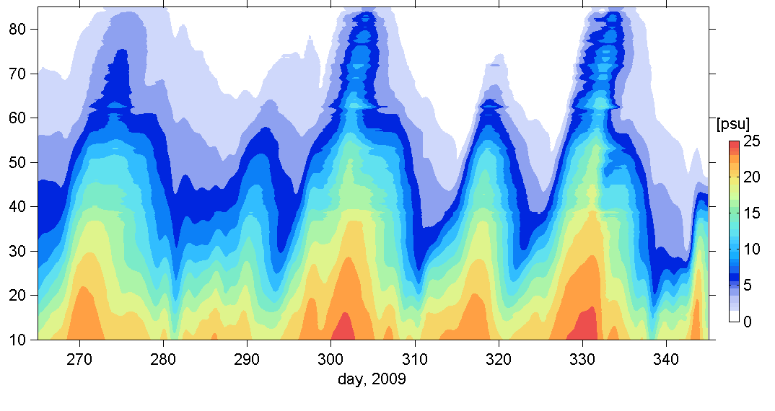
Salinity intrusion
Advances during neap tides, retreats during spring tides
N S N S N S N S N S
bottom salinity
Distance from Battery (km)
model results, Fall 2009

Slide 9
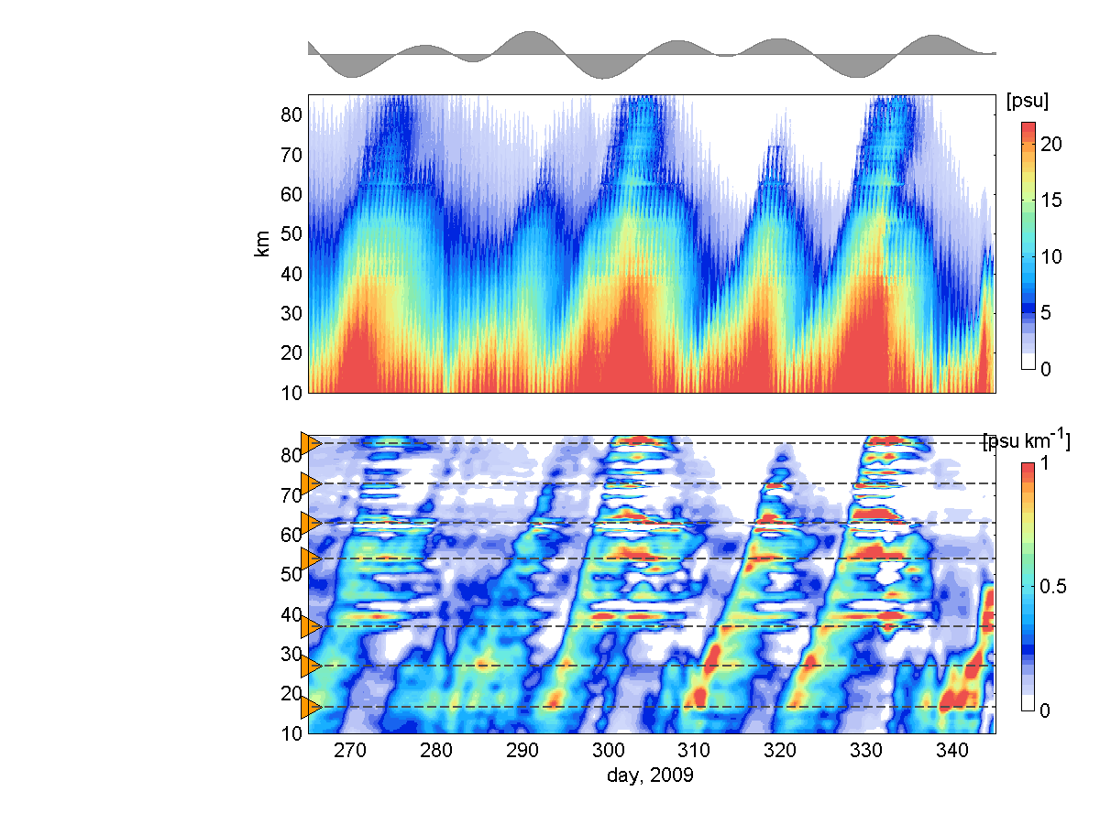
Frontal locations distributed along the estuary
At constrictions: salinity gradient intensified and persistent
West Point
bottom salinity gradient (∂s/∂x)
Distance from Battery (km)
Croton Pt.
Piermont
GW
Bridge
model results, Fall 2009

Slide 10
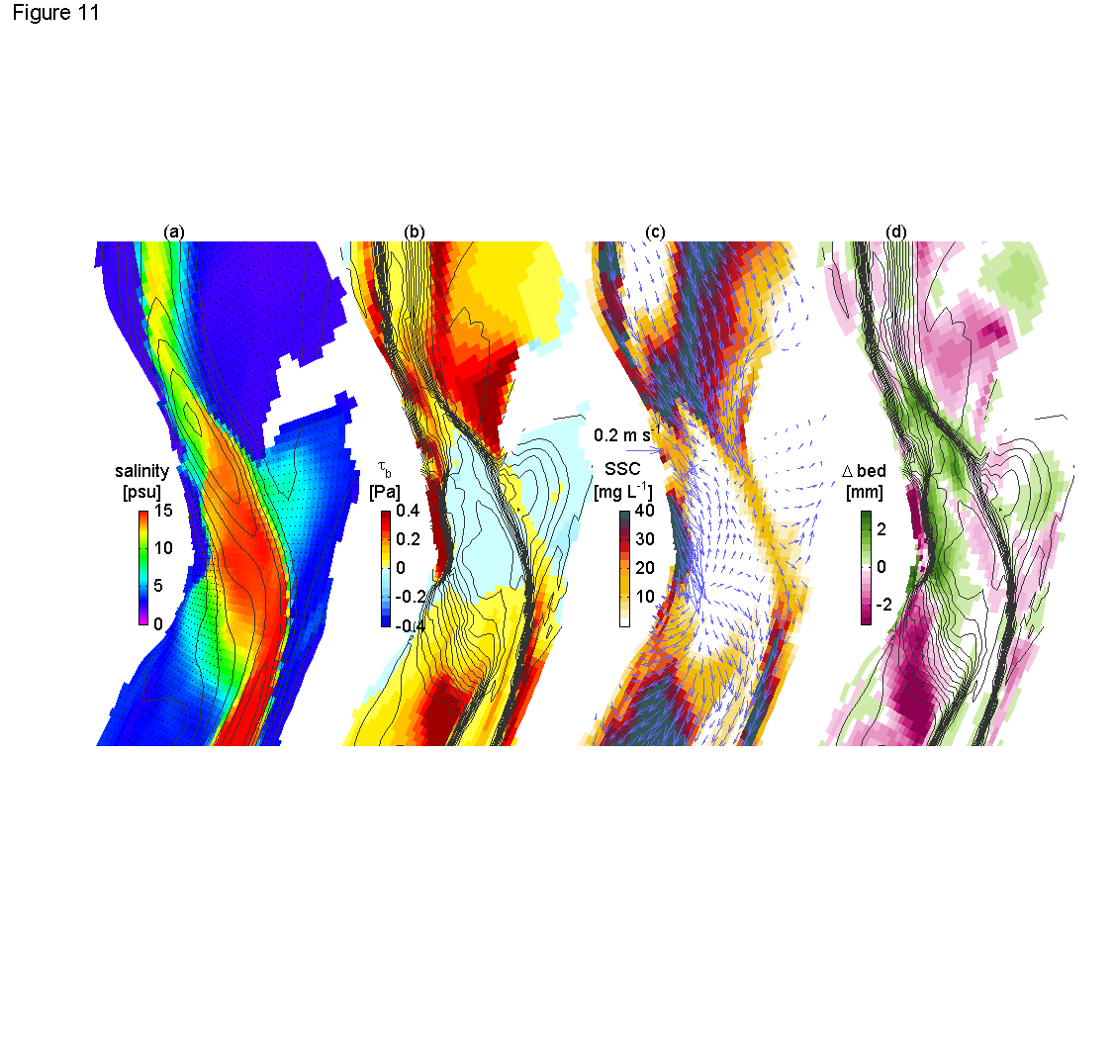
Salinity front sediment trapping: Haverstraw Bay
Salinity + bathy
bottom stress + sal.
SSC + velocity
erosion/deposition + sal.
Slack before flood
Net over 1 tidal cycle
model results, Fall 2009

Slide 11
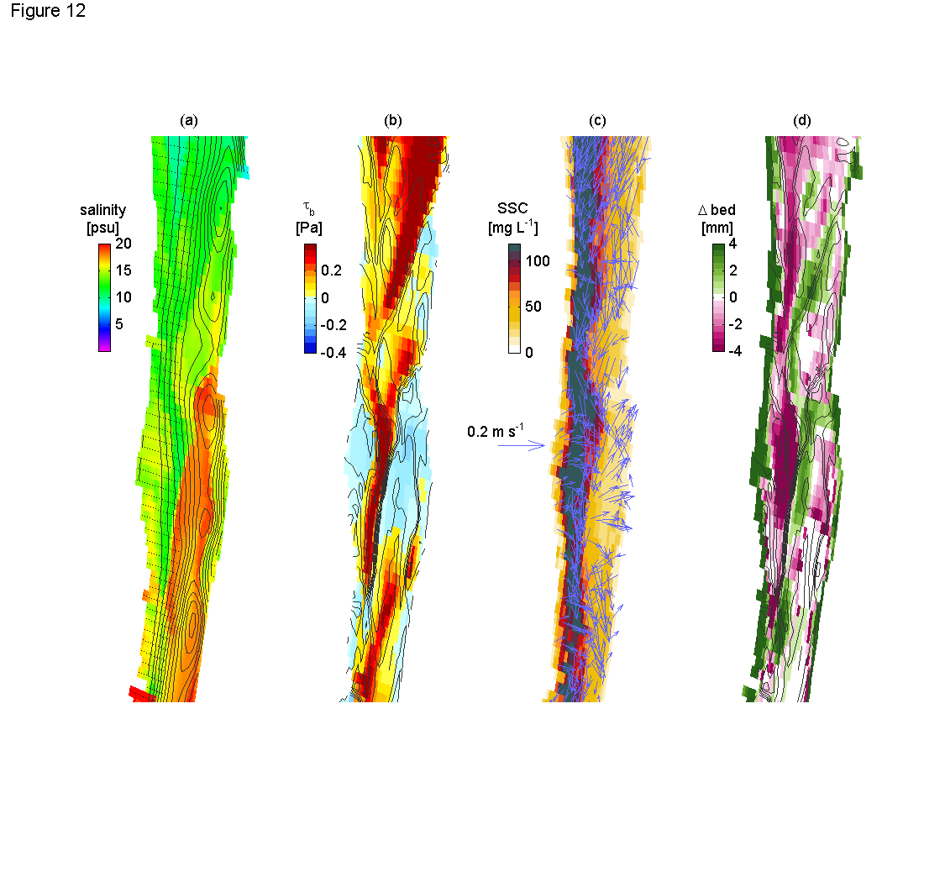
Salinity front sediment trapping: GW Bridge
salinity
+ bathy
stress
+ sal.
erosion/
deposition + sal.
SSC
+ velocity
Slack before flood
Net over 1 tidal cycle
model results, Fall 2009

Slide 12
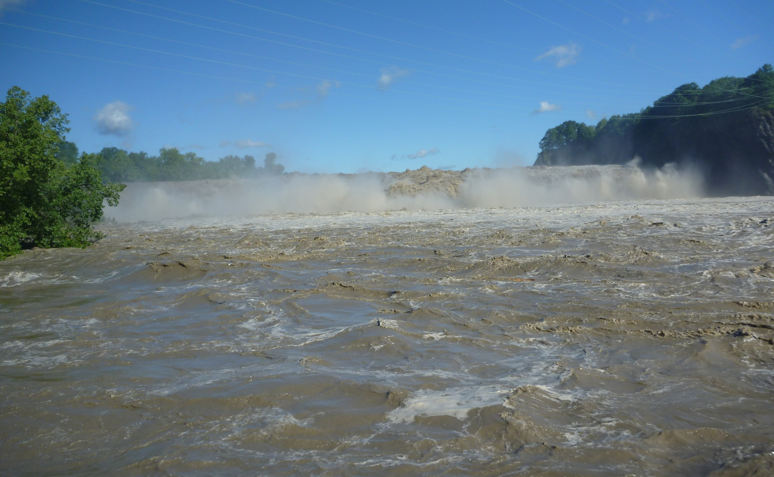
Tropical Storms Irene and Lee
Extremely high discharge: introduce new sediment, push salt seaward
    → added almost 3 Mton of new sediment to the Hudson → where did it go?
Mohawk River @ Cohoes 8/29/11, 2.2 g/L (G. Wall)

Slide 13
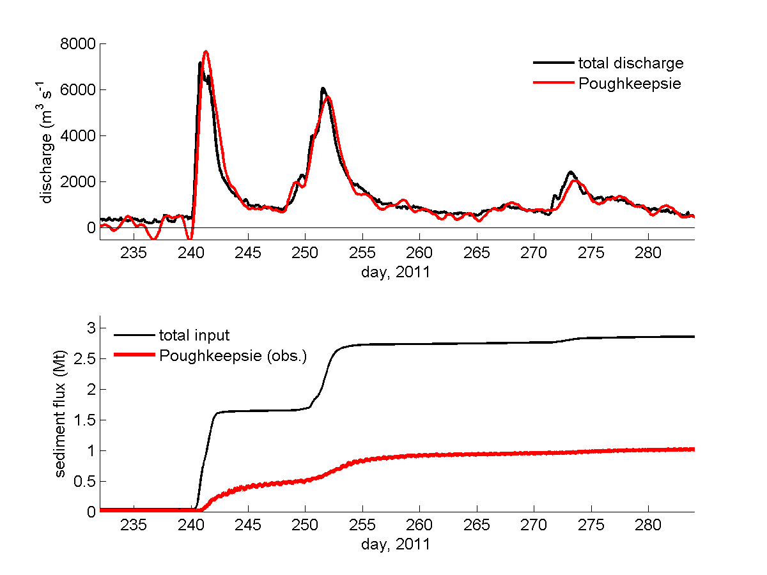
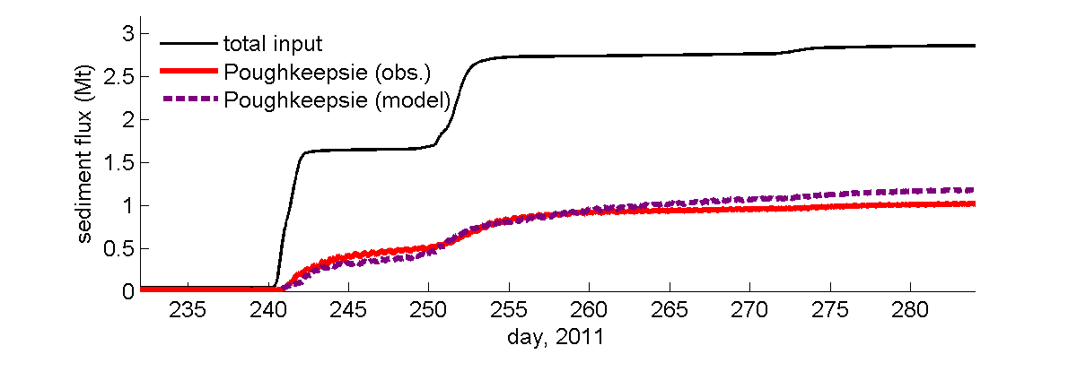
Tropical Storms Irene and Lee: discharge and sediment flux
→ net sediment flux past Poughkeepsie only ~ 1/3 total input
→ model consistent with observed fluxes
data from USGS & HRECOS

Slide 14
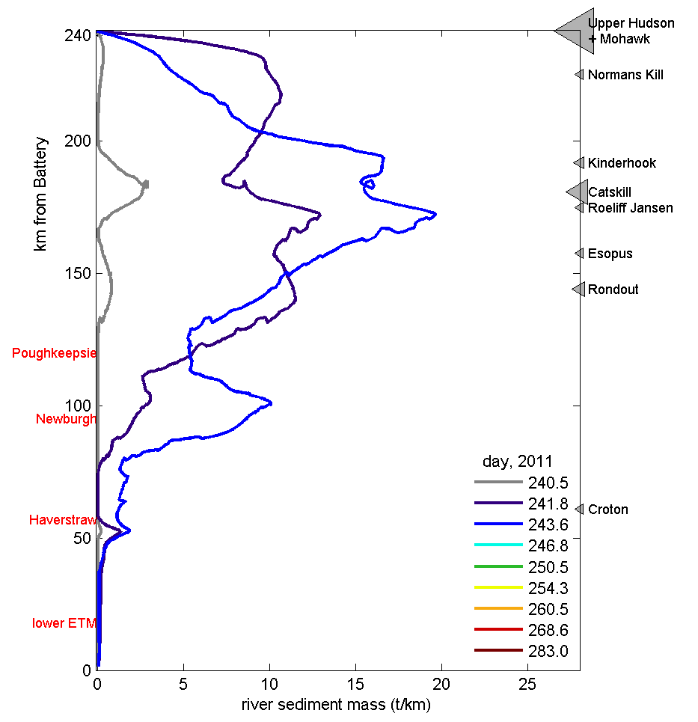
Tropical Storms Irene and Lee
Irene end
Where did the new sediment go?
Mass distributions along the Hudson through time
Irene start
model results

Slide 15
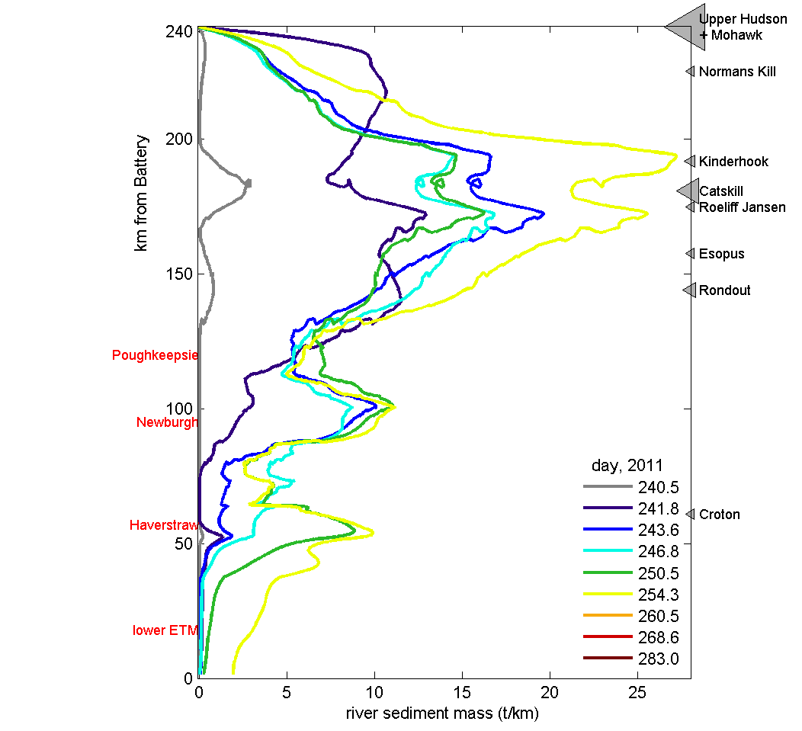
Tropical Storms Irene and Lee
Where did the new sediment go?
Mass distributions along the Hudson through time
After Lee
Before Lee
model results

Slide 16
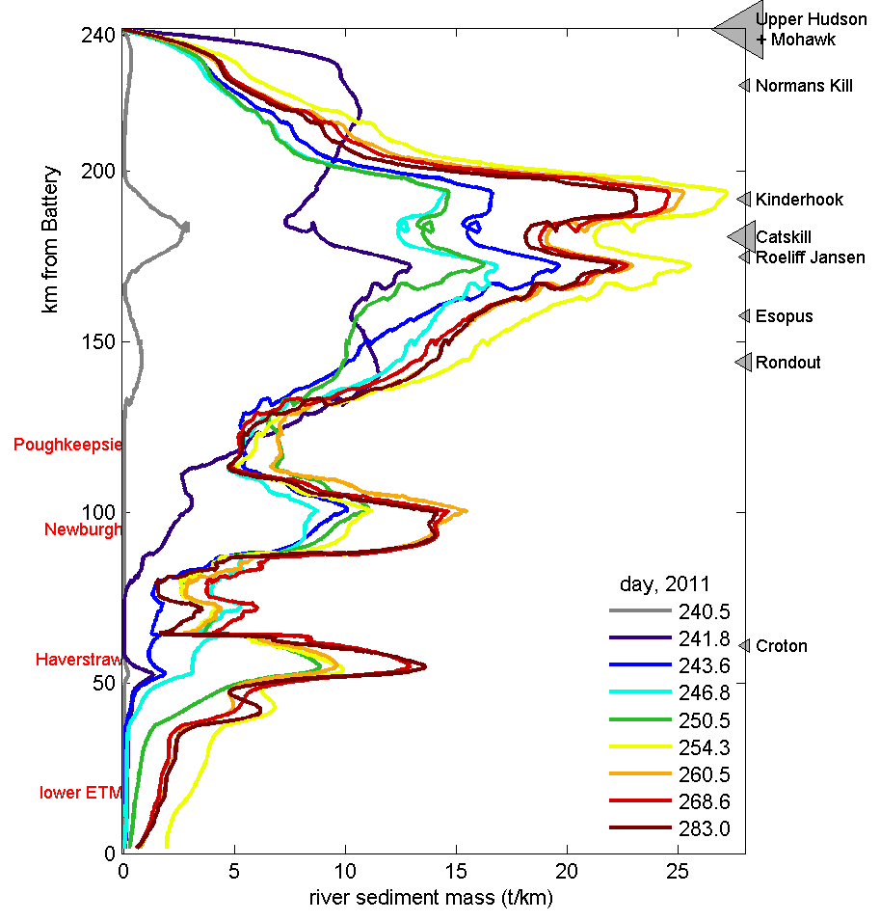
Tropical Storms Irene and Lee
Where did the new sediment go?
Mass distributions along the Hudson through time
1 mo. after Lee
model results

Slide 17
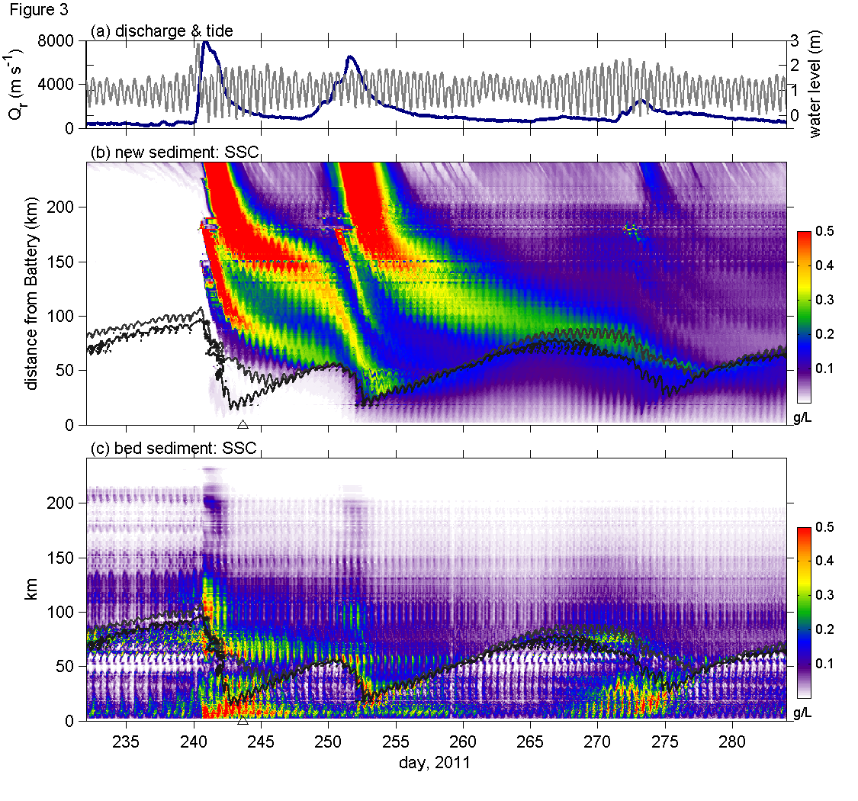
Irene and Lee
Suspended sediment
New sediment largely in the tidal river
Sediment in estuary remobilized by increased velocities & reduced stratification
model results

Slide 18
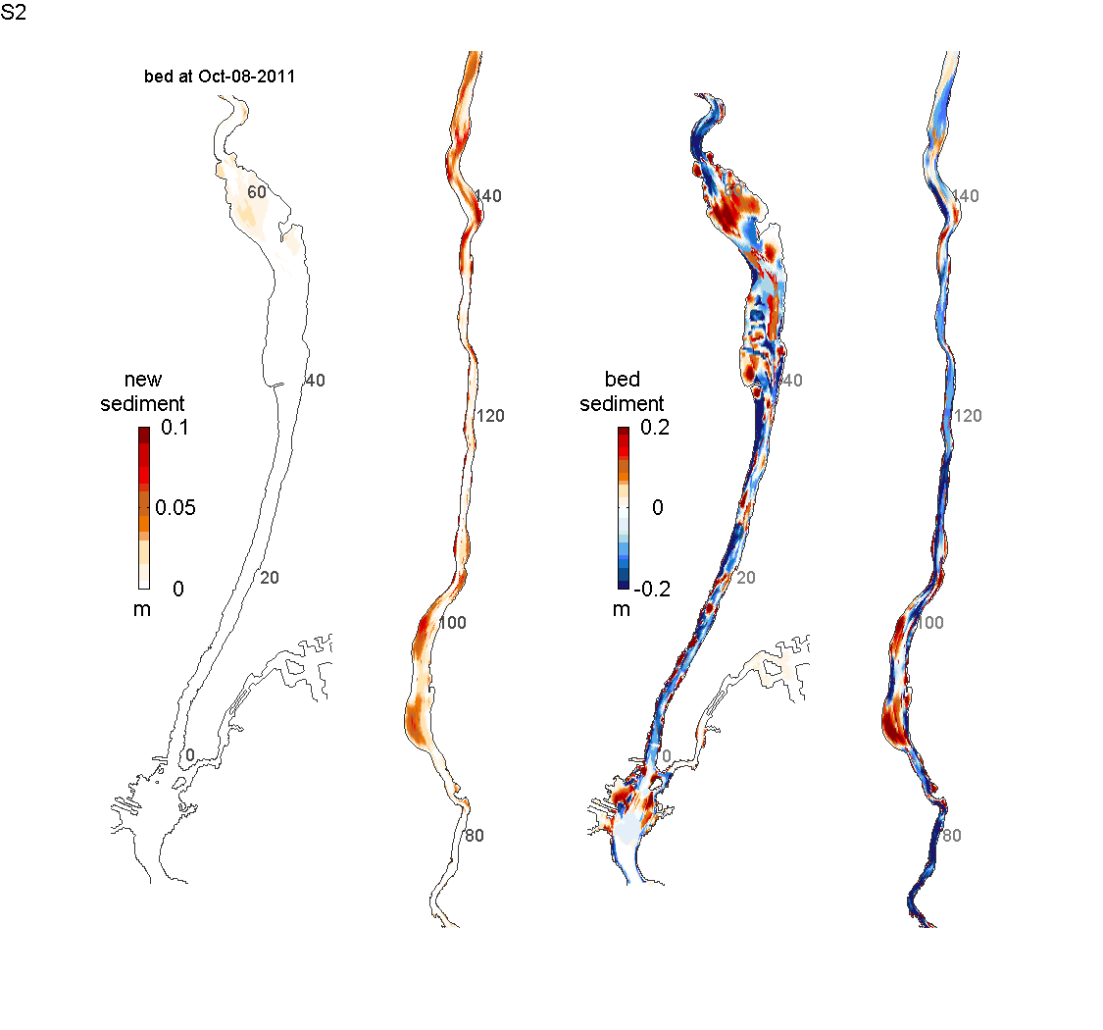
1 month after Tropical Storm Lee
Bed sediment erosion & deposition
New sediment deposition
model results

Slide 19
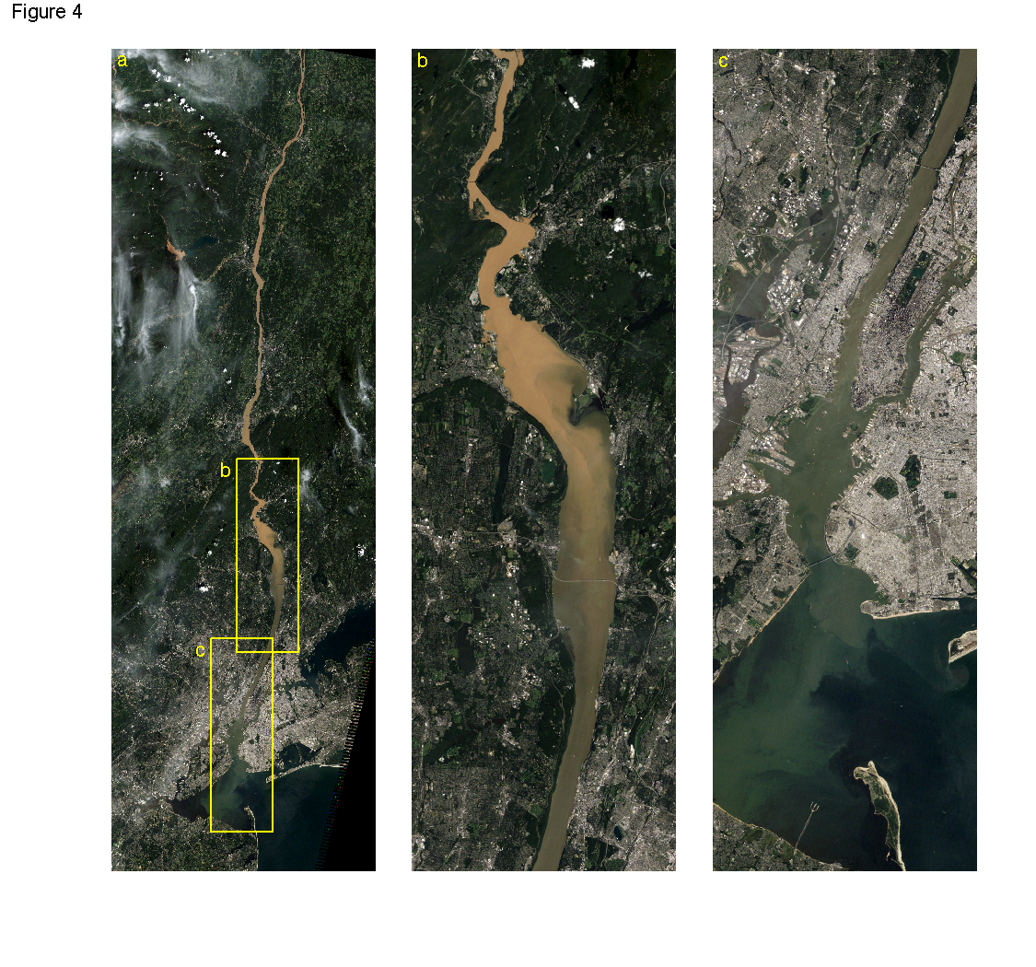
Summary
- Salinity fronts at topographic transitions trap sediment at multiple locations in estuary
- Sediment loading from extreme events greatly exceeds near-term transport capacity, with trapping in both tidal river and estuary
What’s next?
→ Transport and trapping processes in tidal river not well documented or understood
→ Extreme events remobilize bed sediments in estuary, potentially with contaminants that had been sequestered
→ Sediment residence times may be much longer than thought, limiting export of carbon and other terrigenous material to the ocean

