Slide 1
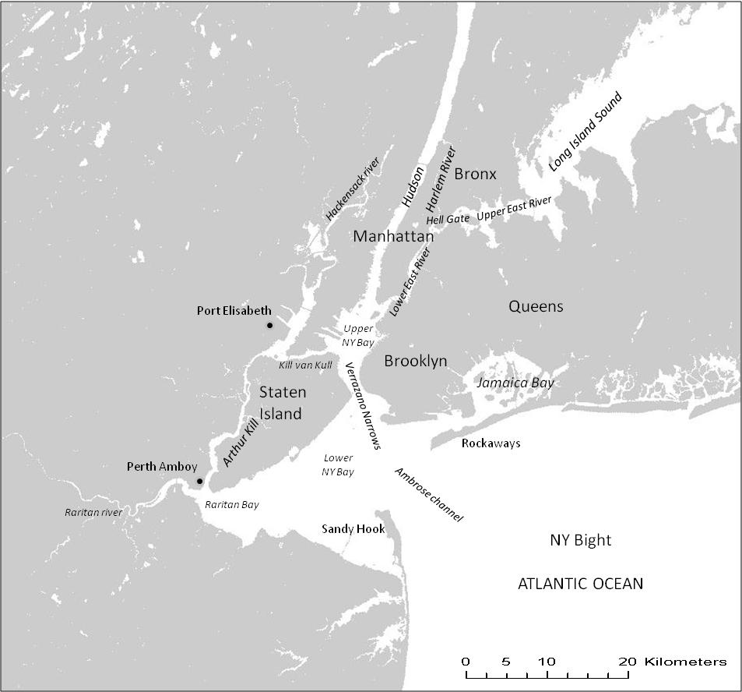



System Transitions and the Urban Environment: Lessons from the New York Region and Hurricane Sandy
William Solecki, City University of New York
2013 Hudson River Science Symposium:“The State of Hudson River Science”
SUNY Campus, New Paltz, NY - 24 April, 2013
Notes:
Sources:
Mombasa, Kenya – Box Figure 5.4 from ARC3 – David Dodman
Santiago, Chile – Box Figure 5.6 from ARC3
New York City – RISA presentation which lists it as public domain

Slide 2
Objective and Outline
Objective: Discuss and define critical linkages between science and policy in the development of climate change adaptation strategies in the New York Metropolitan Region
Outline
  Illustrate the connections between climate science and policy in Region
  Impact of Hurricane Sandy
  Considerations for the future

Slide 3
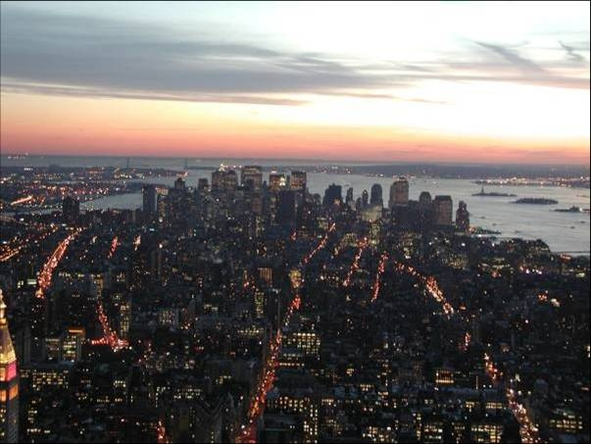
Climate Vulnerability of the New York Metropolitan Region
The Metropolitan Region is prone to losses from weather-related disasters.
  Top 10 in population vulnerable to coastal flooding
  Second only to Miami in assets exposed to coastal flooding
  Simple wind damage index: NYC second to Tokyo, Japan.
  Economic loss ~2x insured loss.
  Major coastal storm could result in ~ billions of $US in economic loss.
Major Storms
Hurricane Sandy 2012
Hurricane Irene 2011
August 8, 2007
December 1992 Nor’easter
Hurricane Gloria 1985
Climate Protection Levels Workbook
Chapter 6 Insurance
NPCC Report, 2010

Slide 4
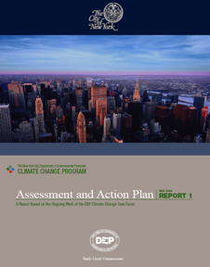

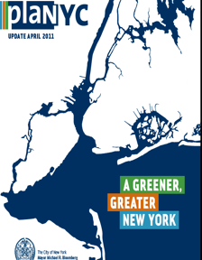
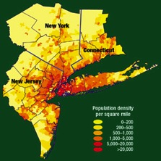
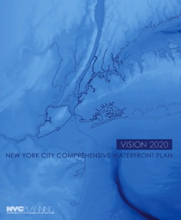
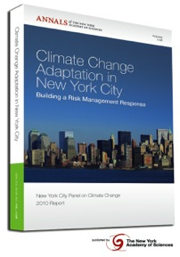
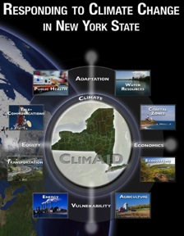
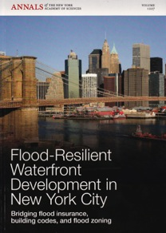
Partial Listing of NYC / NYS Climate Change Risk Assessment / Adaptation,
and Sustainable Development Studies and Plans since about the Year 2000.
Climate Change and a Global City
The Potential Consequences of Climate Variability and Change
Metro East Coast (MEC) July 2001

Slide 5
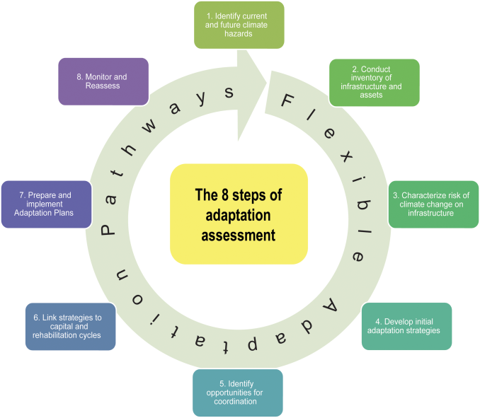
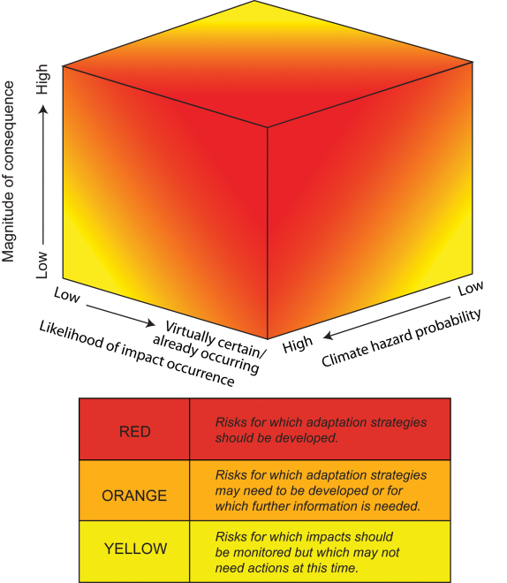
Climate Change Adaptation Assessment
C limate Change developed climate scenarios for New York Metropolitan Region. Used to identify impacts on infrastructure and start the adaptation assessment process
Climate information helped guide stakeholders through:
  Inventory of At-risk Infrastructure
  Risk Assessment Matrix
  Strategy Prioritization Framework
Source: NPCC, 2010

Slide 6
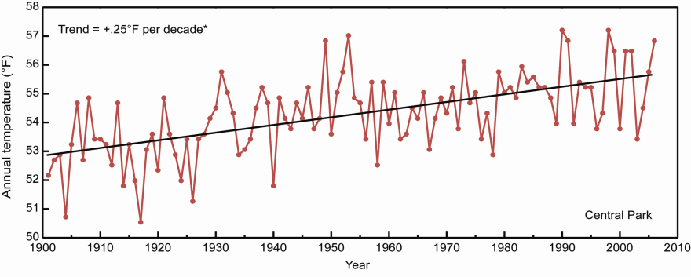
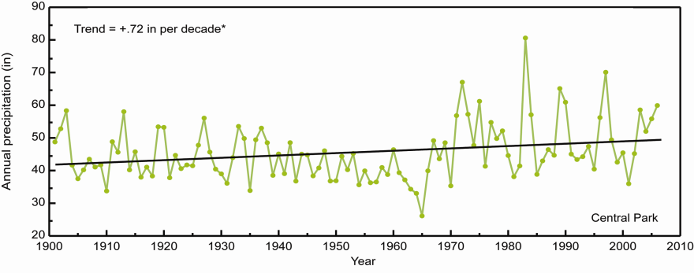
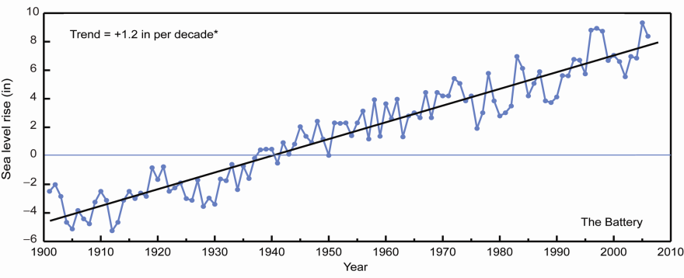
Observed Climate in New York Region
Temperature
  Significant warming at century timescale
Precipitation
  Interannual variability dominates long-term trend
Sea level
  Significant increase over the 20th century at the Battery
Observed climate in Central Park, New York City. Temperature data are not adjusted for urbanization effects. *Trend is significant at the 95% level.

Slide 7
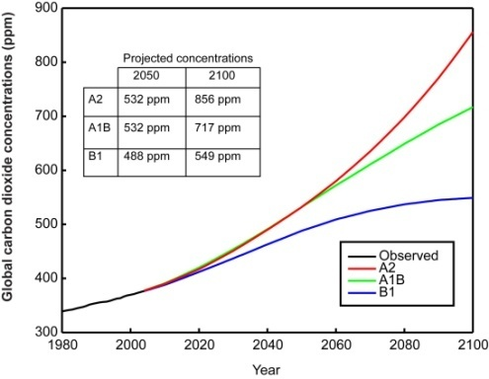
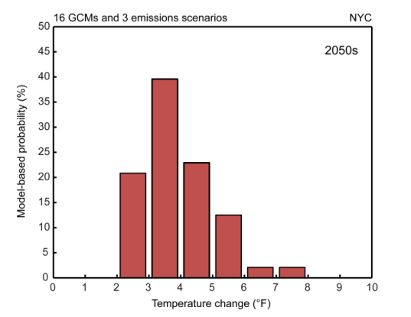
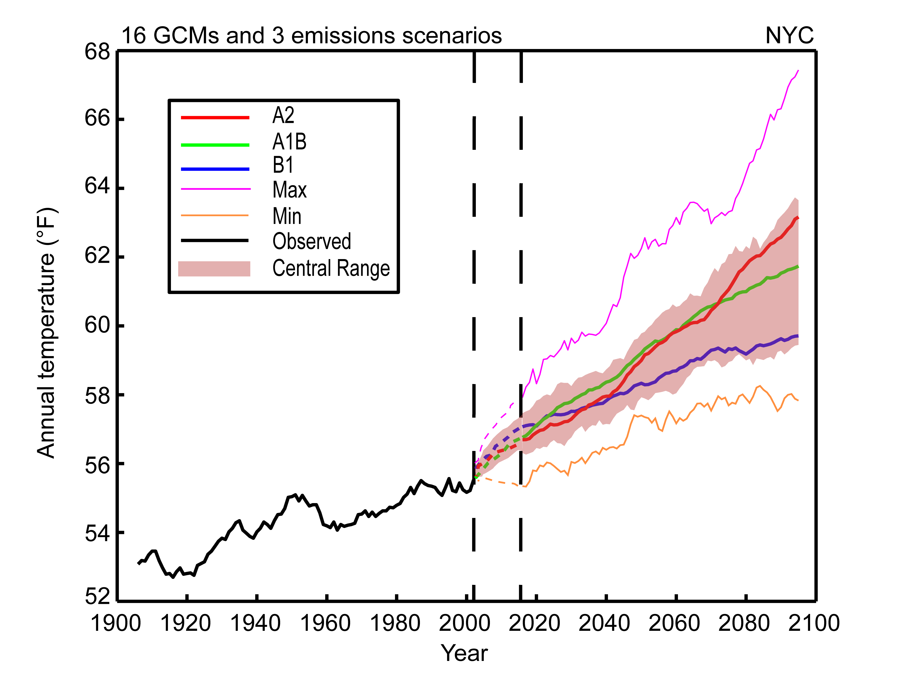
Climate Scenario Methods
Regional climate projections are based on 16 GCMs (7 GCMs for sea level) and 3 emissions scenarios
  Model output for the single gridbox covering New York City is used
Future changes are presented for time slices relative to the 1971 – 2000 baseline period (2000 – 2004 for sea level)
  Time slices are 30 year periods (10 for sea level) centered around a given decade, for example, the 2050s is 2040 – 2069.
Model-based probability
  The combination of GCMS and emissions scenarios produce 48 outputs for temperature and precipitation
  For each scenario time period and variable, the results constitute a model-based probability function
Bias-corrected, spatially downscaled output from the 16 GCMs now being used (Maurer, 2007)
Frequency distribution of model based temperature changes for the 2050s relative to the 1971-2000 base period.

Slide 8
Mean Annual Changes
New York City Infrastructure shed
Baseline Climate and Mean Annual Changes
 | Baseline 1971-2000 | 2020s | 2050s | 2080s
Air temperature Central range | 55° F | + 0.5 (1.5 to 3.0) 3.5° F | + 2.5 (3.0 to 5.0) 7.5° F | + 3.0 (4.0 to 7.5) 10° F
Precipitation Central range | 46.5 in | -5 (0 to 5) 10 % | -10 (0 to 10) 10 % | -10 (5 to 10) 15 %
Sea level rise Central range | NA | + 2 to 5 in | + 7 to 12 in | + 12 to 23 in
Rapid ice-melt scenario | NA | ~ 5 to 10 in | ~ 19 to 29 in | ~ 41 to 55 in
Shown is minimum, the middle 67% of values, and maximum values from model-based probabilities; temperatures ranges are rounded to the nearest half-degree, precipitation to the nearest 5%, and sea level rise to the nearest inch.
- Stakeholders requested the central range of values along with the maximum and minimum values be shown
- Climate information was presented in a “tearsheet” format
so that stakeholders could easily reference it
Source: NPCC, 2010

Slide 9
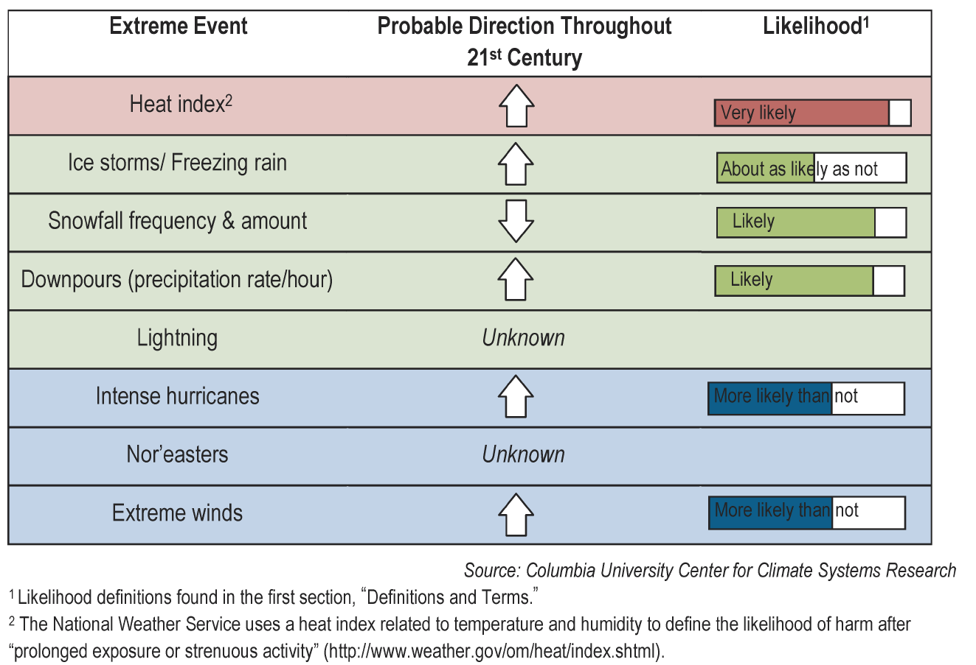
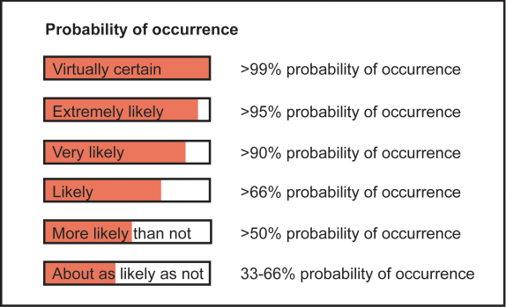
Extreme Events
New York City Infrastructure-shed
Quantitative Changes
The central range (middle 67% of values from model-based probabilities) across
the GCMs and greenhouse gas emissions scenarios is shown.
Qualitative Changes
Based on observations, model process studies, and expert judgment
 | Extreme Event | Baseline (1971- 2000) | 2020s | 2050s | 2080s
Heat waves & Cold Events | # of days/year with maximum temperature exceeding: 90°F | 14 | 23 to 29 | 29 to 45 | 37 to 64
 | # of days/year with minimum temperature at or below 32°F | 72 | 53 to 61 | 45 to 54 | 36 to 49
Intense Precipitation | # of days per year with rainfall exceeding: 1 inch | 13 | 13 to 14 | 13 to 15 | 14 to 16
Coastal Floods & Storms | 1-in-100 yr flood to reoccur, on average | ~once every 100 yrs | ~once every 65 to 80 yrs | ~once every 35 to 55 yrs | ~once every 15 to 35 yrs
 | Flood heights (in ft) associated with 1-in-100 yr flood | 8.6 | 8.8 to 9.0 | 9.2 to 9.6 | 9.6 to 10.5
Source: NPCC, 2010

Slide 10
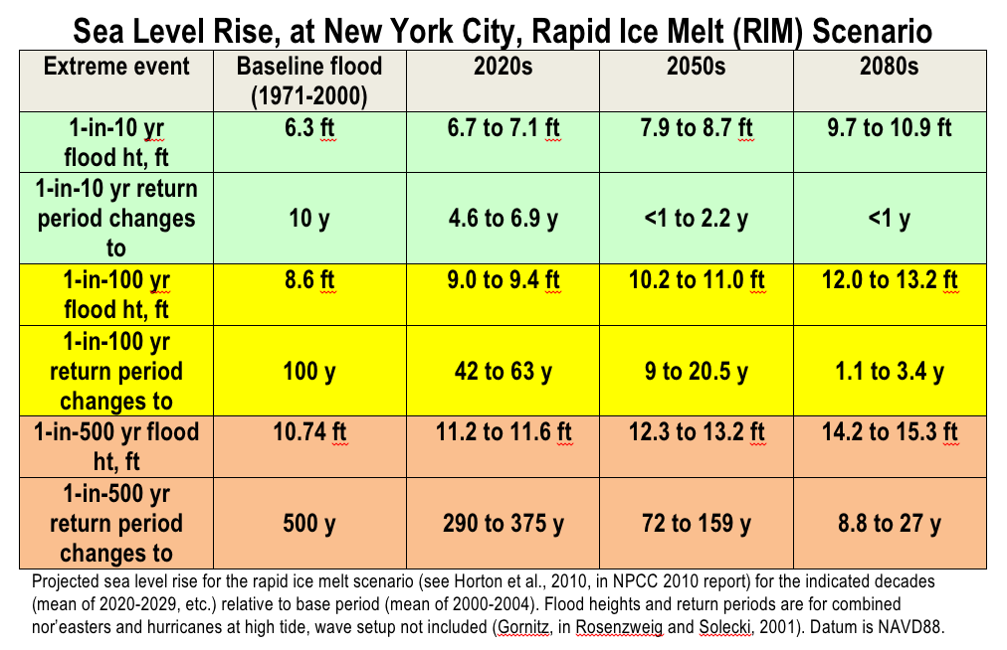
Sea Level Rise, at the Battery, Rapid Ice Melt (RIM) Scenario
Source: NPCC – slide from K. Jacob

Slide 11
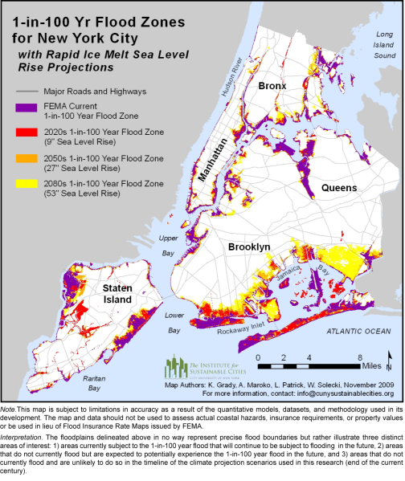
Mapping Products
Showing additional areas that could be flooded during extreme coastal storms
Planning needs include information on flooding depth and uncertainty
Climate Protection Levels Workbook
Chapter 6 Insurance
NPCC Report, 2010

Slide 12
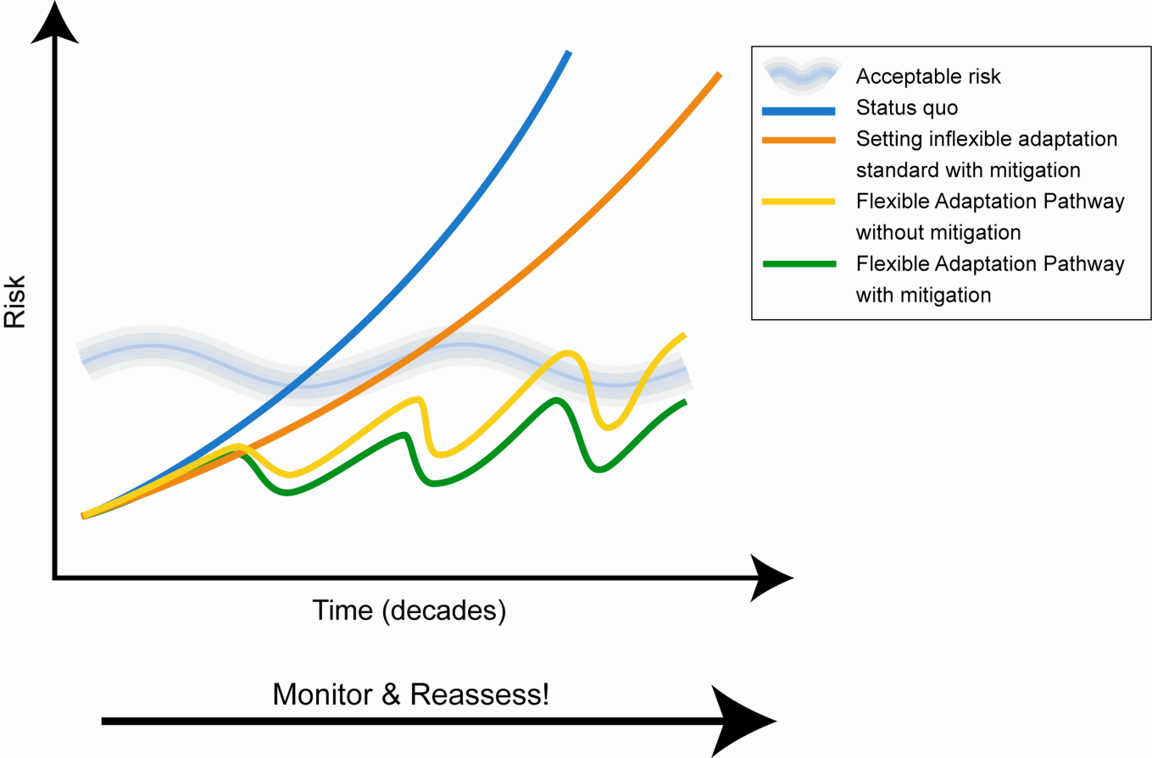
Adaptive Urbanization - Climate Risk Management,
Flexible Adaptation Pathways and Interactive Mitigation and Adaptation
Graphic adapted from: Lowe, J., T. Reeder, K. Horsburgh, and V. Bell. “Using the new TE2100 science scenarios.” UK Environment Agency
Source: NPCC, 2010

Slide 13
  Impact of Hurricane Sandy: Science and Adaptation

Slide 14
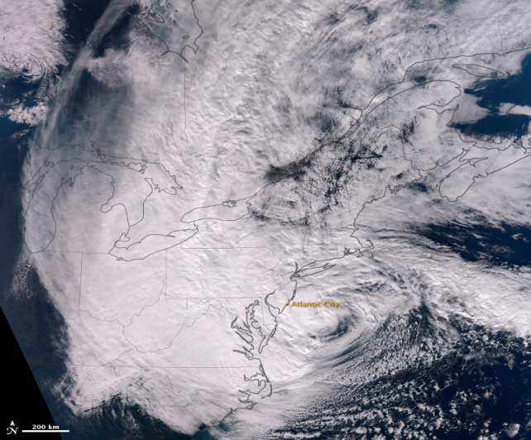
Hurricane Sandy, 28 October 2012
Source: NOAA

Slide 15
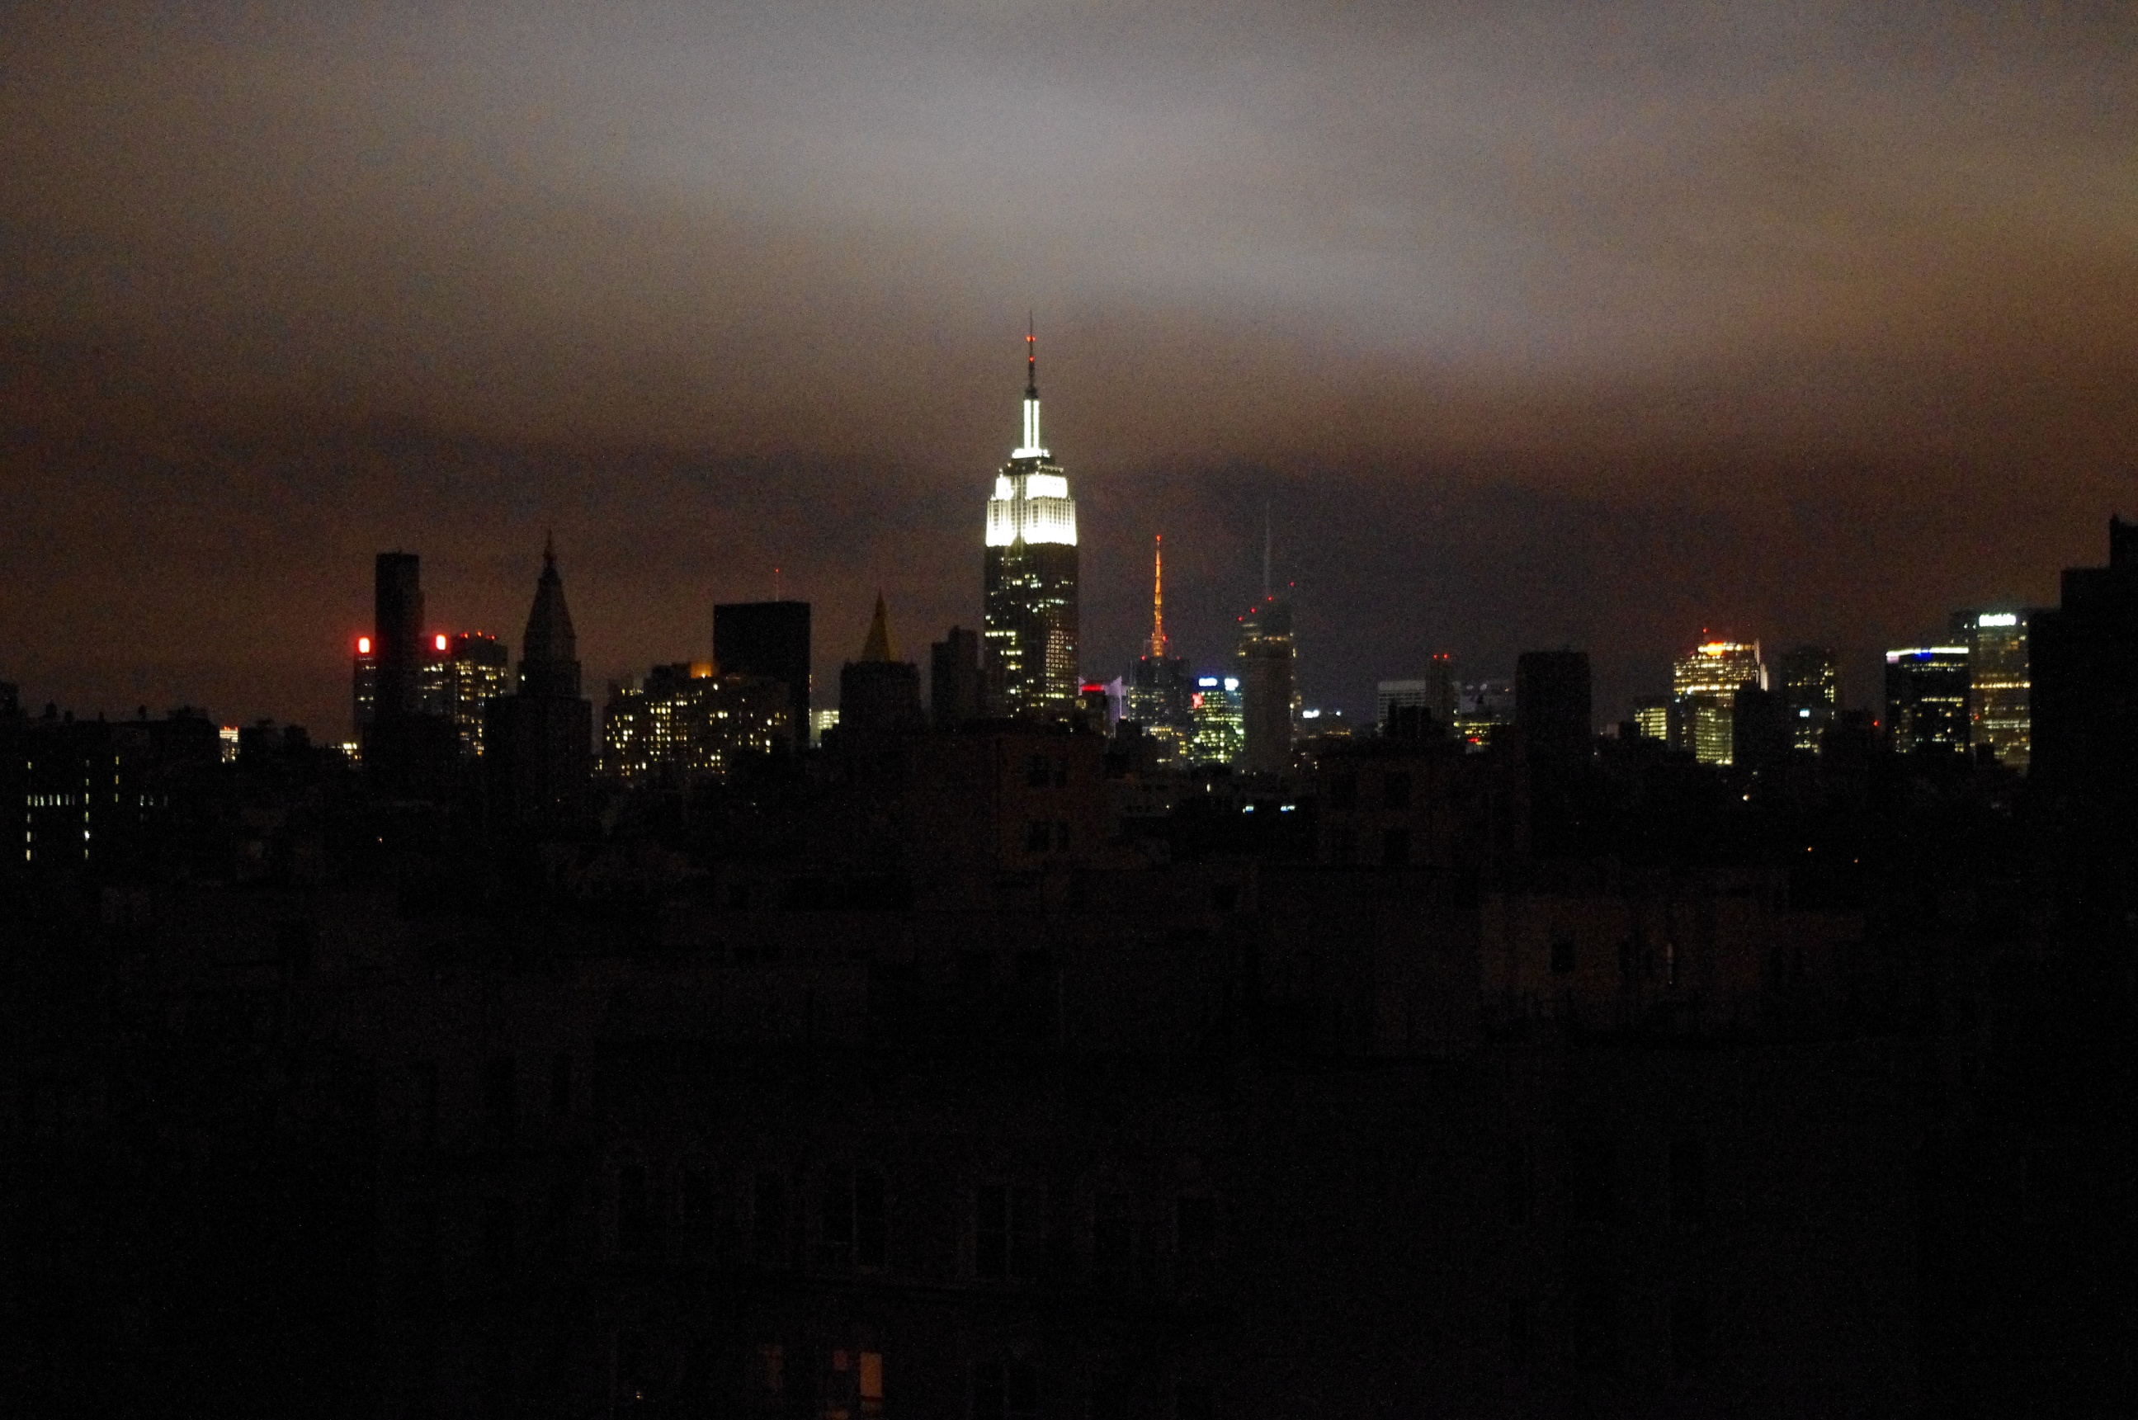

Slide 16
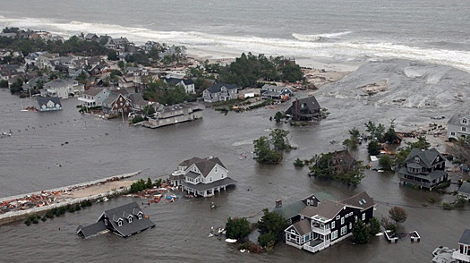
Sandy, October 2012

Slide 17
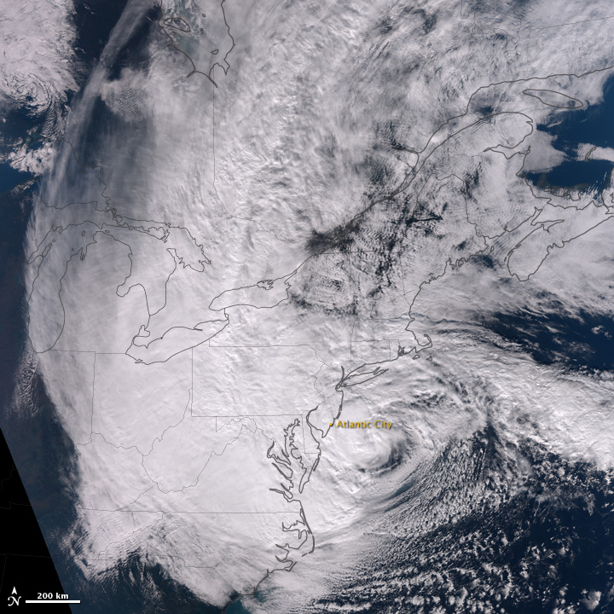
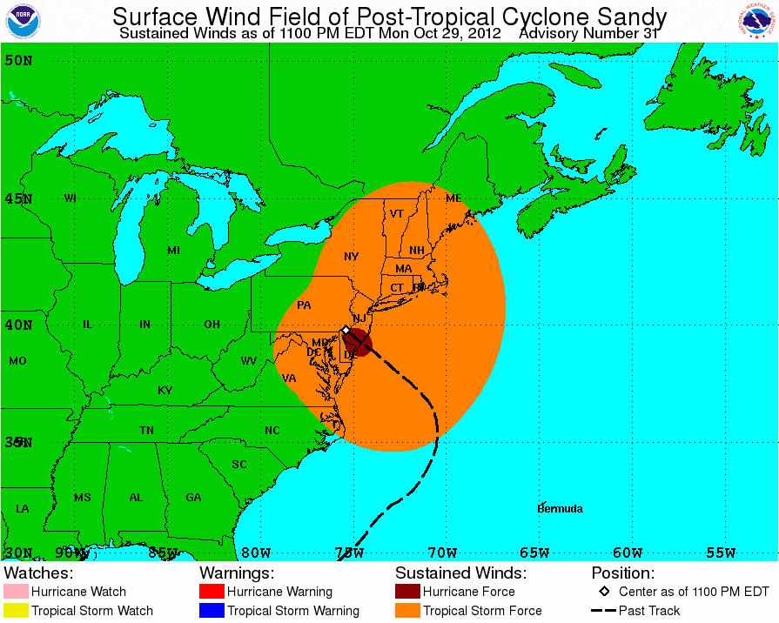
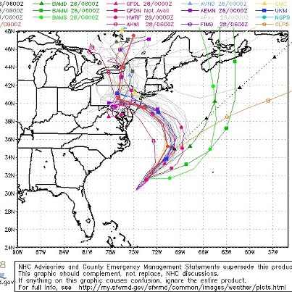
Sandy, Science and Forecasting
Lowest central pressure north of Cape Hatteras, NC at 943 mb
Exceptionally large wind field (tropical storm force winds over ~500 miles from the center)
Storm forecast well in advance

Slide 18
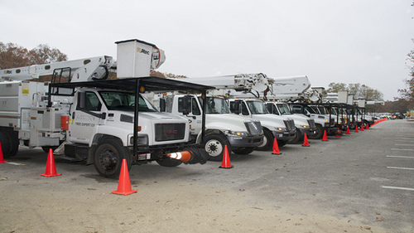
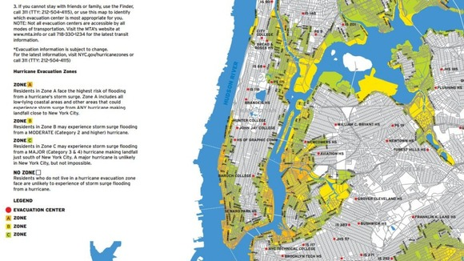
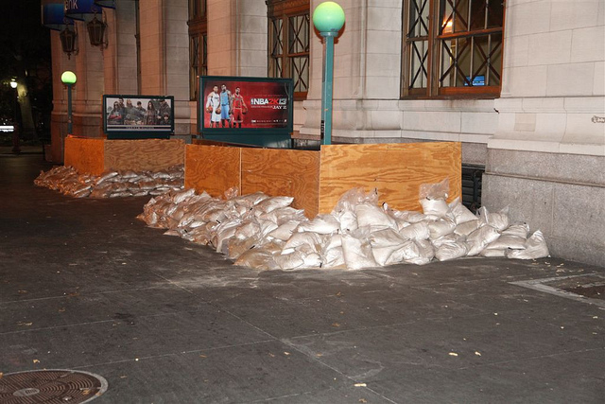
Sandy, Science and Preparation
Out of state utility crews brought in before the storm
New York City issued mandatory evacuation of Zone A on October 28, 2012
MTA boarded and placed sandbags at subway entrances to protect against flooding

Slide 19
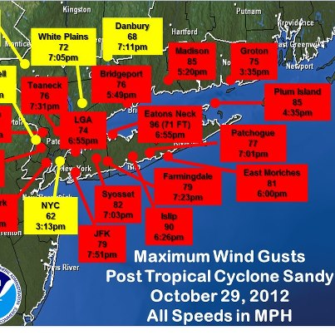
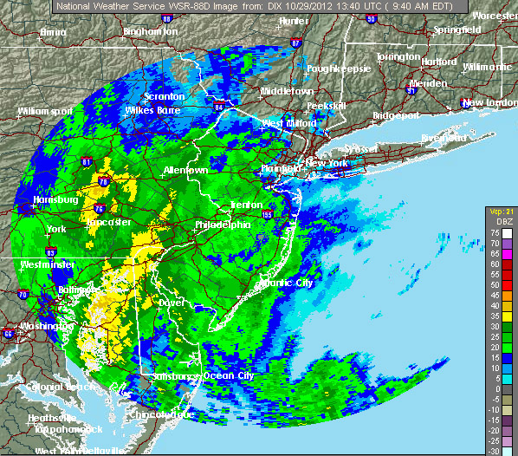
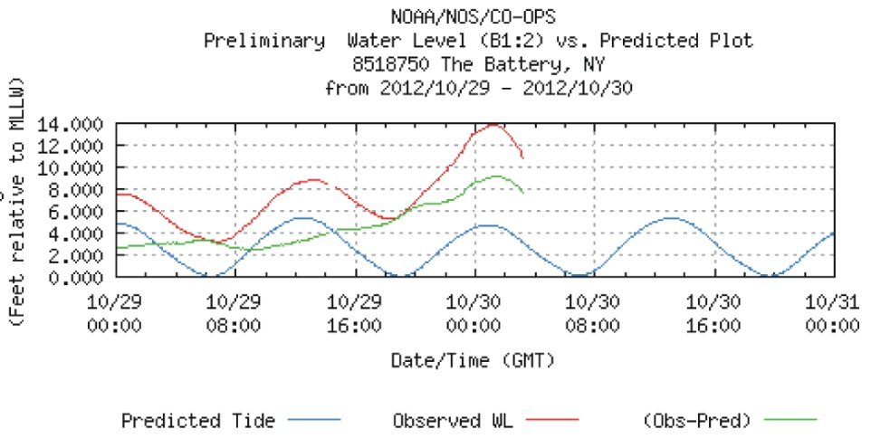
Sandy, Science, and Extreme Events
Wind gusts over 60 mph
Heavy rainfall to the south and west of the storm’s center
Highest surge on record at the Battery

Slide 20
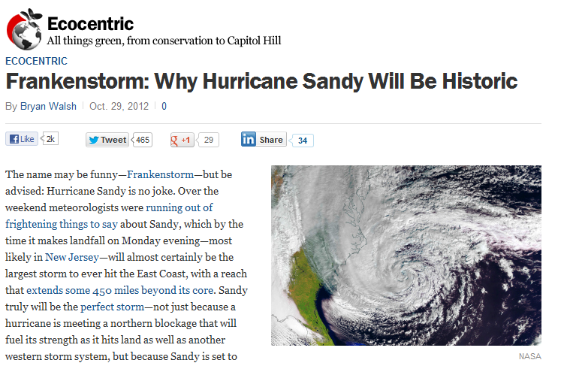
Climate change related?
?
?
Hurricane Sandy as a “Frankenstorm”?
Implies that storm is partly of our own creation
Atlantic Ocean Sea Surface Temperatures: warmer than average
Warmer atmosphere can hold more water vapor:
more energy for hurricanes, more water for precipitation
High Storm Surge due to confluence of events:
sea level, high tide, full moon, and shape of coast
Unusual Storm Track:
sharp turn towards the coast
http://science.time.com/2012/10/29/frankenstorm-why-hurricane-sandy-will-be-historic/
Image courtesy of W. Solecki
Source of slide A. Frei

Slide 21
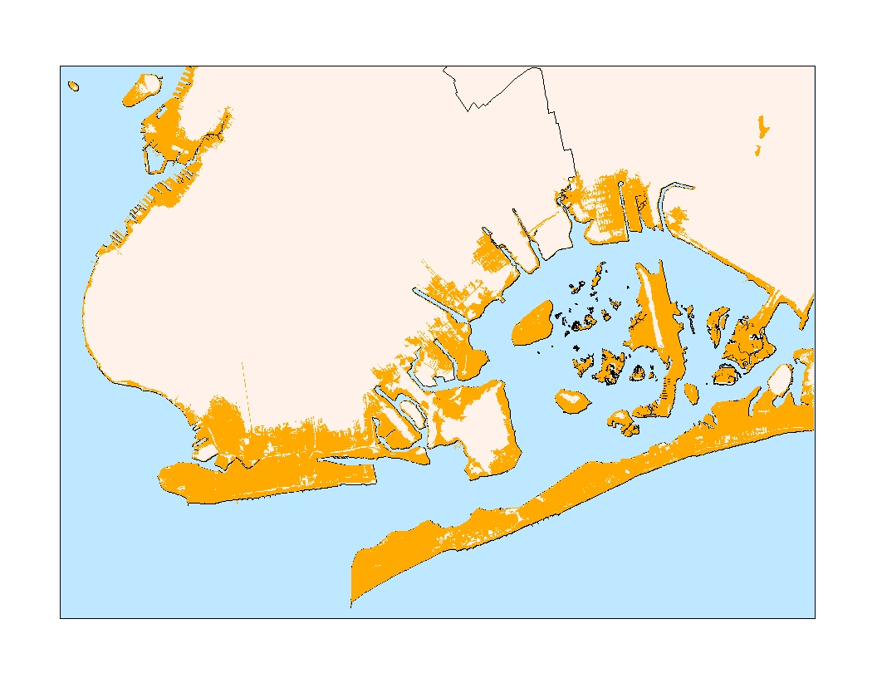
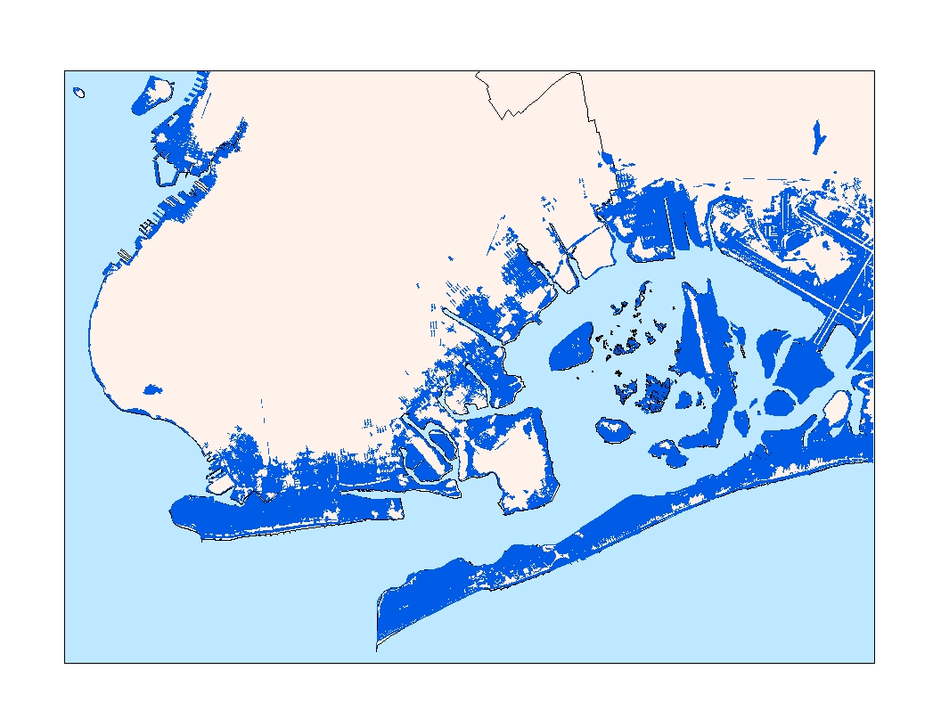
Observed Inundation – Hurricane Sandy
NPCC Rapid Ice Melt Scenario 2050s – 1% flood event with ~ two feet of sea level rise

Slide 22
Metropolitan Region Lifelines and Infrastructure System Failures
Water Supply
Electricity
Transportation
Gasoline Supply
Pharmacy – Drug Supply
  Cascading impacts
  Uneven geography – not all on the coast and waterfront, but most impactful on there

Slide 23

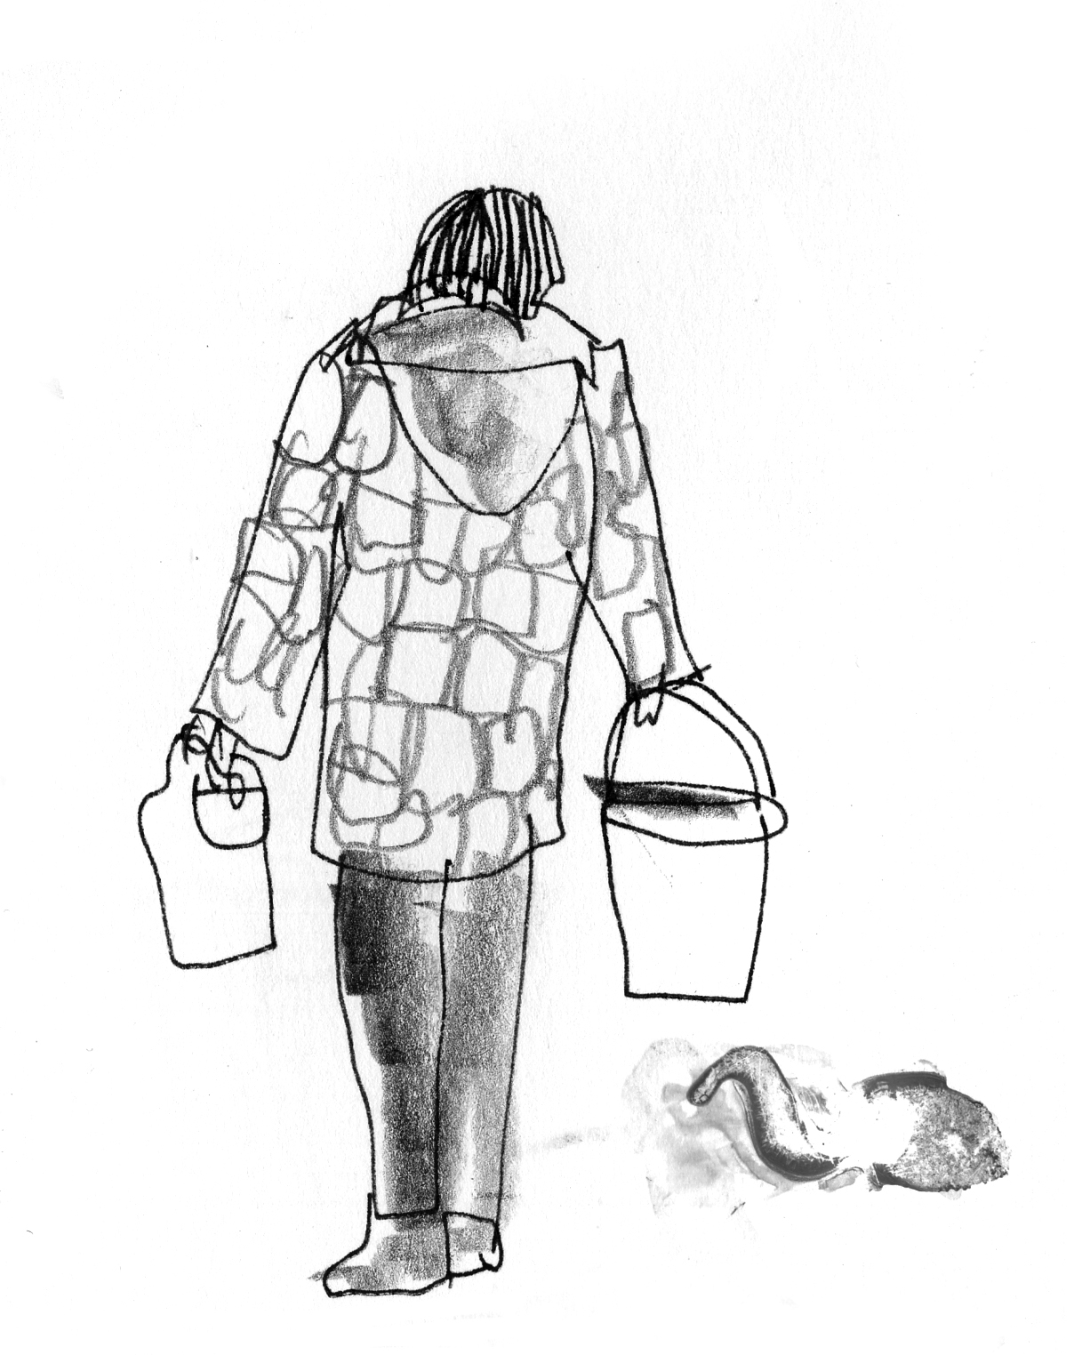
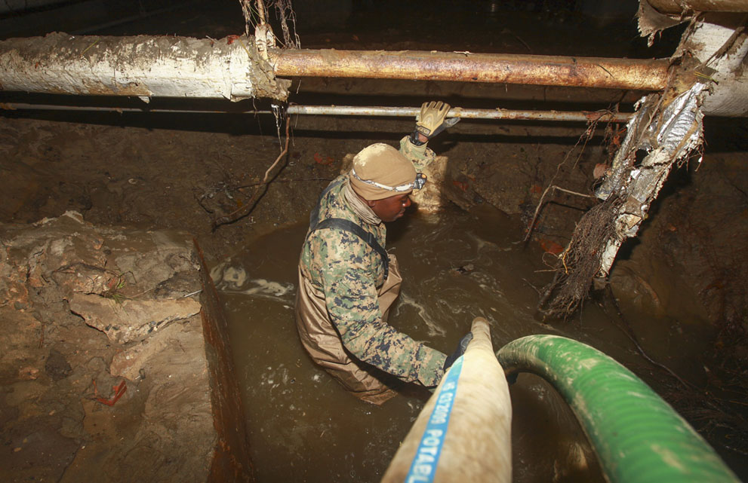
http://www.theatlantic.com/infocus/2012/11/hurricane-sandy-one-week-after-landfall/100399/
Blackouts and water supply
Cascading Vulnerability Pathways

Slide 24
All Resilience (Adaptation) Approaches Reviewed
Large scale, hard infrastructure – e.g. storm surge barrier
Small scale, hard infrastructure – e.g., “Taipei solutions”, step up before stepping down into subway
Large scale, soft infrastructure (ecosystem services) – e.g. large scale constructed wetlands and lagoons
Small scale, soft infrastructure (ecosystem services) – e.g., restored wetlands, beach dunes (places with remnant coastal wetlands had less damage; places built on old wetlands were most impacted)
Large scale policy shifts – including phased retreat from the shore, rezoning, relocation of public facilities
Small scale policy shifts – insurance, green infrastructure to direct flood water, storm water retention

Slide 25
NYC Special Initiative for Rebuilding and Resiliency
Addresses how to rebuild New York City to be more resilient in the wake of Sandy but with a long‐term focus on:
  1) how to rebuild locally; and
  2) how to improve citywide infrastructure and building resilience
A comprehensive report in May 2013 that will address these challenges by investigating three key questions:
  What happened during and after Sandy and why?
  What is the likely risk to NYC as the climate changes and the threat of future storms and severe weather increases?
  What to do in the coastal neighborhoods and citywide infrastructure

Slide 26
New York City Panel of Climate Change – Current Work
  Contribute to the SIRR Report process to be released in May
  Updated climate science data and modeling
  Update sea level rise mapping
  Contribute to general understanding and definition of opportunities for enhanced resilience

Slide 27
Large Scale Adaptation Infrastructure
Storm Surge Barriers

Slide 28
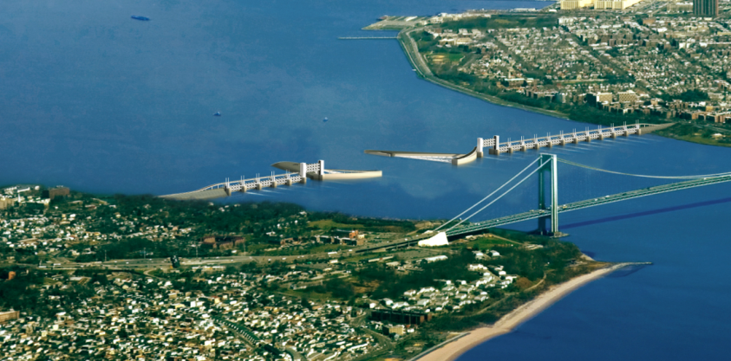
Citywide Approaches
Storm-Surge Barriers
Each barrier would require large open navigation channels for ships and a porous cross section allowing sufficient tidal exchange and river discharge from New York Harbor to maintain ship passage and water quality.
Conceptual designs of storm surge barriers are contributing to discussion on how to deal with the increasing risks of storm surge in New York City and the surrounding region in the era.
Significant economic, environmental, and social costs. Barriers would not protect all neighborhoods, nor would they protect against other substantial damages from wind and rain that often accompany hurricanes in the New York City region.
New York could protect against levels of surge with a combination of local measures (such as flood walls and reclaimed natural barriers), improved storm information and forecasting, and evacuation plans for at least the next several decades.
More study of risks and large-scale interventions needed at this time.
NPCC Report, 2010

Slide 29
Opportunities for Storm Surge Barriers

Slide 30
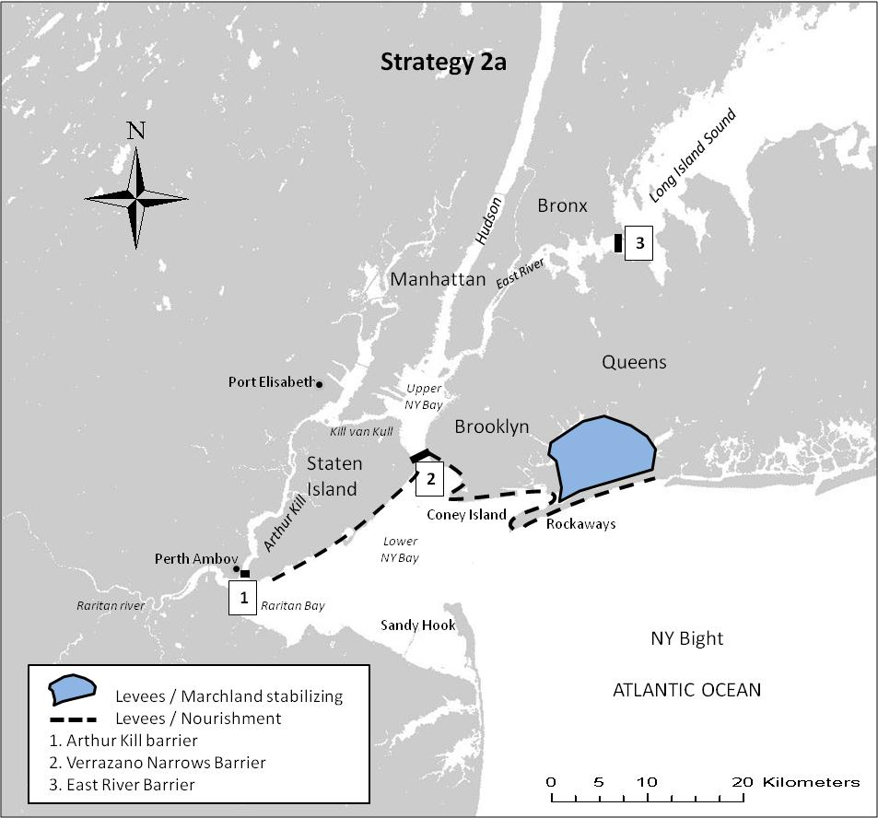

Slide 31
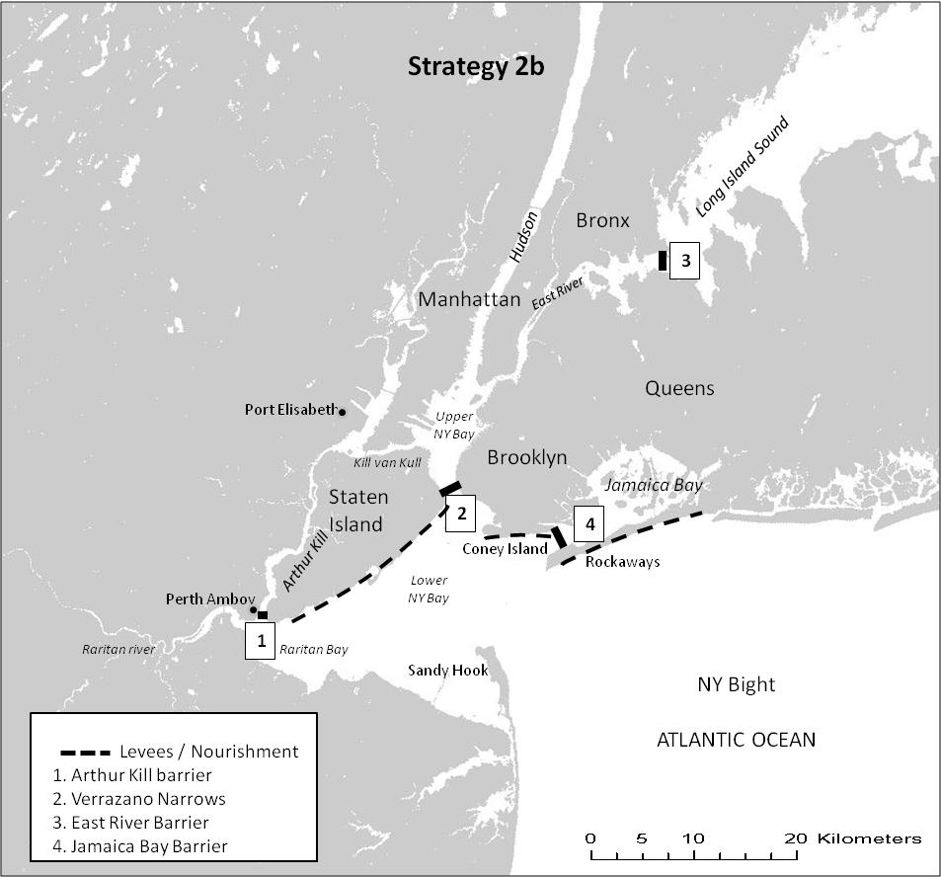

Slide 32
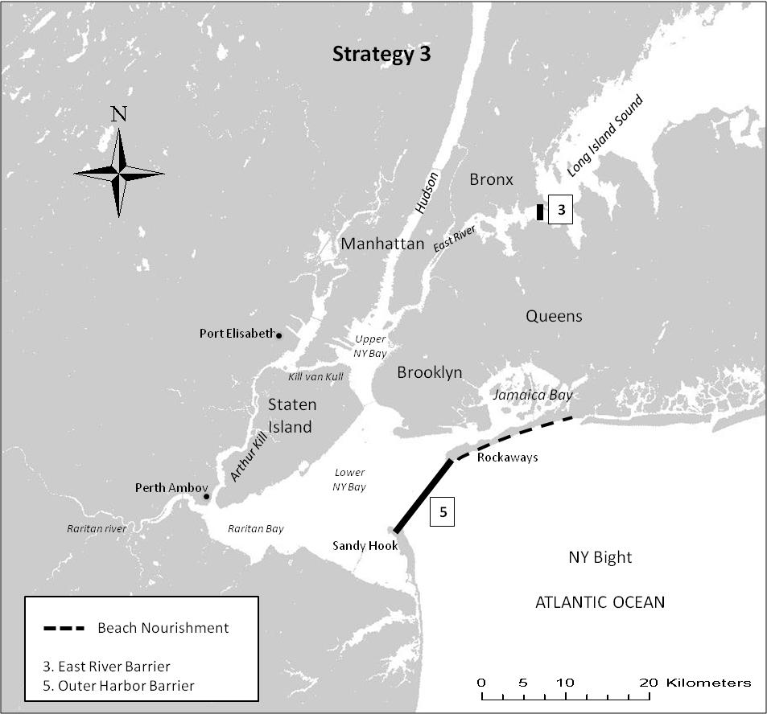
NJ-NY Connect

Slide 33
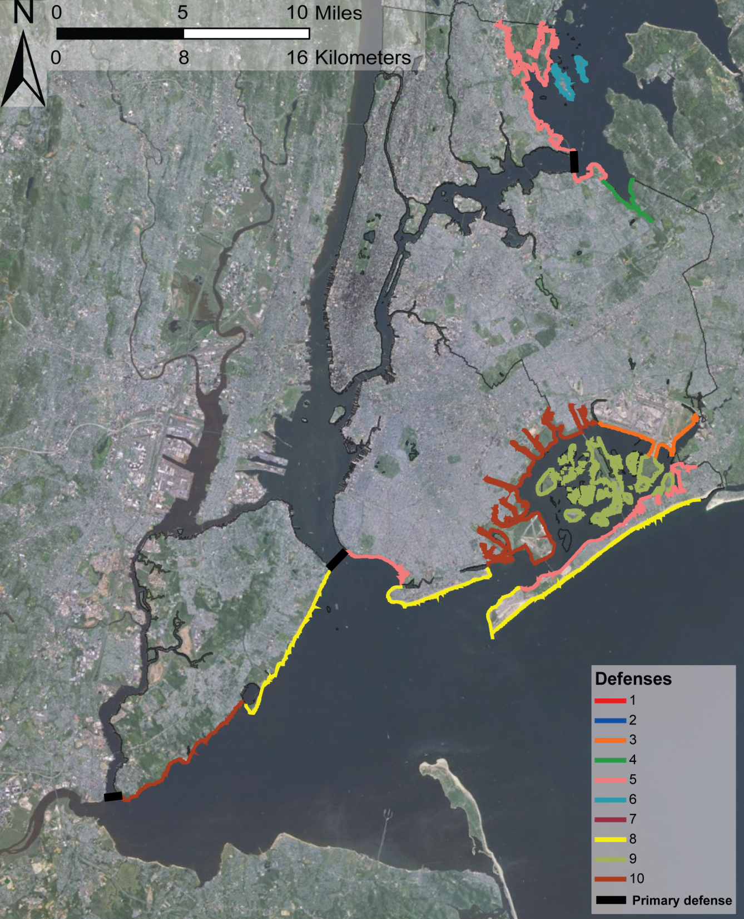
Additional protection
measures:
Beach nourishment
Levees / flood walls
Stabilize marchlands
Land fill
Etc.
3
2
1

Slide 34
What Does Hurricane Sandy Mean?
What did it reveal about exposure and vulnerability?
What does it mean about disaster risk reduction and climate change adaptation?
Will it signal a change in policy?

Slide 35
Post Hurricane Sandy Adaptation
Emerging Challenges and Opportunities
Baseline climate science data (and modeling if possible)
Rapid assessment strategy of impacts, vulnerabilities, opportunities for increased resiliency
Long term goal (e.g. resilience) as frame for action
Interagency cooperative (within govt. and across governments)
Climate protection levels – access codes, standards, and regulations, and monitoring and indicators for climate change robustness
System perspective – for identifying tipping points/cascade impacts and vulnerabilities
Climate science data and mapping uncertainties (besides cost uncertainties) and greater transparency of data analysis and data interpretation
Promote greater post extreme event learning – pushing open the policy window

Slide 36
Disaster Response and How Might
Hurricane Sandy Points to Wider Transitions and Transformations
After a disaster, response typically is focused on addressing failures and cost-benefit calculations in the context of future risk probability
Hurricane Sandy response also is often discussed in the context of climate change
Movement from disaster recovery to disaster rebuilding and resilience
Change in conceptualization of extreme events
  From discrete acute events to events as part of a chronic process
  Looking into future dynamics as much as the present and past
The question is being asked whether climate change impacts will be like other urban environment-related crises

Slide 37
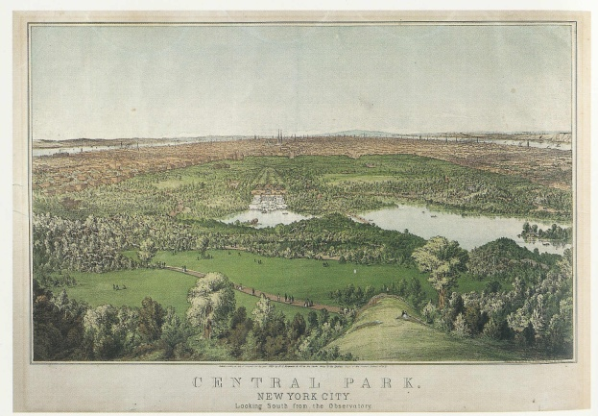
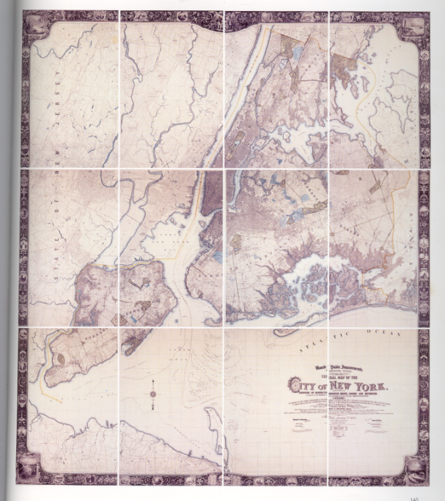
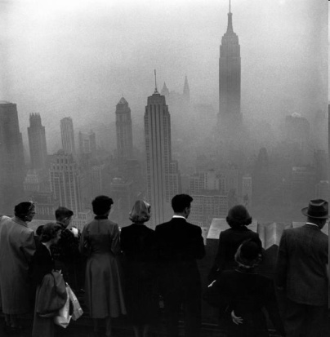
Urban Environment Crises in the New York Region
Water quality and supply - 1830s
Open Space and Recreation -1850s
Public Health and Sanitation – 1870s
Mobility and Congestion – 1910s
‘Urban Renewal’/Loss of Community – 1950s
Air Pollution – 1960s
Climate Change – 2010s?
Looking south over Central Park in 1861
New York City Environs - 1900
Smog - November 1953

Slide 38
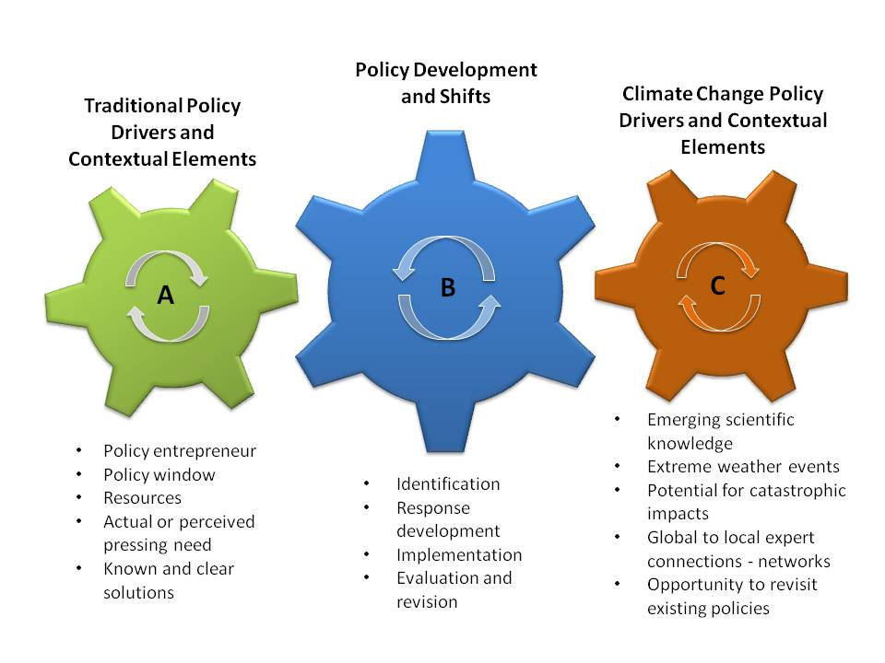
(Solecki et al. 2013)

Slide 39
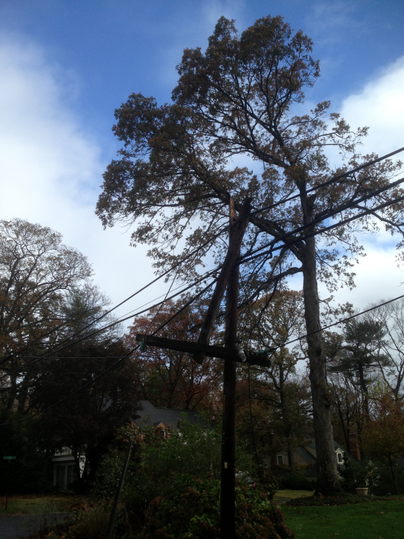
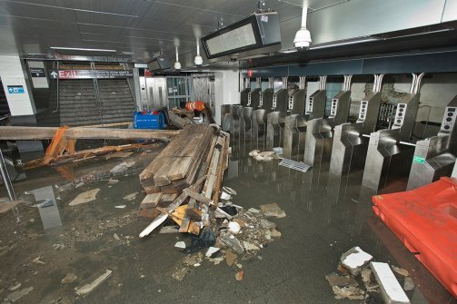

Hurricane Sandy Impacts – as the “New Normal” has pushed forward a set of new science and planning issues
Flooding at South Ferry Station in New York City
Extensive power outages
Coastal erosion and boardwalk damage

Slide 40
Final Conclusions
Connections between science and adaptation efforts in New York Metropolitan Region are lengthy and multi-faceted
Hurricane Sandy has changed the character of the science questions but not of the connection (this can be qualified – science is ever more demand driven)
It remains to be seen if the science-planning policy connection is at a transition point

Slide 41

Conclusion – Hurricane Sandy Seems to be Ushering in a New Era of Disaster Risk Reduction-Climate Change Adaptation Dialogue in the U.S. – Challenges Lie ahead for a Non-Stationary Climate Policy
Hurricane Sandy Damage in Oakwood Neighborhood (Staten Island, NY)
(photo source F. Montalto)

Slide 42
Thank You.
Contact: wsolecki@hunter.cuny.edu

