Slide 1
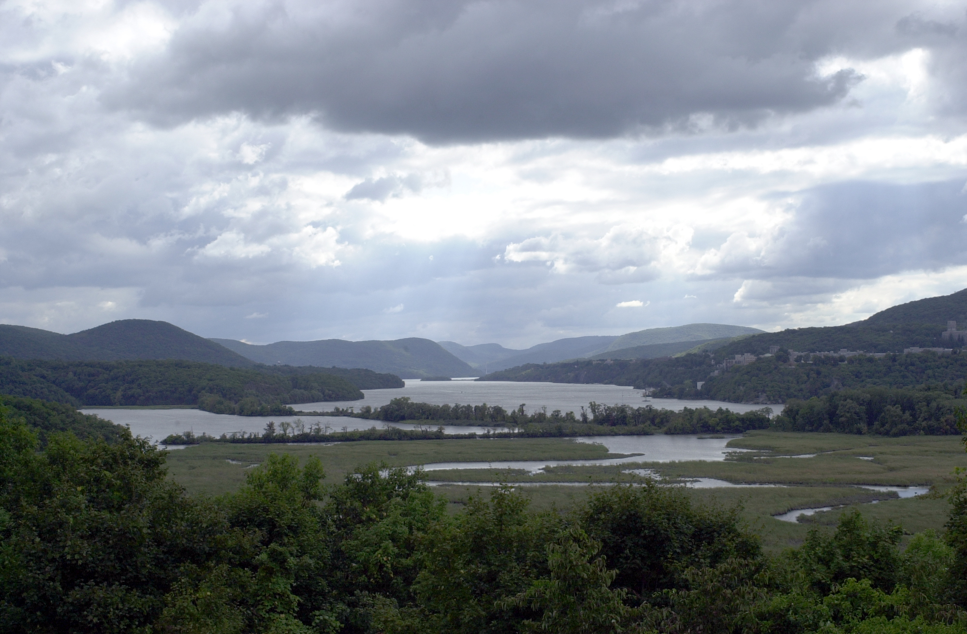
Hudson River Science: Scanning the Rearview Mirror While Looking Forward
Jeff Levinton
Stony Brook University
4/25/2013

Slide 2
What must be said
Much progress has been made in the past few decades
We are grateful for a large number of crucial studies done by individuals and groups from many institutions
We were lucky to get timely support from generous agencies and donors
But there is much more needed to be done

Slide 3
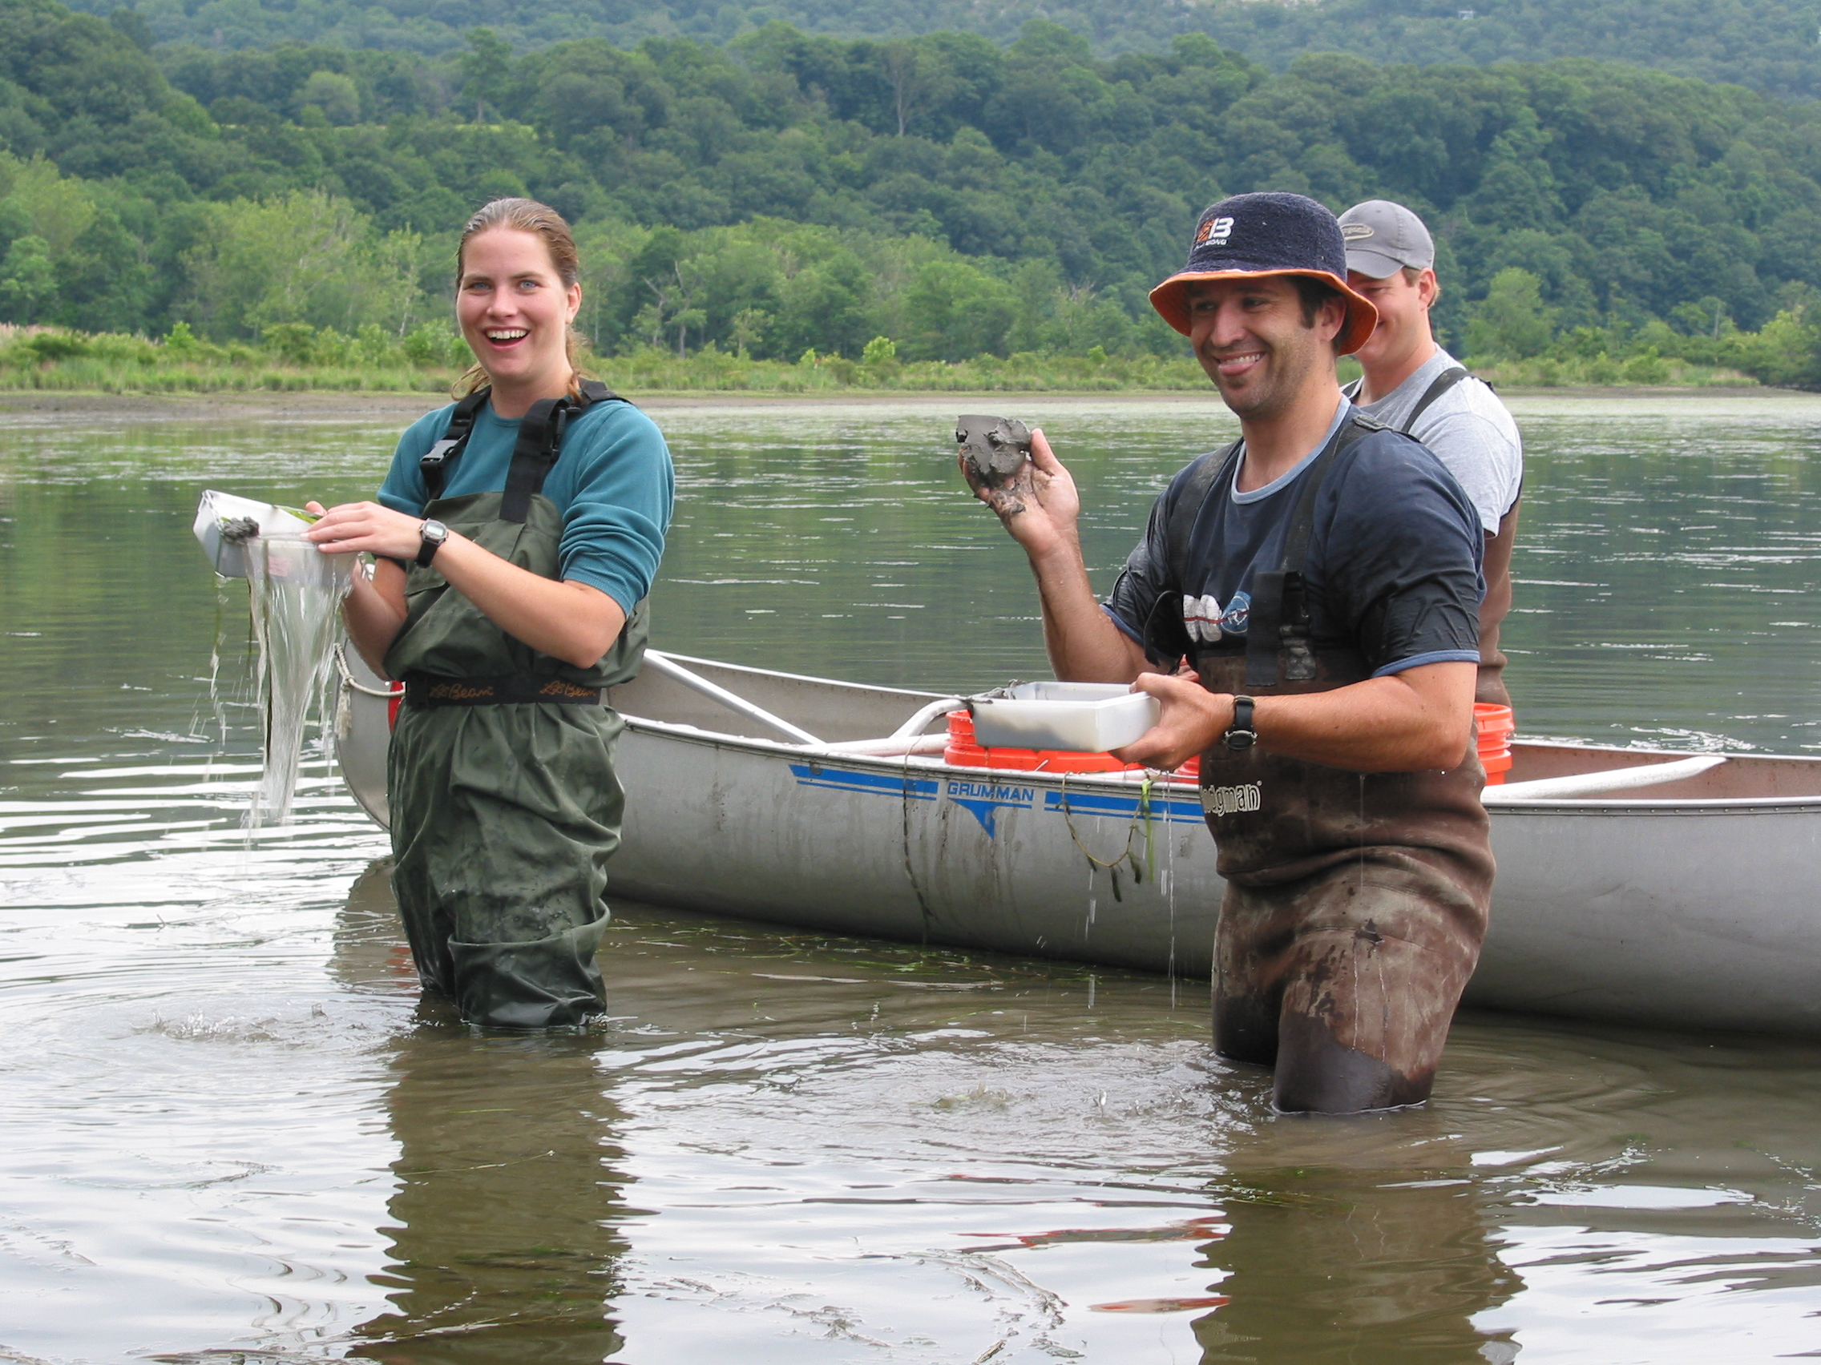
ANY QUESTIONS?

Slide 4
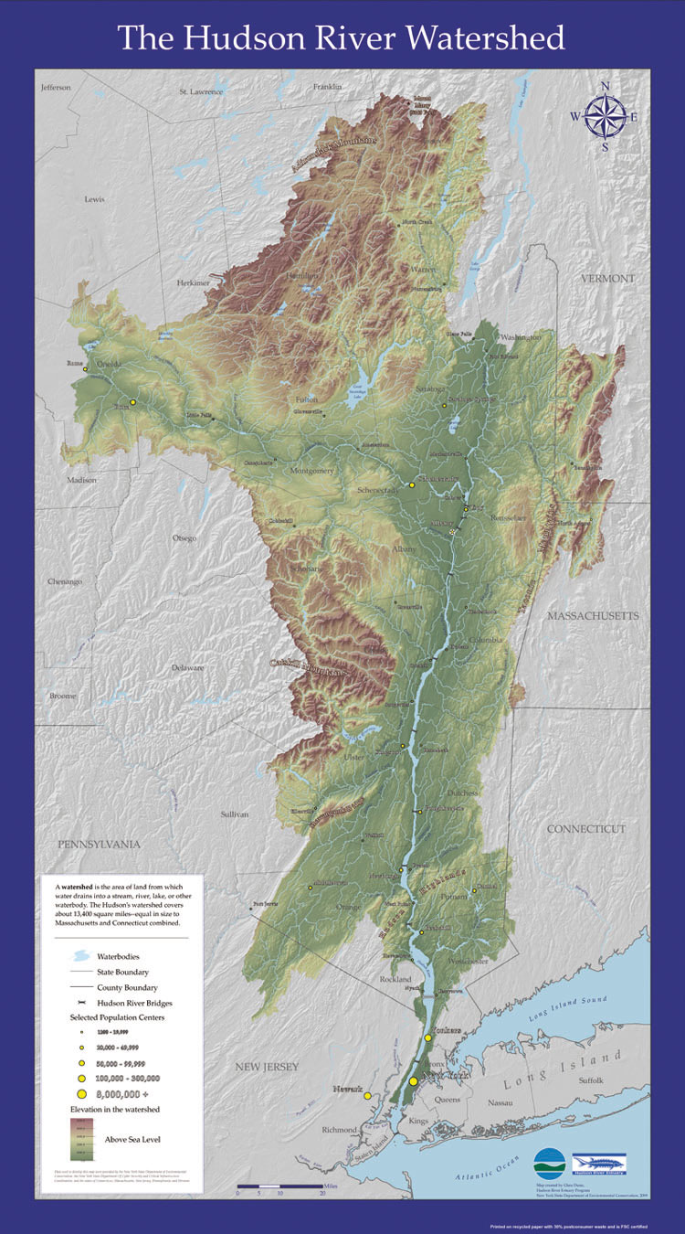
http://www.dec.ny.gov/education/63069.html

Slide 5
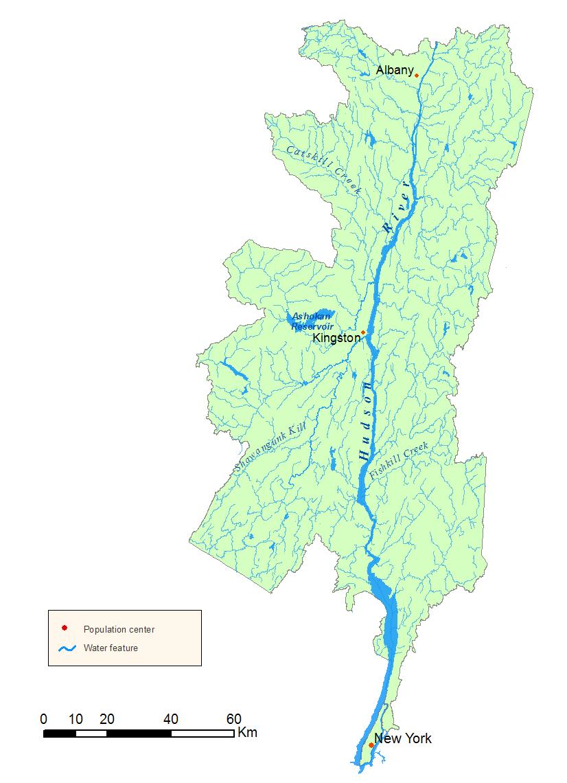
A network of tributaries
www.dec.ny.gov

Slide 6
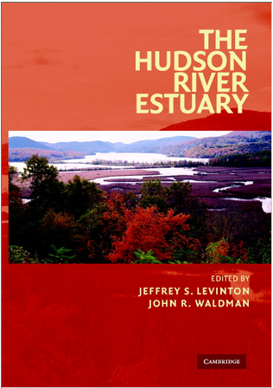
The Rearview Mirror

Slide 7
Big Picture
500 km long, small watershed (34,000 km²), rich in tributaries:
Upper Hudson (little damming) – Mohawk Basin - Lower Hudson (240 km - tidal, fjord) – moderately stratified estuary
Steep banks
Dynamic sedimentation-erosion, Loci of high turbidity
Strong control by precipitation coupled with discharge
Turbid, high nutrient input – low primary productivity – light limited
Primary productivity, zooplankton maximized with high residence time – low flow, neap tide

Slide 8
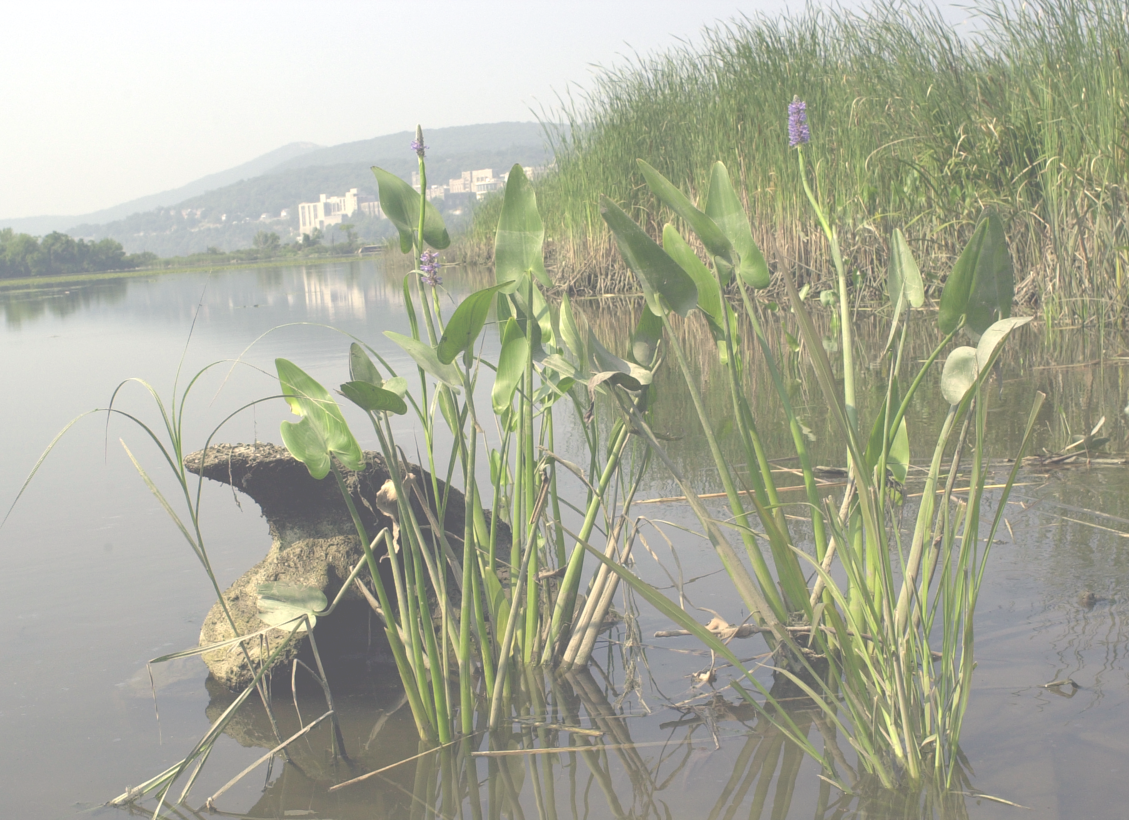
Big Picture 2
Habitat Type | Percent
Shallows | 34
Tidal Wetlands (cattail, common reed) | 9
SAV | 6
Floating vegetation | 2
Bare bottom | 17
Deep-water bottom > 3m | 66
Source NYSDEC, thanks to Betsy Blair

Slide 9

Big Picture 3
BIOTA
High fish diversity (> 200 spp)
No (more) commercial fisheries (contamination, overfishing)
Rich benthos (100s of spp), with some serious declines (e.g., native mussels)
High Invasive diversity (> 100 spp), strong impacts of a few species (e.g., zebra mussels)
Strong impact of anadromous fishes (shad, striped bass), migratory inverts (blue crabs)
Estuarine species in lower estuary with larval retention adaptations (crabs, barnacles, oysters?)
Zooplankton: very sensitive to flow, phytoplankton, and zebra mussels

Slide 10
Spatial-Temporal Scales
Days – high precipitation events → increase in discharge, strong changes in salinity gradient, change in residence time
Season – effects on water column (productivity, zooplankton); migration effects of diadromous fish (e.g., striped bass, shad); sediment distribution;
Interannual – nutrient input, discharge, effects on water column
Decades – precipitation changes, sea level rise, temperature increase, effects of habitat alterations, loss of key biota –CRUCIAL BUT USUALLY NEGLECTED

Slide 11
Spatial-Temporal Scales
Days – high precipitation events → increased in discharge, strong changes in salinity gradient
Season – effects on water column (productivity, zooplankton); migration effects of diadromous fish (e.g., striped bass, shad); sediment distribution;
Interannual – nutrient input, discharge, effects on water column
Decades – precipitation changes, sea level rise, temperature increase

Slide 12
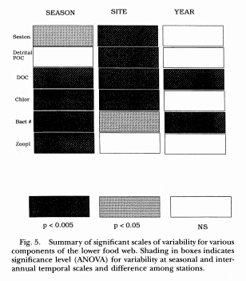
Spatial discordance among variables in a year (e.g., bacteria, chlorophyll
Interannual discordance (DOC, Bacteria)
Findlay, S. et al. 1996 Estuaries 19:666-673

Slide 13
Spatial-Temporal Scales
Days – high precipitation events → increased in discharge, strong changes in salinity gradient
Season – effects on water column (productivity, zooplankton); migration effects of diadromous fish (e.g., striped bass, shad); sediment distribution;
Interannual – nutrient input, discharge, effects on water column
Decadal – precipitation changes, sea level rise, temperature increase

Slide 14
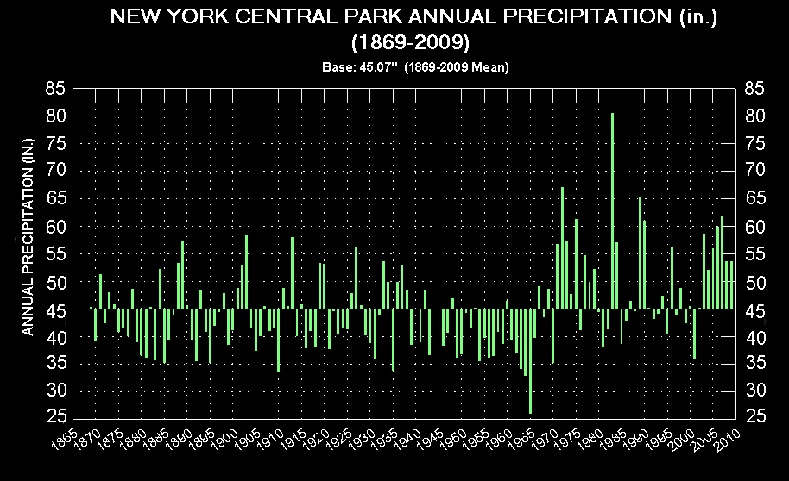

Slide 15

“Getting so much better all the time”

Slide 16
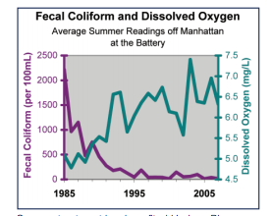
Source: the State of the Hudson 2009, NYSDEC

Slide 17
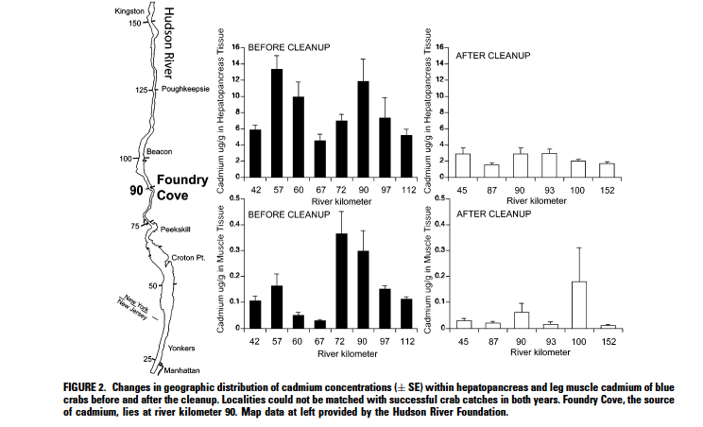
Levinton and Pochron 2006 Env. Sci. Technol.

Slide 18
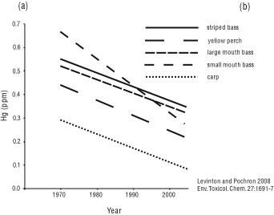
Hg decline in fish over time

Slide 19
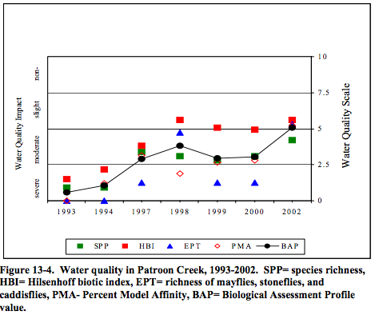
Source: NYSDEC 30 year trends

Slide 20
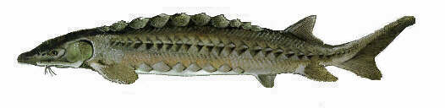
Recovery shortnose sturgeon
4x in 30 years
Woodland and Secor 2007, Trans. Amer. Fish. Soc.136: 72-81

Slide 21

“Can’t get more worse.”

Slide 22
A network of tributaries
www.dec.ny.gov

Slide 23
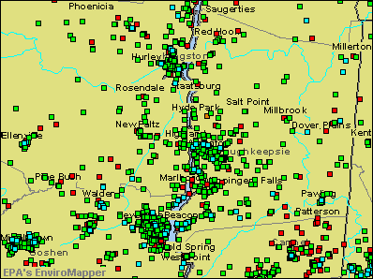
Hazardous Waste and Toxic Water Discharges
(not to mention..Newtown Creek!)

Slide 24
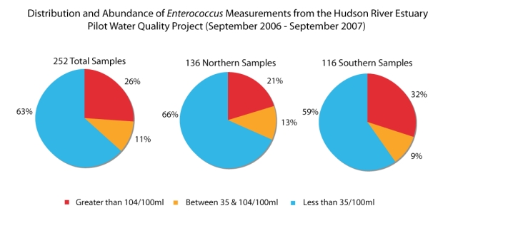
SOURCE: Swimmable River. Riverkeeper, 2008.

Slide 25
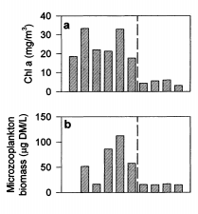
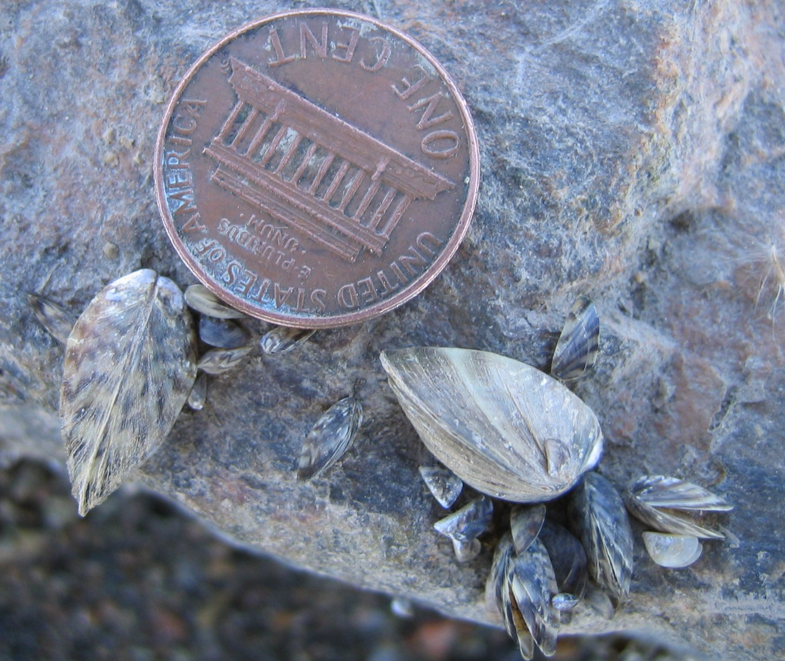
Invasives – Ecosystem Engineers
Zebra mussel,
Dreissena polymorpha
87 92 93 1996
Strayer et al. 1999, BioScience, 49, 19-27

Slide 26

Invasives – ecosystem engineers
Water chestnut Trapa natans

Slide 27
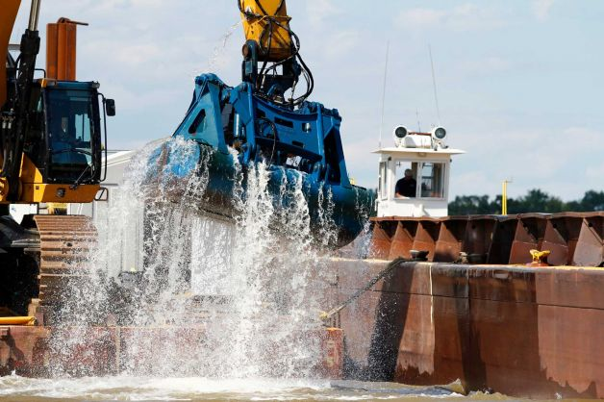
Toxics – PCBs!

Slide 28

“..there are also unknown unknowns – there are things we do not know we don’t know.”

Slide 29
CLIMATE CHANGE – GETTING READY WITH DATA COLLECTION AND MODELLING
Temperature
Precipitation-Discharge
Sea Level Rise
Sedimentation changes
Salinity changes
Reorganization of water motion, affecting larval dispersal and migration patterns

Slide 30
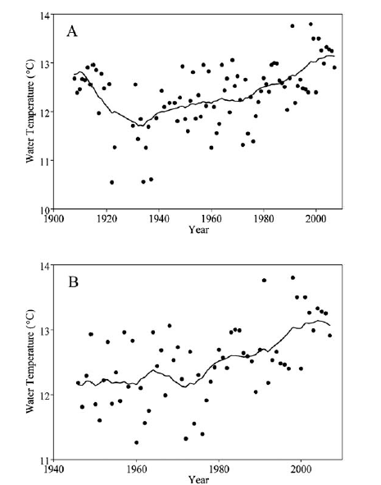
The bumpy road
to increased water
temperature
Seekell and Pace 2011 J. Env. Model.

Slide 31
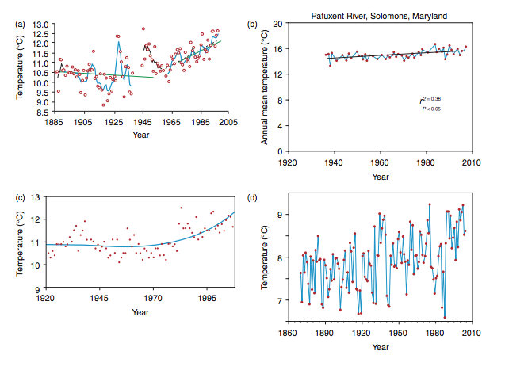
Bumpy everywhere
Woods Hole, Massachusetts
Kaushal et al. 2010 Frontiers Ecol. Env.
Nixon et al. 2004 Estuaries, v. 27, pp. 397–404.
Race Rocks, Vancouver Island
Baltic Sea
Race Rocks web site
MacKenzie et al. 2007, Global Change Biology, v.
13, pp. 1348–1367.

Slide 33
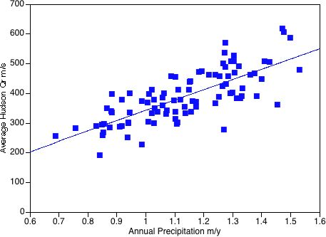
Annual Precipitation at Albany NY versus Hudson River Discharge
1990s
1950s
R²=0.57
David Ralston, unpublished

Slide 34
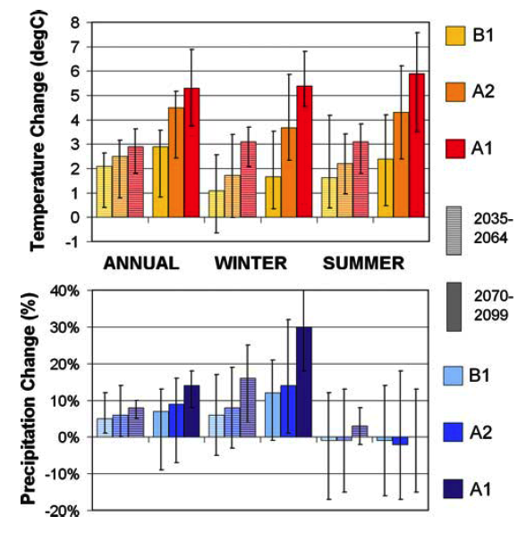
Hayhoe et al. 2007, Clim. Dyn.,

Slide 35
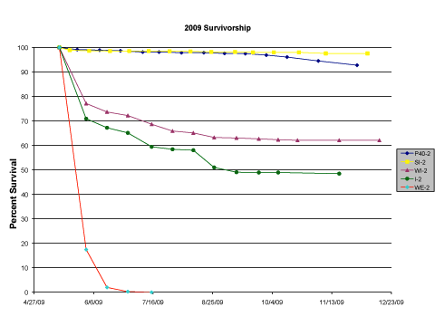
Oyster Survivorship in a Rainy Summer - 2009
Shelter Island
Pier 40
Washington Irving
Irvington
Westerly
Levinton et al. 2011 PLoS One

Slide 36
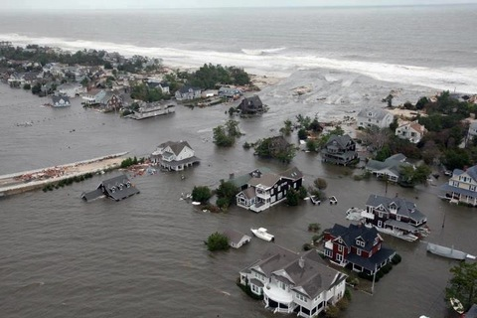
Mantoloking NJ

Slide 37
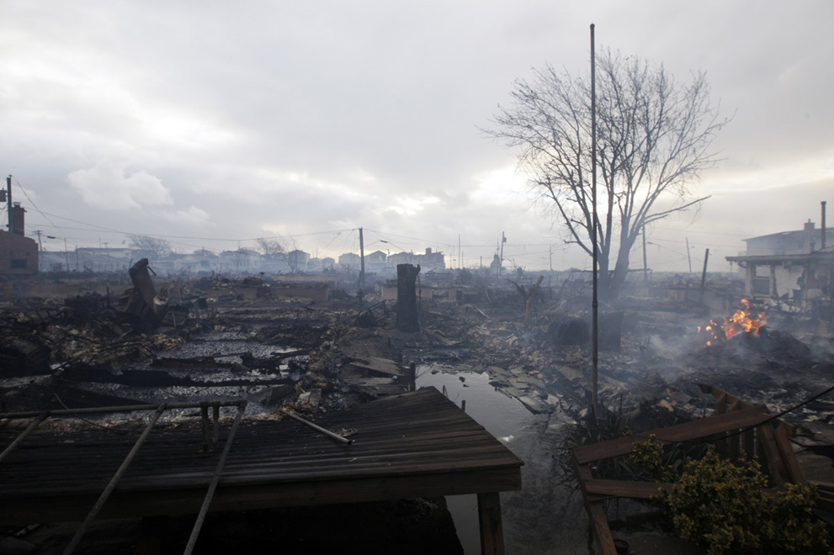
Breezy Point

Slide 38
Hudson Future – Random Thoughts
Should we (continue to) engineer the Hudson?
Do tributary dams matter?
Does walling off of bays (by railroads) matter?
What about megaprojects, such as Tappan Zee Bridge II? Will they affect Hudson River Biology
Climate Change – the Tyrranosaurus in the room?
Does increased temperature matter? Clipping off southern ranges of important species?
Does flow matter? Reduced residence time affecting salinity structure, primary production and lower trophic levels, migration routes, larval flow structure
Will we ever remove all toxics?
What about new threats? Pharmaceuticals

Slide 39
Hudson Future – More Random Thoughts
Gaps of Knowledge
Tributaries and Riparian Zones, effects from fungi to beavers on riparian zones -> Hudson
General relationship of the HR watershed landscape with hydrology, geochemistry, atmospheric deposition
Policy decisions – dealing with sea level rise, storm surges – do we really have any idea how to minimize ecological damage and human societal damage? Are there small bore solutions or do we have to move to major scale solutions, such as large engineering projects and relocations of residents/office use
Fisheries – with new technology, have we connected methods to data collection to ecosystem analysis to fishing policy? Can we adapt new methods to time-worn problems such as mortality caused by hydrologic loss, power plant mortality?
Habitat restoration? What is the value? Where can we get more bang for our buck?
Salt marshes?
Oyster Reefs? Aquaculture? What success can really be achieved and what really will the impacts be?
Proposition: Clean up the water and many other things will follow?
Focus on habitats with dominant ecosystem engineers as species (so far we are the victim of ecosystem engineers the zebra mussel, water chestnut) – fight back!

Slide 40
What next? 1 – Climate Change of Course!
Climate Change – temperature, sea level, river discharge, sediments, storm surge/frequency
Effects on Channel deepening, sediment distribution, feedback effect from hardened shorelines
Monitoring and Modeling – a permanent marriage – internal to the estuary and merged with regional modeling
Habitat shifts due to sea level rise, changes in current dispersal and habitat preference of swimming species, elimination of northern species
Resilience of the Hudson to sudden changes – storm surge, discharge surge
Merging Modeling with relation of hydrologic changes to POC/DOC fluxes,

Slide 41
WHAT NEXT? 2A – Better Instrumentation and Higher Density of Modelling
Greatly increase spatial density monitoring T,S,O₂, monitoring of bottom waters – particle density
Increase monitoring of nutrient inputs
Increase spatial density of monitoring to follow spatial effects of remediation (e.g., reefs on nearby recruitment)
Submarine observatories – with an array resembling southern Vancouver Island – or more focused on specific parameters (e.g., turbidity)?

Slide 42
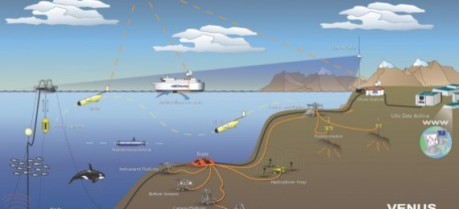
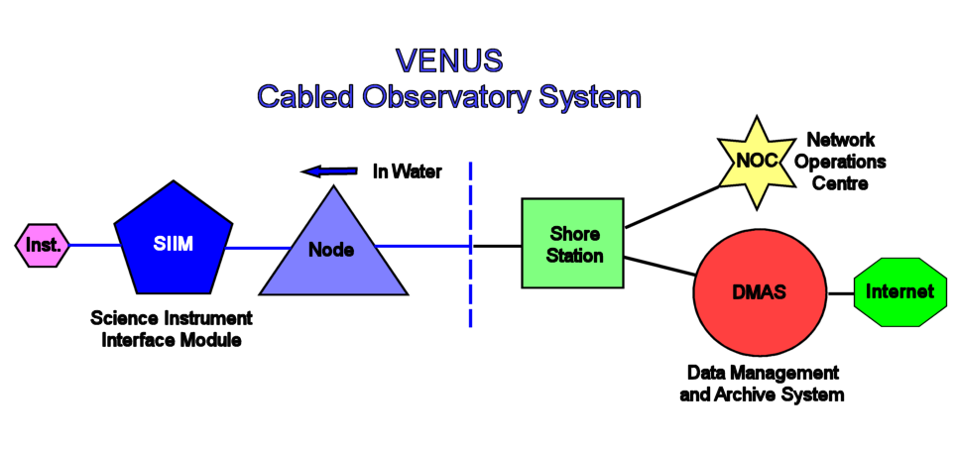

Slide 43
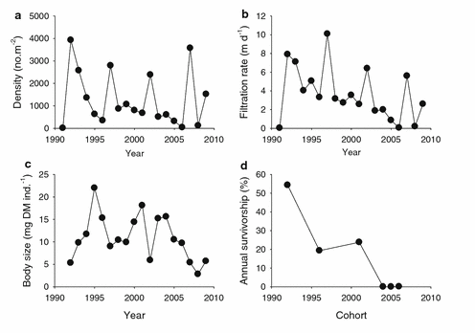
WHAT NEXT 2B – THINK OF MONITORING IN THE LONG TERM
Strayer, D. et al. 2011. Oecologia 165:1063-72

Slide 44
What next - 3 – more vigilance on toxics
Vigilance over the toxics of past decades
Monitor effects of PCB remediation on downstream HR communities
Vigilance for toxics to come – novel substances
New approaches: genomic and metagenomic analyses (microbial responses) of organismal responses – detection of contemporary-rapid evolution

Slide 45
What next? 4 – Modernizing fish studies – ecosystem approaches
Changing from fish counting to ecosystem science – what is the effect of shifting predators on HR food webs? Especially impacts of anadromous fish migrations and shifts in abundance on food webs
Integrated models of tributaries and rivers – is there a connection with regard to fish populations? Benthos?
The rise hopefully of molecular biology approaches: molecular markers – connectivity within and with other estuaries – establishment of metapopulation structures, megagenomic approaches to investigation of lower food webs – pay attention to retained species within the estuary

Slide 46
What next? 5 Restoring ecosystem functions using spatial planning
Given that we now have excellent habitat maps for the Hudson:
Finding a proper balance to restore habitats
Strategic Spatial Planning for Hudson River Sustainability
Priority on restorations that affect ecosystem function (nitrogen cycling, restoring indigenous ecosystem engineers)
DON’T ASSUME THAT RESTORATION WILL MAKE UP FOR CLEANING THE ENVIRONMENT. DON’T MOP THE FLOOR, TURN OFF THE FAUCET!
DON’T AVOID NECESSARY “INDUSTRIAL STRENGTH” FIXES TO PROTECT AGAINST FLOODING OF URBAN INFRASTRUCTURE
DON’T AVOID REZONING IN MOST DANGEROUS PLACES

Slide 47
Example of Strategic Spatial Planning
Self-Sustaining Metapopulation
Low growth,
Low disease,
Low Predation
Tappan Zee – Haverstraw Bay
Larval retention
RECRUITMENT
Tradeoff Strategy
NY-NJ Harbor, coastal sites
High growth rate,
High disease,
High predation
Larval retention
RECRUITMENT

Slide 48
Many Thanks To:
Jon Cole
Rocky Geyer
Eric Kiviat
Mike Pace
Dave Ralston
Malcolm Scully
Dave Strayer
John Waldman
Ike Wirgin

