Slide 1
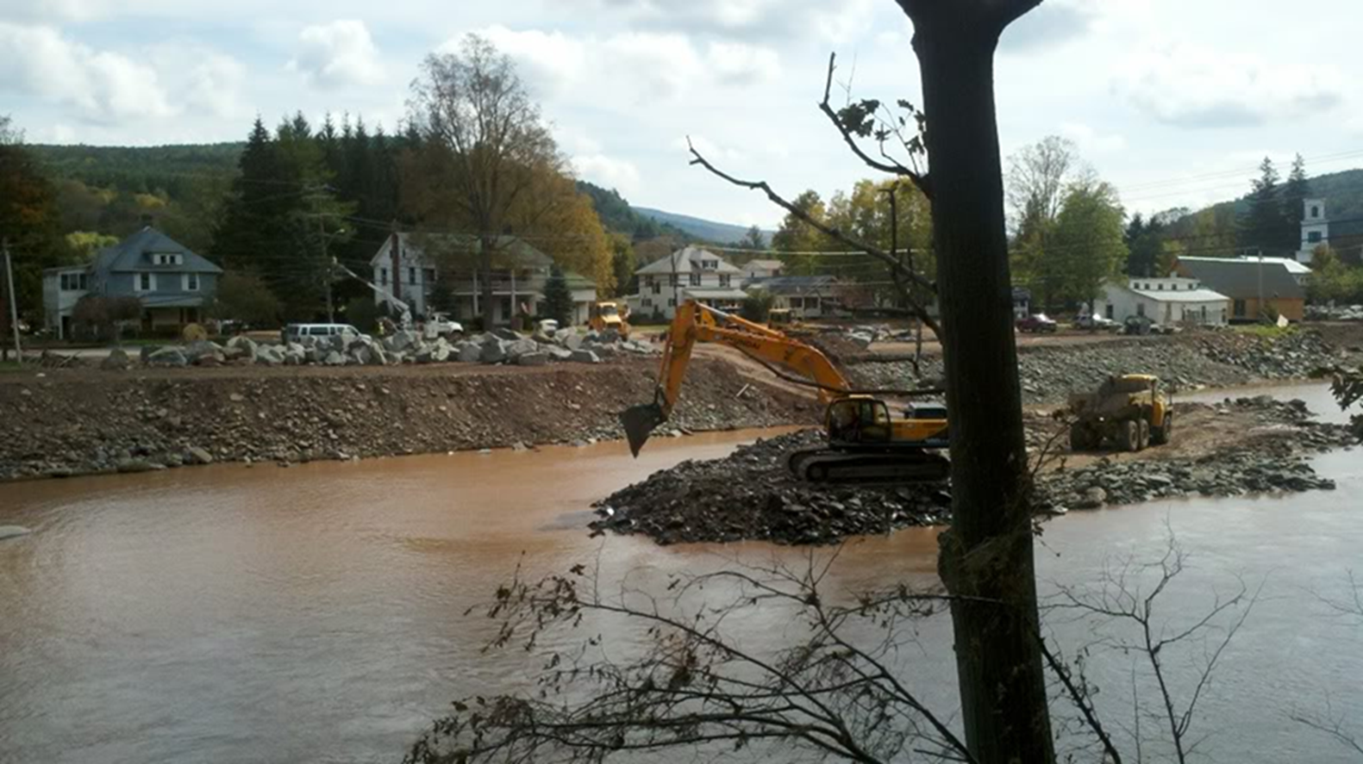
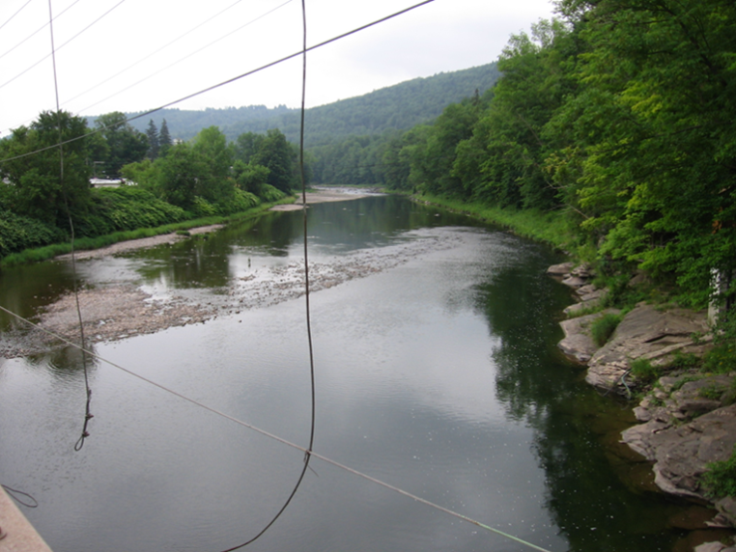
Hydrology of
Tropical Storms Irene & Lee
DEC Mohawk Update Sept. 13, 2012
Britt E. Westergard, Senior Service Hydrologist
National Weather Service, Albany, NY
with Joseph Villani, Hugh Johnson, Vasil Koleci, Kevin Lipton, George Maglaras,
Kimberly McMahon, Timothy Scrom, and Thomas Wasula

Slide 2
Hydrology Topics
Tropical Storm Irene
Remnants of T.S. Lee
Outlook / Forecasts
Rainfall
Flood magnitude
Storm surge on Hudson
Operational challenges
Rainfall
Flood magnitude
Operational challenges
Impacts of Irene & Lee
Post-event activities

Slide 3
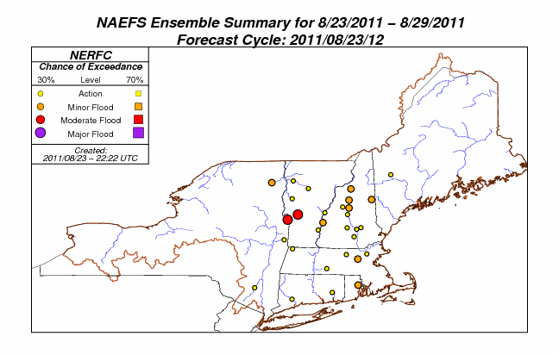
Irene: MMEFS Outlook
http://www.erh.noaa.gov/mmefs/

Slide 4
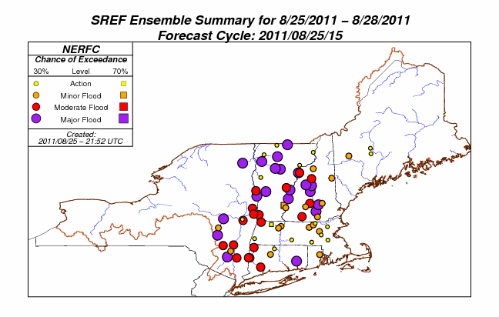
Irene: MMEFS Outlook
http://www.erh.noaa.gov/mmefs/

Slide 5
Irene: Hydrologic Forecasts
Flood watch issued at 4:47 am Friday Aug. 26th
First flash flood warning issued 1:42 am Saturday
Issued river flood warnings (including updated warnings as forecast crests increased in category) for 37 forecast points…flooding occurred at 35
Average lead time from warning to flood stage was 3 hours 12 minutes (FFW LT = 3 hrs)
WIDESPREAD RAINFALL AMOUNTS OF 4 TO 7 INCHES ARE LIKELY.
LOCALIZED AMOUNTS OVER THE HIGHER TERRAIN OF THE
CATSKILLS...BERKSHIRES...LITCHFIELD HILLS AND GREEN MOUNTAINS
COULD REACH 10 INCHES.
IF THIS AMOUNT OF RAIN OCCURS MANY MAIN STEM RIVERS WOULD FLOOD.
FLASH FLOODING MAY ALSO BE A THREAT WHERE HEAVIER RAIN BANDS OCCUR.

Slide 6
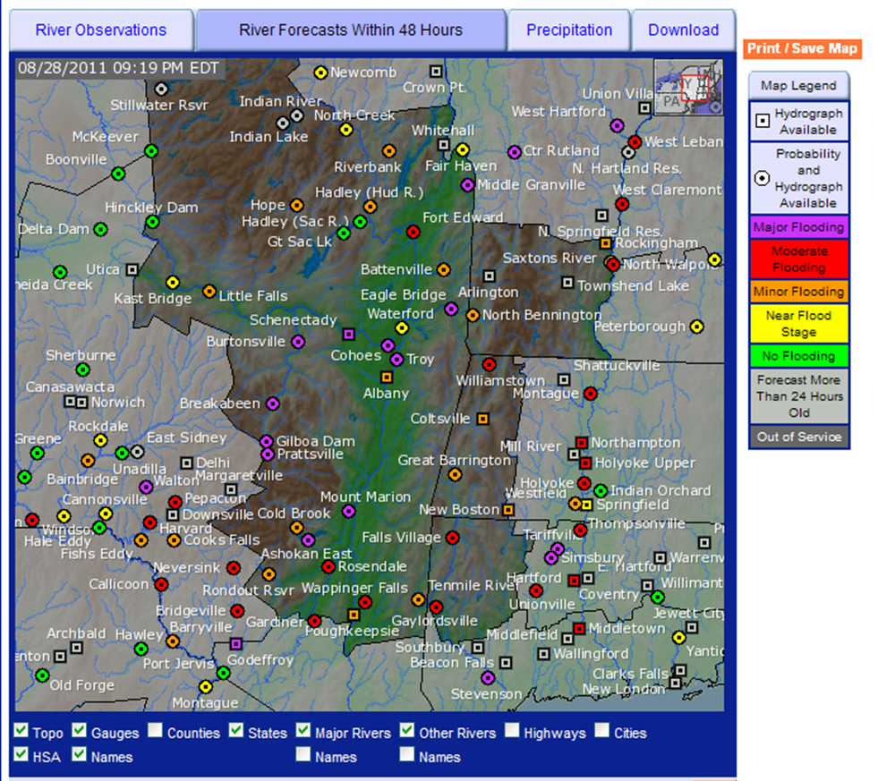
Irene: AHPS forecasts
Sunday
http://water.weather.gov/ahps2/index.php?wfo=aly

Slide 7
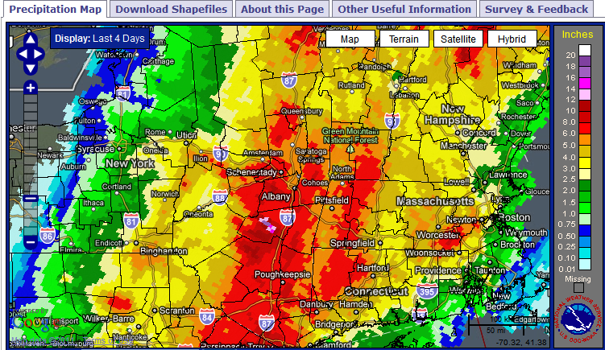
Irene Storm Total Rainfall:
Multisensor Estimate
http://www.srh.noaa.gov/ridge2/RFC_Precip/

Slide 8
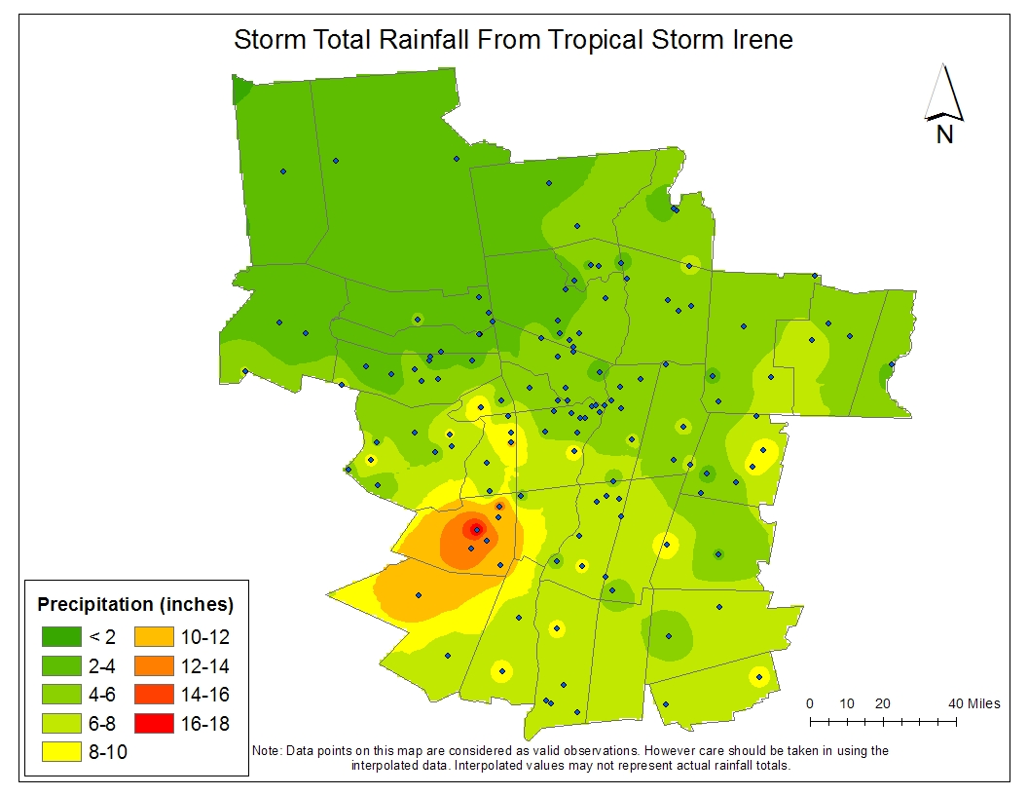
Irene: Storm Total Rainfall
Interpolated Rain Gages

Slide 9
Top 5 Wettest Calendar Days at Albany (since 1874)
      5.60" SEP 16 1999 (Floyd)
      4.69" AUG 28 2011 (Irene)
      4.08" AUG 31 1950
      3.50" AUG 28 1971 (Doria)
      3.49" JUL 13 1996 (Bertha)
2011 was the wettest year on record at Albany

Slide 10
Irene: Tannersville Rainfall
11.6” storm total
New NY State 24 hour rainfall record: 11.6”
Previous record set in 1903 in Central Park
Inches of rainfall
10” in
12 hours

Slide 11
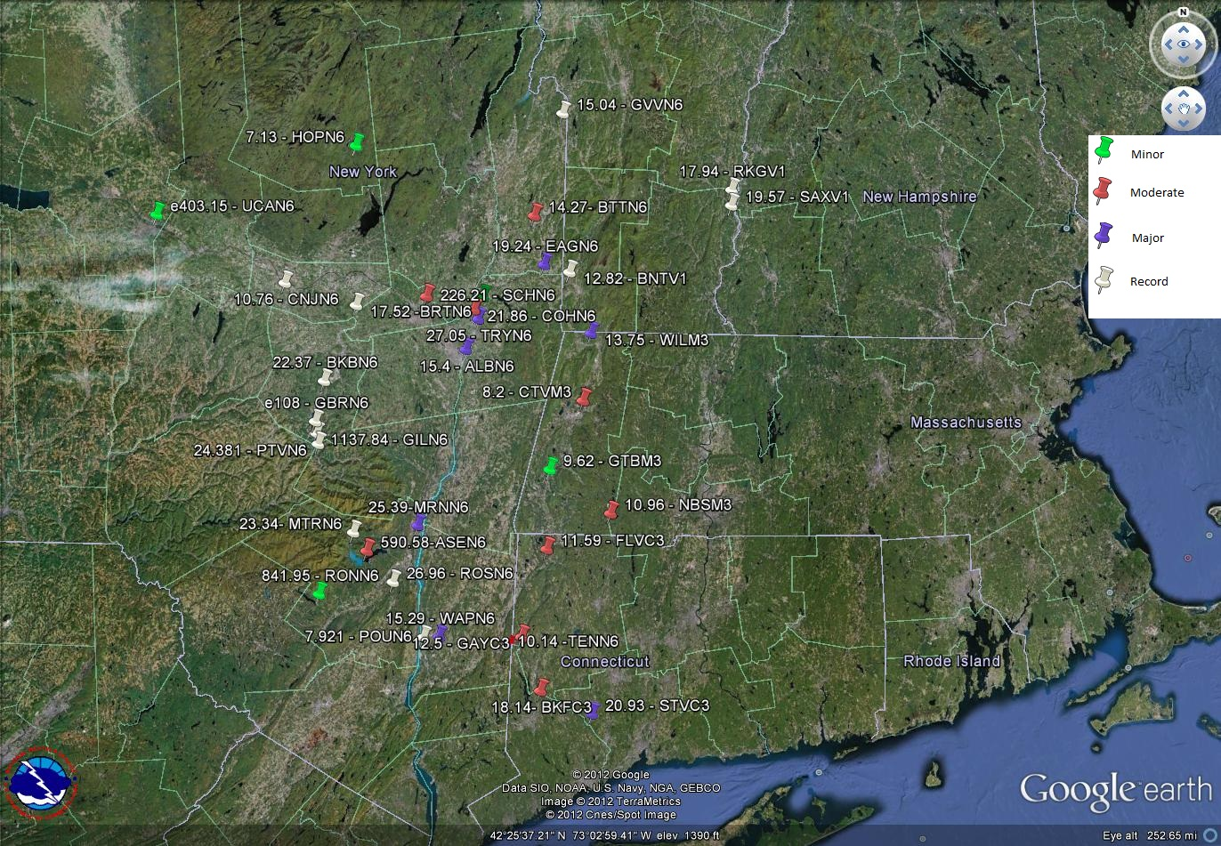
(5)
(9)
(8)
(13)
Flooding at 35 of 44 forecast points.

Slide 12
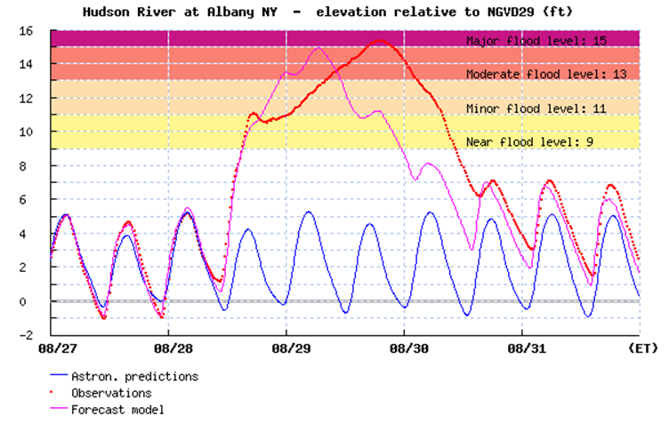
Irene: Storm Surge
http://hudson.dl.stevens-tech.edu/SSWS/d/index.shtml
Storm Surge = feet above astronomical tide
Storm Tide = feet above datum
(= actual gage elevation if gage datum is zero)

Slide 13
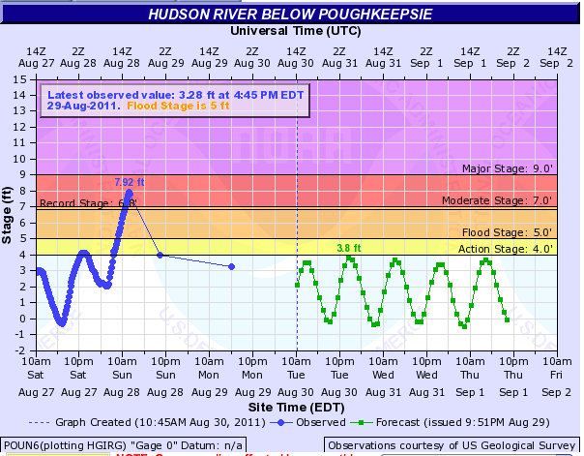
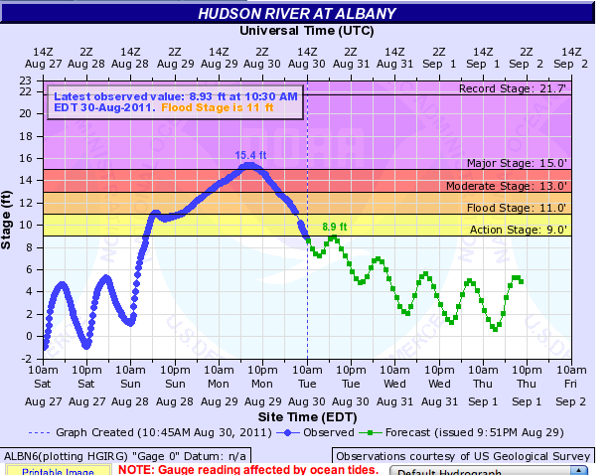
Irene: Storm Surge
@POU: 5.39 ft surge (7.96 tide)
29th highest Irene surge (of 98 meas.)
@ALY:
7.23 ft surge (11.11 ft tide)
16th highest Irene surge
(of 98 meas.)

Slide 14
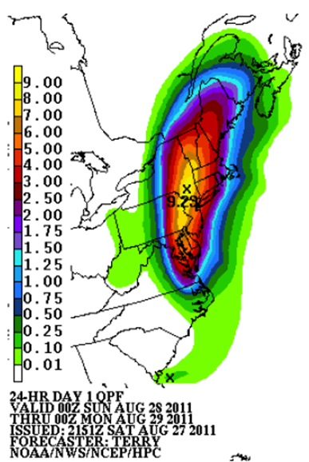
Irene: Operational Challenges
Rainfall forecasting
  Placement – 24 hours out, very good
  Timing – reasonable; onset about 6 hours earlier than forecast
  Amount – maximum rainfall in Catskills (18.12”) under-forecast (forecasted max around 10 inches)
HPC Forecast Rainfall
Aug 27-29, 2011

Slide 15
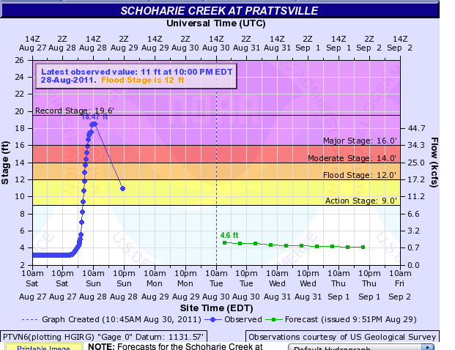
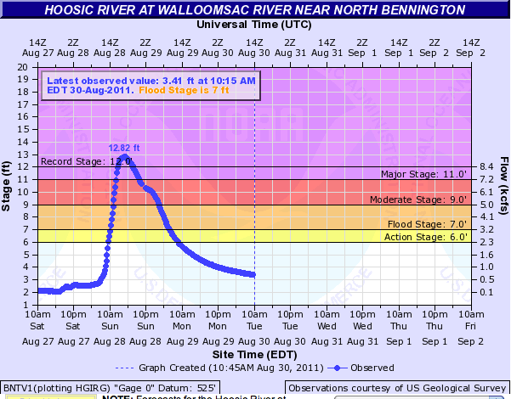
Irene: Operational Challenges
Extreme rates of rise on many rivers
Schoharie Creek at Prattsville, NY
on Aug. 28, exceeded:
- 12 ft flood stage at 7:02am
- 14 ft moderate flood at 7:36am
- 16 ft major flood at 8:17am
Walloomsac River at Bennington, VT
on Aug. 28, exceeded:
- 7 ft flood stage at 10:48am
- 9 ft moderate flood at 11:50am
- 11 ft major flood at 12:46pm

Slide 16
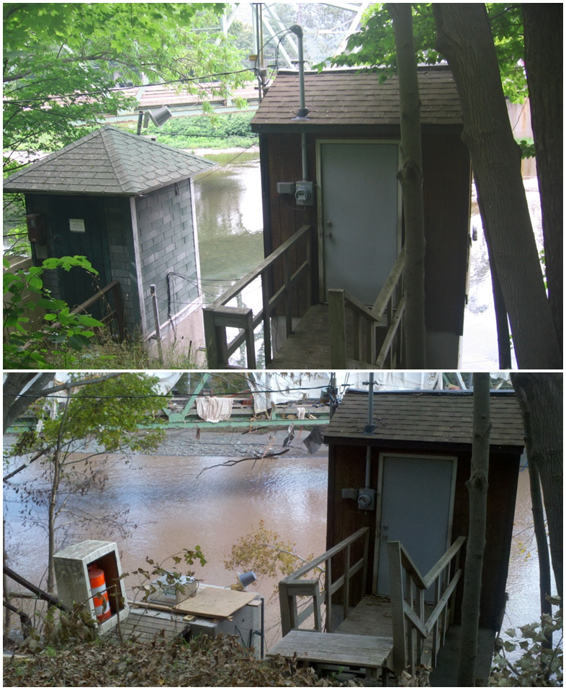
Irene: Operational Challenges
River gages washed away or damaged:
  Prattsville
  Gilboa Bridge
  Burtonsville
  Poughkeepsie
  Gaylordsville

Slide 17
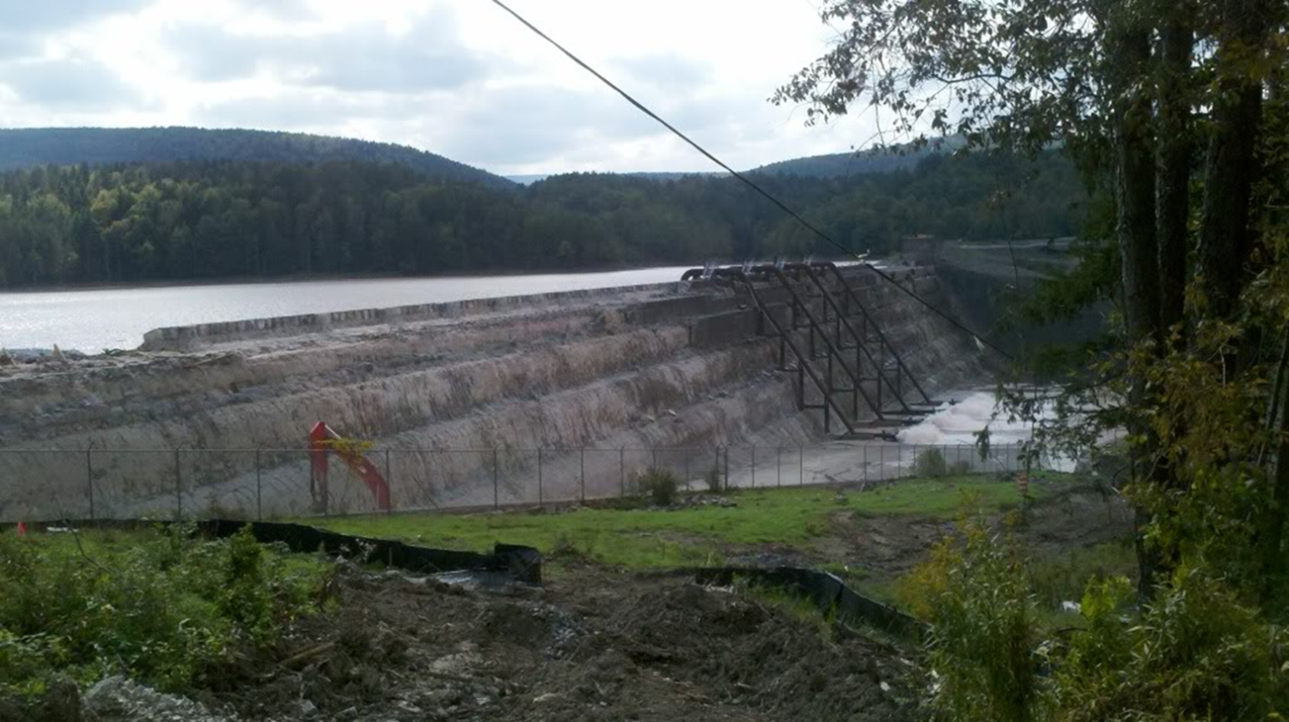
Irene: Operational Challenges
Conveying the potential severity of multiple hazards
Communications outages…partners in hardest hit areas
Issues at various locks and dams:
  Misinformation about Gilboa failure
  EAS alert watches for Condition B at several projects taxed the capabilities of our software

Slide 18
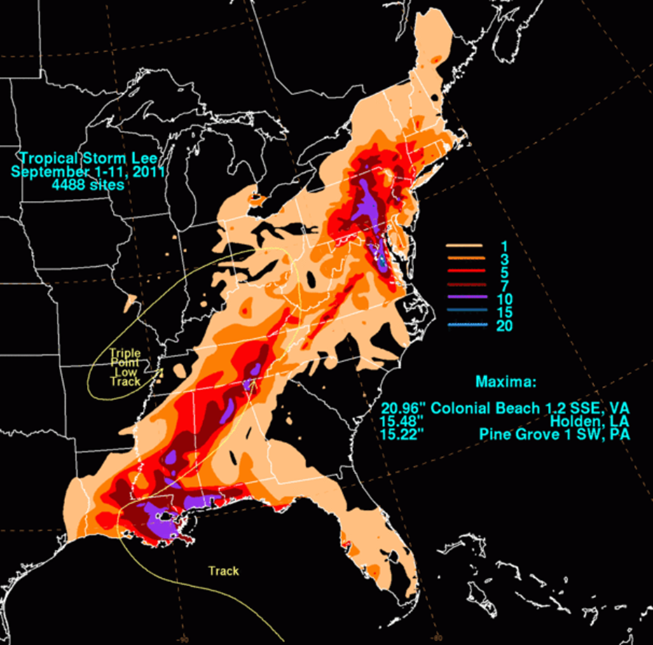
Lee:
Track and Rainfall
Notes:
http://hydrology.princeton.edu/~luo/research/FORECAST/current.php

Slide 19
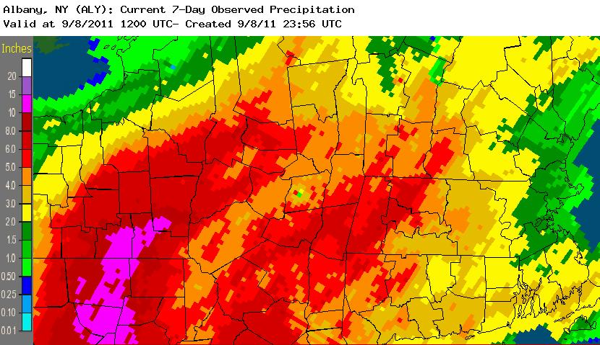
Lee Storm Total Rainfall: Multisensor Estimate
Moderate to major flood crests:
Major:
  Canajoharie Creek at Canajoharie
  Mohawk River at Utica
  Mohawk River at Little Falls
8 Moderate floods including 3 locations on Schoharie Creek that had just experienced record flooding
http://www.srh.noaa.gov/ridge2/RFC_Precip/

Slide 20
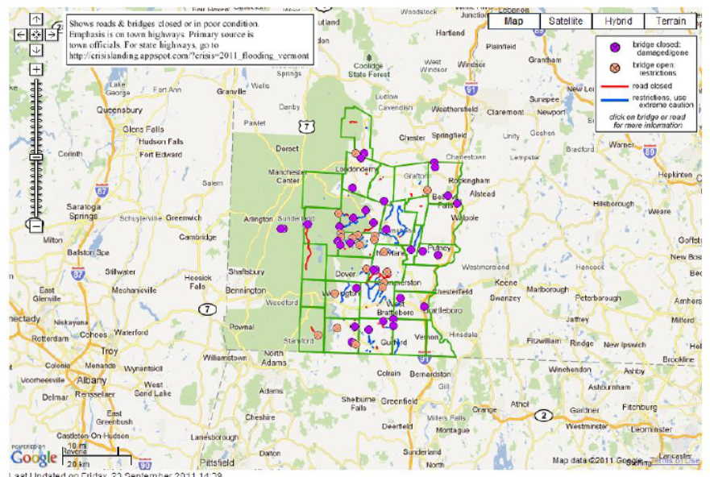

Lee: Operational Challenges
Precipitation forecast uncertainty
  Placement / Timing / Amount
Irene debris
Understanding reports of flooding
Ongoing recovery efforts
Public sensitivity to flooding

Slide 21
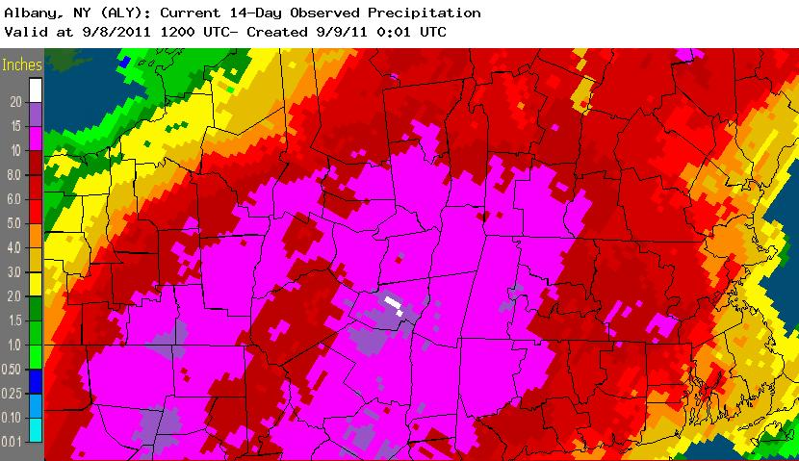
14 Day Total Rainfall: Multisensor Estimate
14 days from Thurs. Aug. 25 to Thurs. Sept. 8
http://www.srh.noaa.gov/ridge2/RFC_Precip/

Slide 22
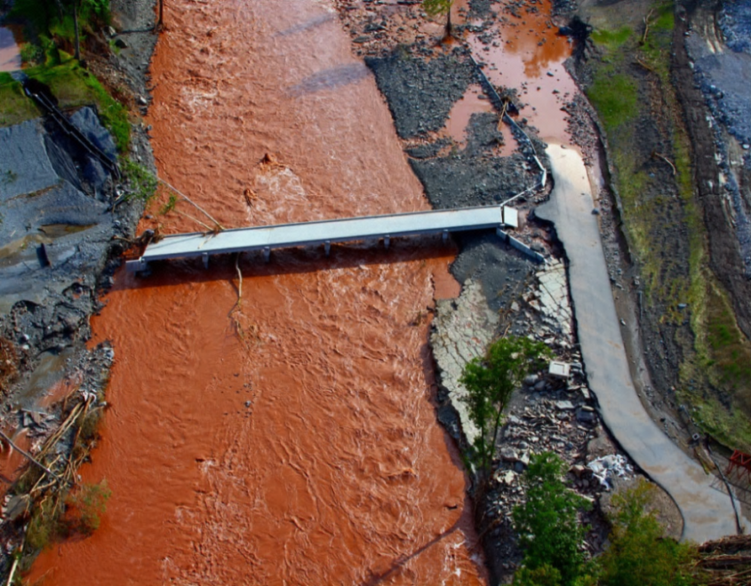
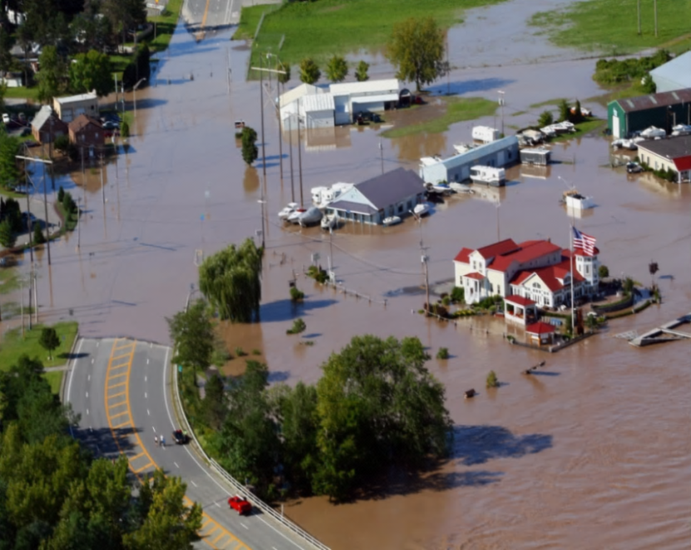
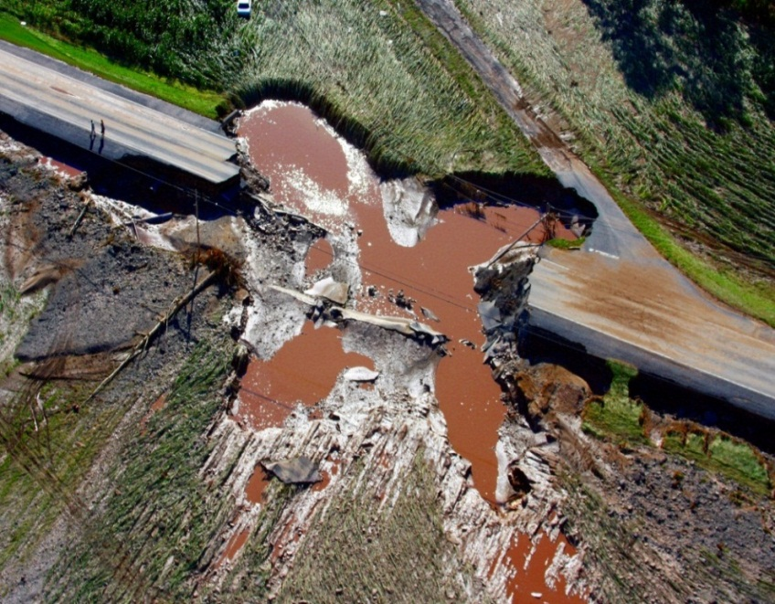
KEY IMPACT STATS | HURRICANE IRENE | TROP. STORM LEE
POWER OUTAGES (PEAK) | 997,000 | 68,000
BRIDGES CLOSED (PEAK) | 24 | 37
ROAD SEGMENTS IMPACTED (PEAK) | 157 | 181
REPORTED SWIFTWATER RESCUES | 150 | 959
EVACUATIONS ORDERED | 370,000+ | 21,000+
Information & photos courtesy of NYS Office of Emergency Management
Notes:
Peak outage numbers per PSC. Also, per PSC, there were 11,500 natural gas outages due to Lee and a total of 900,000 telecom outages for Irene/Lee combined.

Slide 23
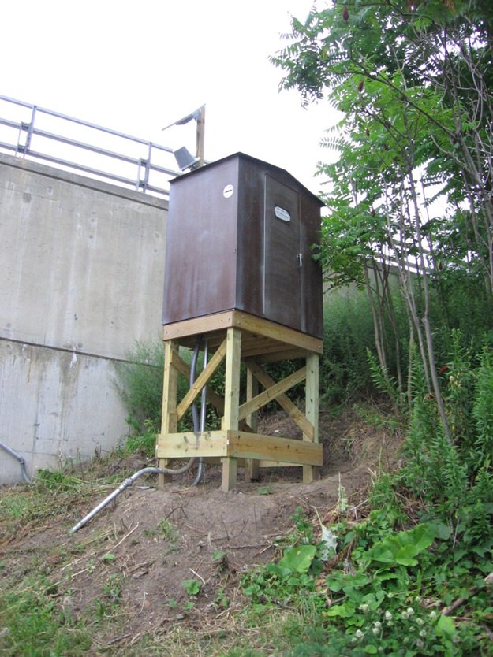
Post-Event Activities
Schenectady river gage
  Automated U.S. Geological Survey gage installed January 2011 in coordination w/NYS DEC, Hudson River Environmental Conditions Observing System, Schenectady County EM and Union College
  Flood stage changed January 2012 (223’ → 220’)
  Impact statement updates
http://www.nws.noaa.gov/om/assessments/index.shtml

Slide 24
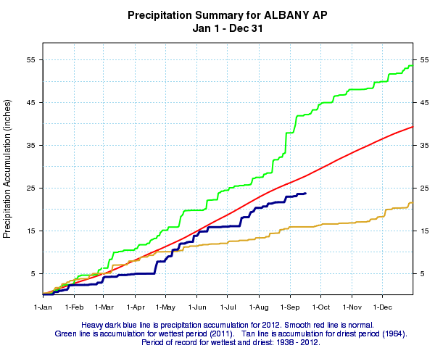


weather.gov/albany
What a difference a year makes…
Britt Westergard
britt.westergard@noaa.gov

