Slide 1
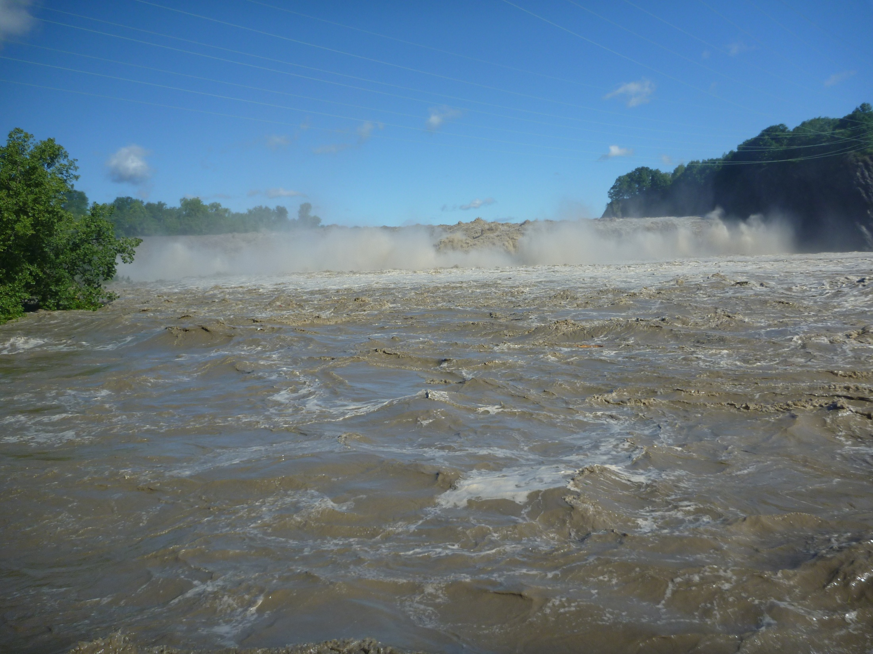


Hudson River Watershed Sediment Transport following Tropical Storms Irene and Lee
Gary R. Wall and Timothy F. Hoffman
U.S. Geological Survey
New York Water Science Center
In cooperation with:
Mohawk River @ Cohoes 8/29/11 101,000 ft³/sec
2,200 mg/L

Slide 2
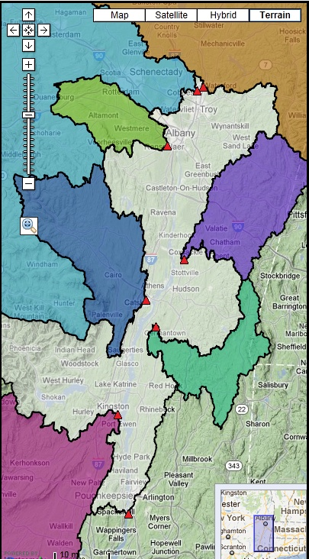
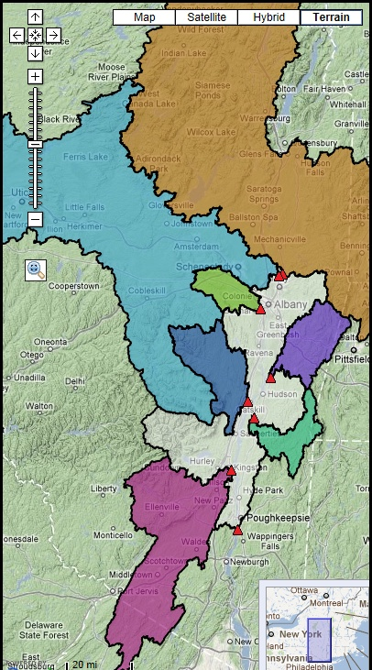
Mohawk
Upper Hudson
USGS Suspended-Sediment Monitoring Stations
Normanskill
Name | Watershed Area (mi²) | % Above Poughkeepsie
Upper Hudson | 4,616 | 39.4
Mohawk | 3,450 | 29.4
Rondout | 1,185 | 10.1
Catskill | 405 | 3.4
Kinderhook | 329 | 2.8
Roeliff Jansen | 212 | 1.8
Normanskill | 168 | 1.4
Total | 10,365 | 88.3%
Kinderhook
Catskill
RoJan
Rondout
Poughkeepsie

Slide 3
Mohawk
Upper Hudson
USGS Suspended-Sediment Monitoring Stations
Normanskill
Name | Watershed Area (mi²) | % Above Poughkeepsie
Upper Hudson | 4,616 | 39.4
Mohawk | 3,450 | 29.4
Rondout | 1,185 | 10.1
Catskill | 405 | 3.4
Kinderhook | 329 | 2.8
Roeliff Jansen | 212 | 1.8
Normanskill | 168 | 1.4
Esopus (NYCDEP) | 425 | 3.6
Total | 10,790 | 91.9%
Kinderhook
Catskill
Esopus
RoJan
Rondout
Poughkeepsie

Slide 4
Methodology
River Discharge x Sediment Concentration = Mass of sediment per unit time (Tons/day)
Need a continuous record of both
USGS stream gages provide continuous discharge
High frequency sampling or a continuous surrogate provide sediment concentration

Slide 5
Methodology
High-frequency sampling

Slide 6
Methodology
Surrogate
Rondout
Catskill
Log₁₀ Suspended Sediment Concentration
Roeliff Jansen
Kinderhook
Log₁₀ Turbidity

Slide 7
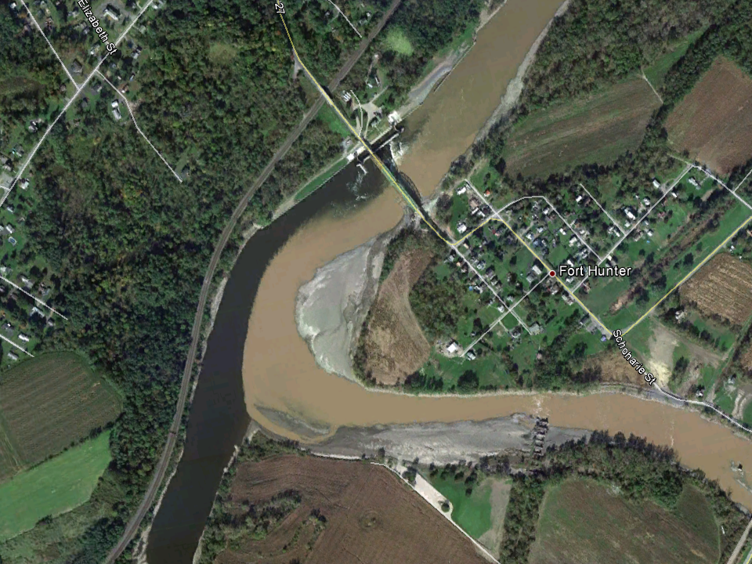
Head-of-Tide Results
Schoharie Creek
Mohawk River

Slide 8
Head-of-Tide Results

Slide 11

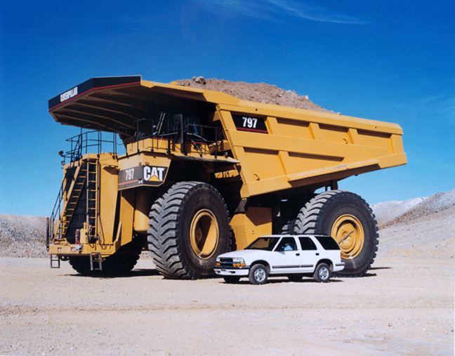
How much is 1.75 million tons of sediment?
This truck can carry 400 tons…

Slide 12
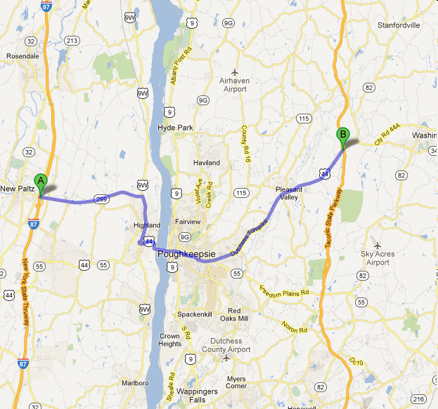
Cary Institute
4,375 trucks
Bumper-to-bumper
Both directions

Slide 13
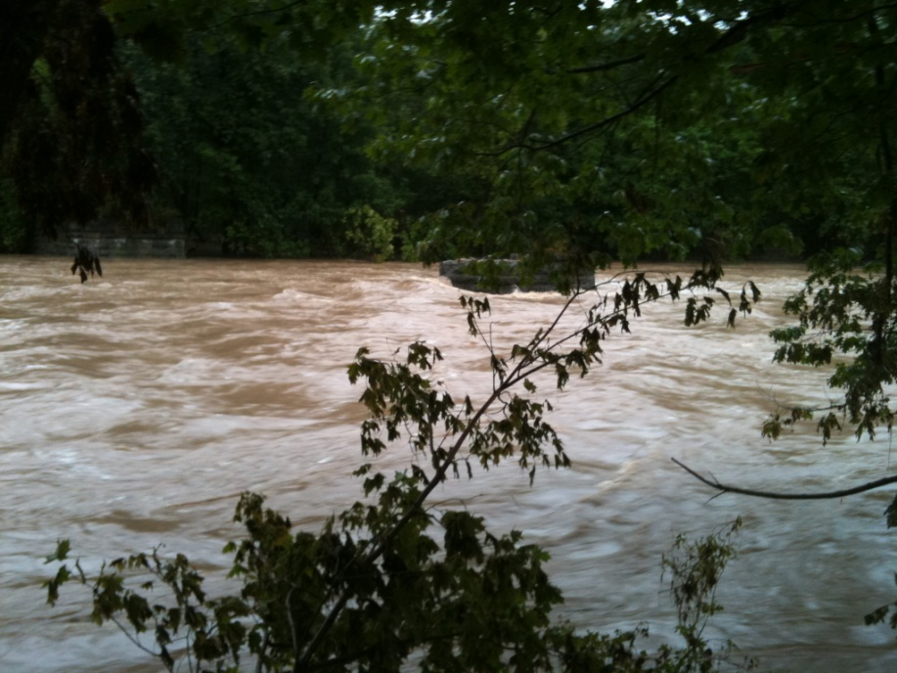
Lower Hudson Tributary Results
Catskill Creek near Catskill 9/7/11 – 29,000 ft³/sec ~1,700 mg/L

Slide 14
Lower Hudson Tributary Loads
* Irene only

Slide 15
Tributary Yields
* Irene only

Slide 16
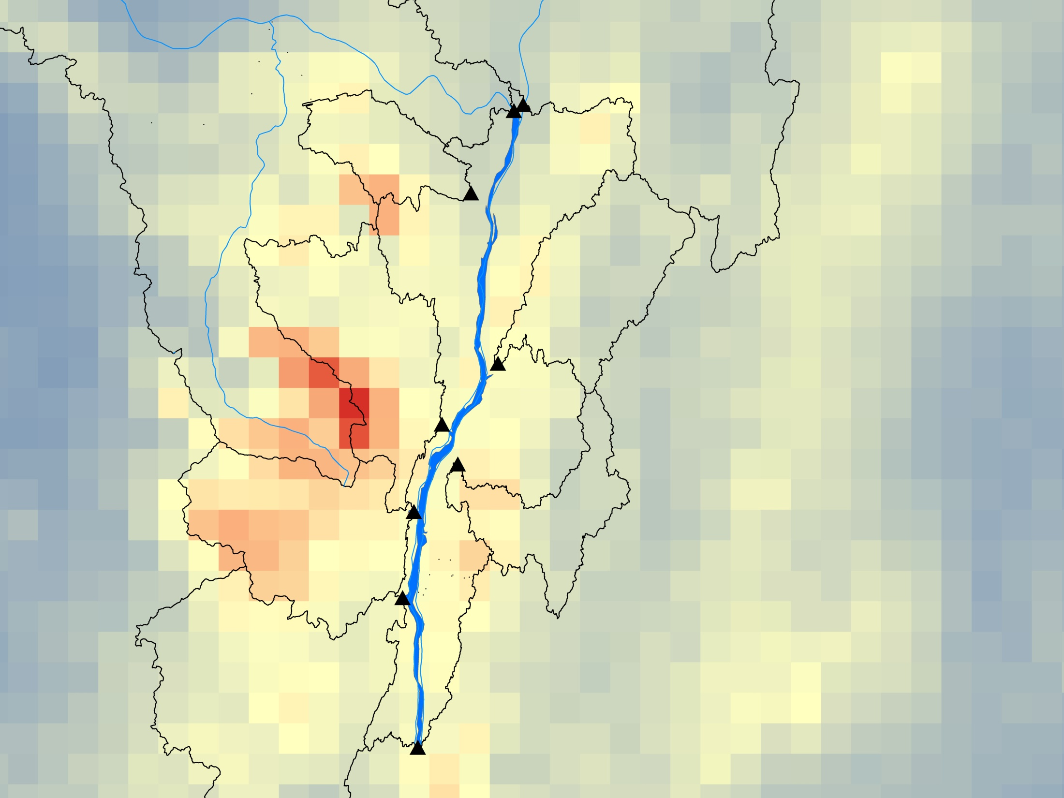
Upper Hudson
Mohawk
Normanskill
Kinderhook
Catskill
National Weather Service Radar-Based Precipitation Estimates for TS Irene
RoJan
Esopus
Rondout
Poughkeepsie Gage

Slide 17
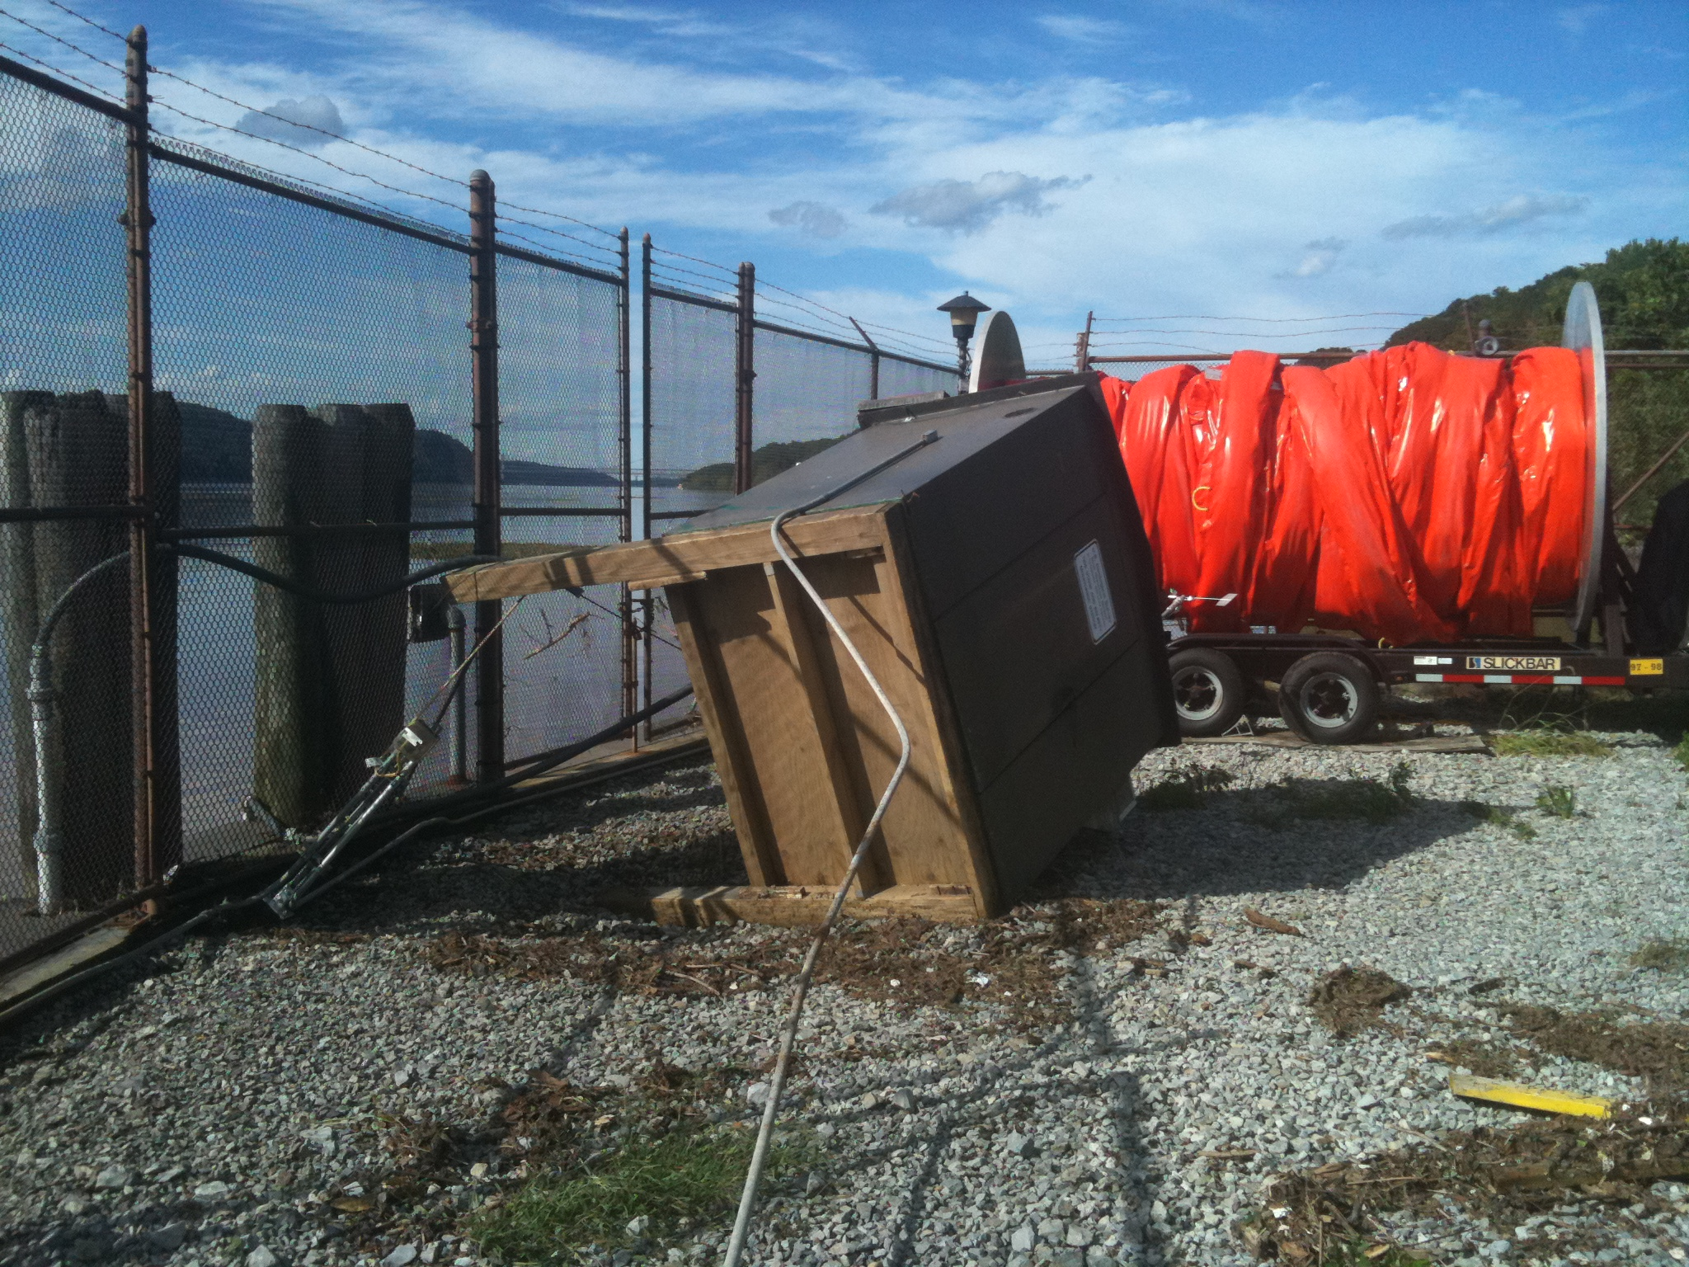
Poughkeepsie Results

Slide 18

Institute

Slide 19
Poughkeepsie Results
Concentration x Discharge = 1 million tons of suspended sediment through mid-October 2011

Slide 20
Green Island Dam
1.75 million
tons
West-of-Hudson
tributaries
95,000 tons
~1.75 million
tons trapped
900,000 tons
East-of-Hudson
tributaries
Poughkeepsie
1 million
tons

Slide 21
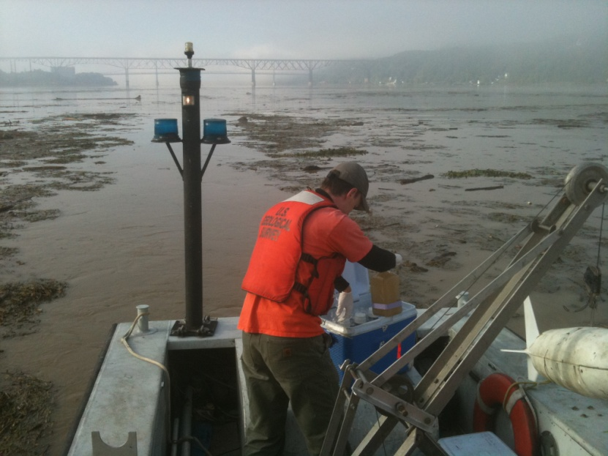
Hudson River near Poughkeepsie 8/30/11
Net Discharge = 170,000 ft3/sec , 248mg/L
Acknowledgements:
DEC Hudson River Estuary Program and Div. of Water
EPA Harbor Estuary Program
NEIWPCC
Stuart Findlay – Cary Institute
Randy Alstadt – City of Poughkeepsie
Hudson River Foundation
HRECOS
National Weather Service

