Slide 1
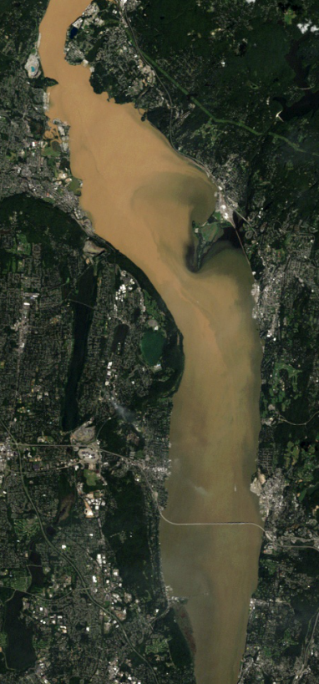


Salinity and sediment
in the Hudson River estuary
after Tropical Storms Irene & Lee
David Ralston, Rocky Geyer,
and John Warner
Impacts of Tropical Storms Irene and Lee on the Hudson River
Cary Institute, Millbrook, NY – Sep 19, 2012
LANDSAT
Aug 31, 2011

Slide 2
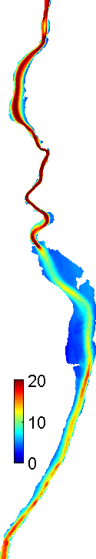
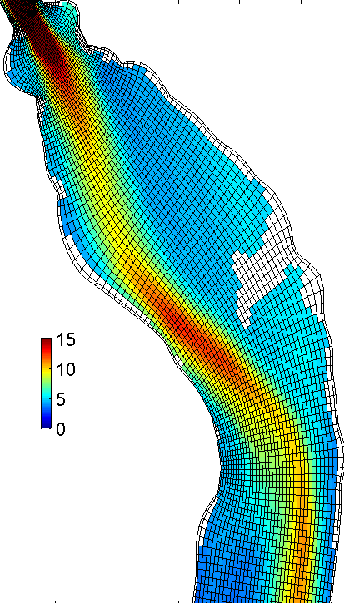
Bathymetry and grid
ROMS + CSTMS
Regional Ocean Modeling System
Community Sediment Transport Modeling System
Grid spacing 50 to 200 m,
16 sigma-levels
Output fields
water level
velocity: u,v,w
salinity
suspended sediment
bed composition
turbulence intensity, bed stress

Slide 3
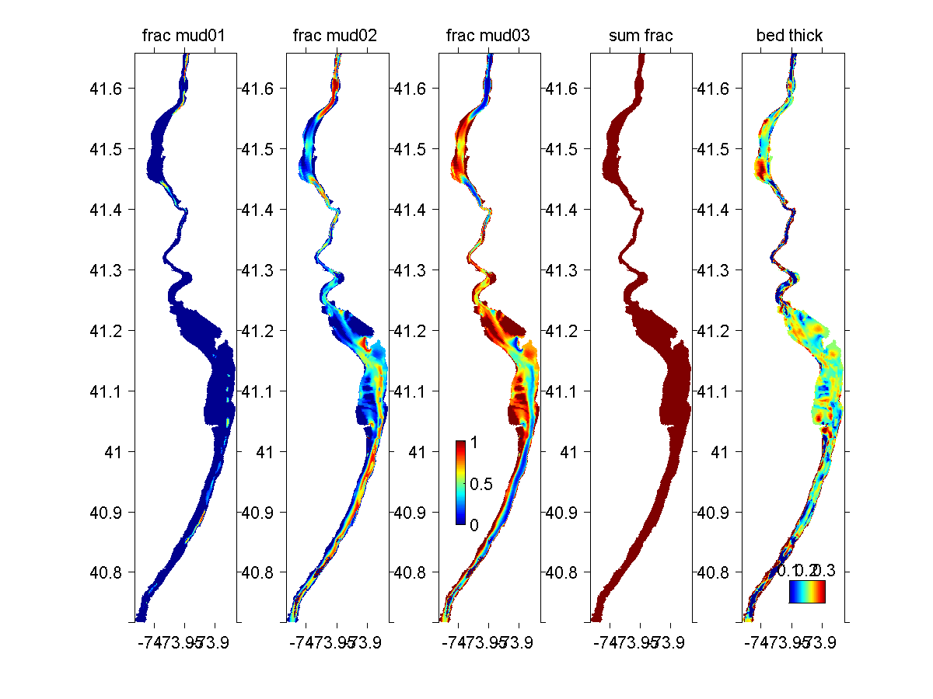
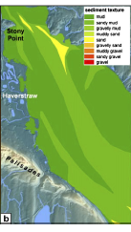
Bed sediment distribution
Map observations of bed composition (Nitsche et al. 2007) to grid:
→ fractional mud, fine sand, & coarse sand
sand
mud

Slide 4
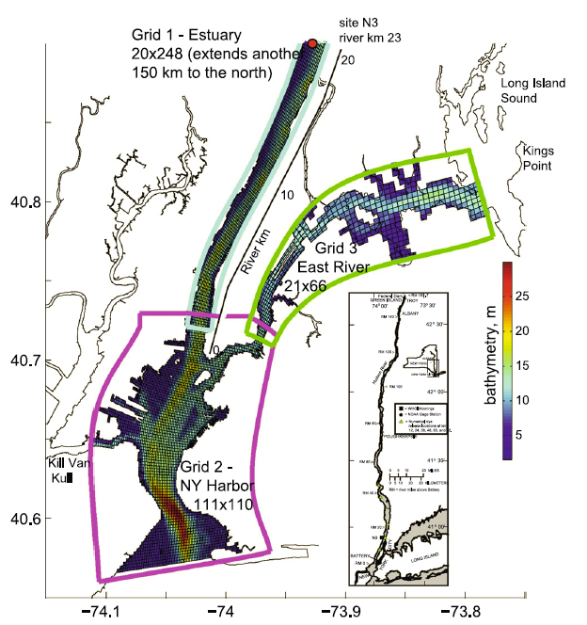
Model extension
Estuary: 45 x 924 (to Green Island)
Composite grid extends down to NY Harbor & East River, up to dam at Green Island
East River: 40x66 cells
Harbor:
220 x 100 cells

Slide 5
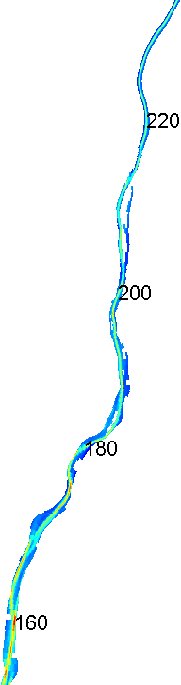
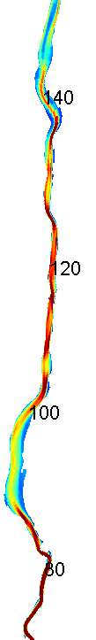
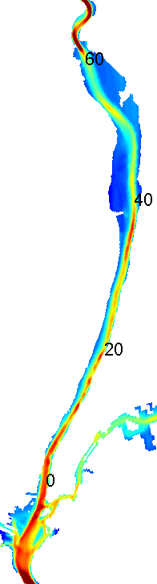
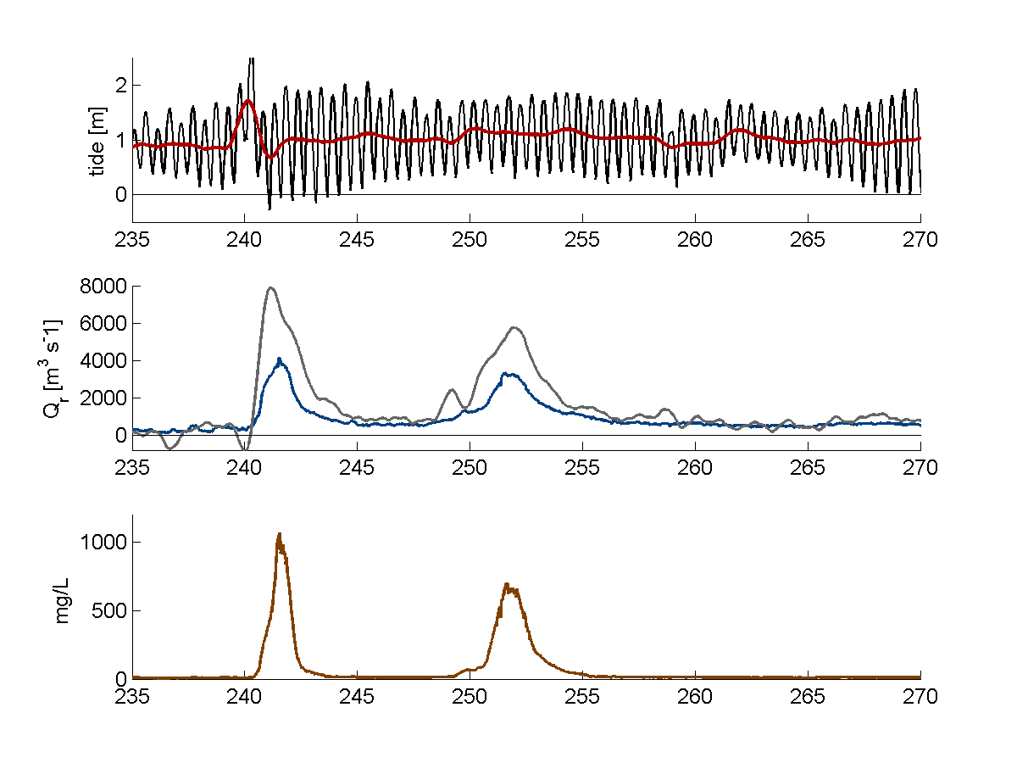
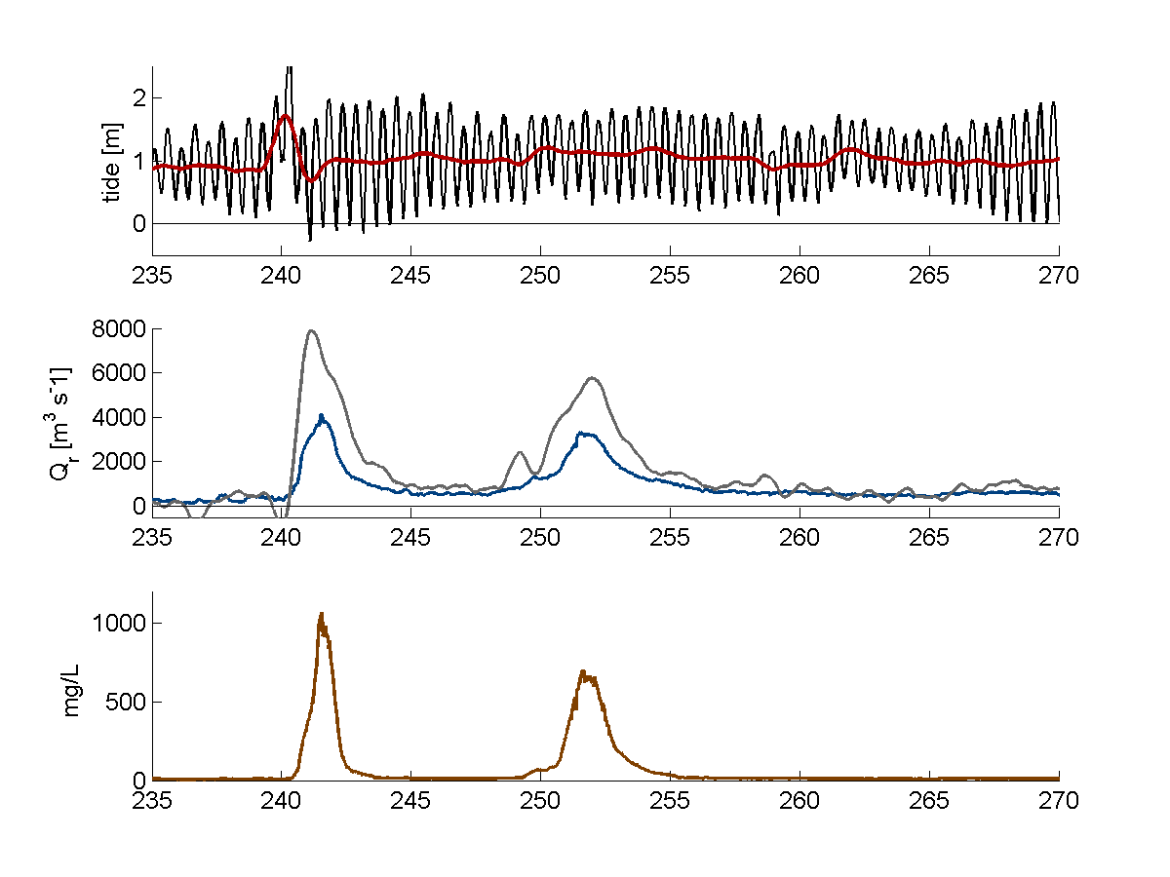
Mohawk +
upper Hudson
(1.7 Mt)
Boundary forcing
Discharge and sediment load at
Green Island + tributaries:
Catskill, Esopus, Rondout, Croton
Croton
(0.03 Mt)
Sediment based on rating curves & estimates from G. Wall/USGS
Rondout
(0.3 Mt)
Poughkeepsie
Green Island
Catskill
(0.6 Mt)
Tides at Harbor and East River
Esopus
(0.03 Mt)
day, 2011

Slide 6
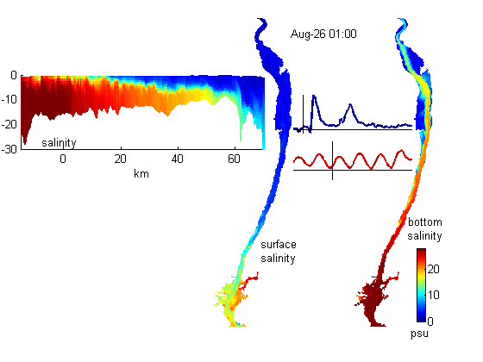
Salinity
discharge
salinity (thalweg)
tide
bottom salinity
surface salinity

Slide 7
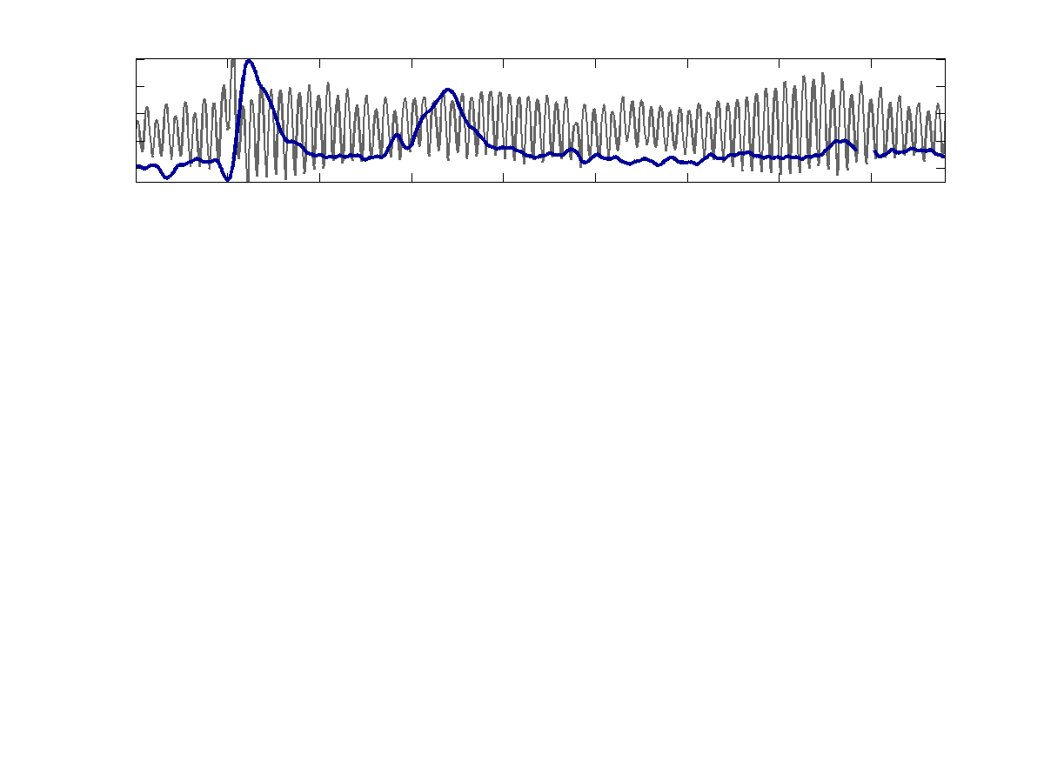
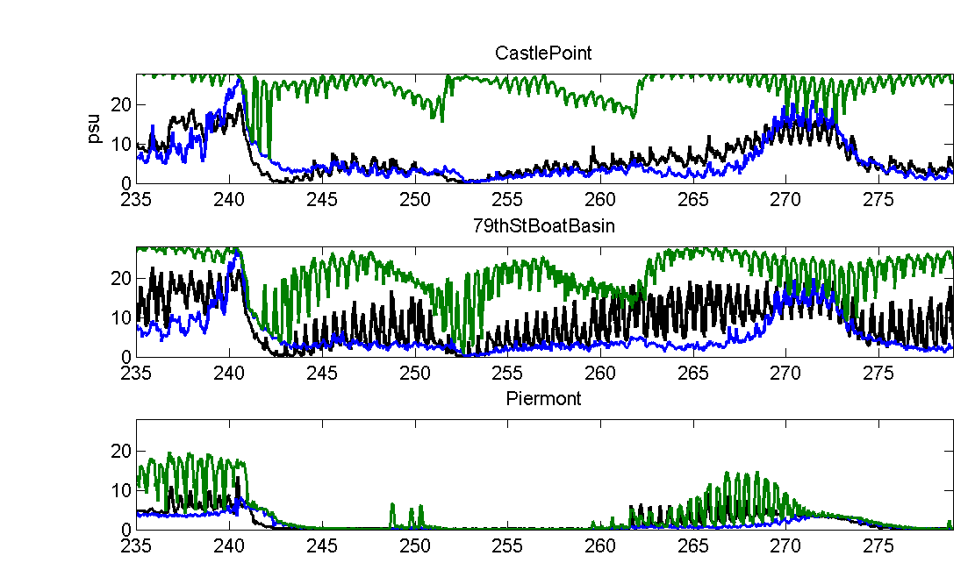
Tidal Height and Discharge
Salinity - observations
observed
model, bottom
model, surface
buoy
pier
pier
day, 2011

Slide 8
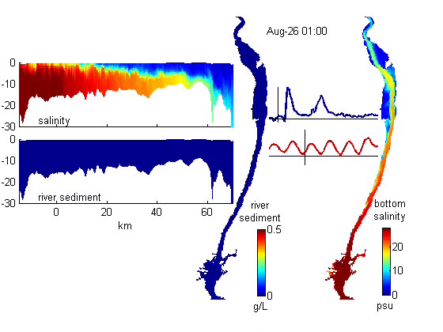
Salinity and River Sediment
discharge
tide

Slide 9
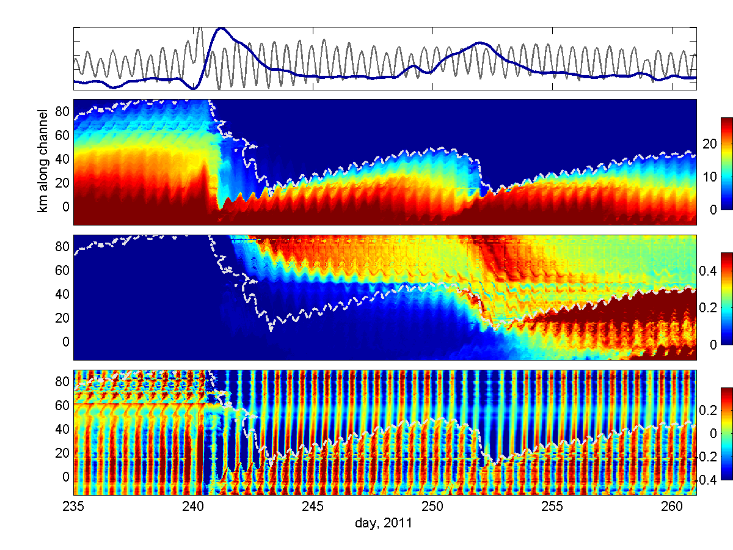
Salinity, river sediment, velocity
bottom salinity
susp. sed (river)
bottom velocity

Slide 10
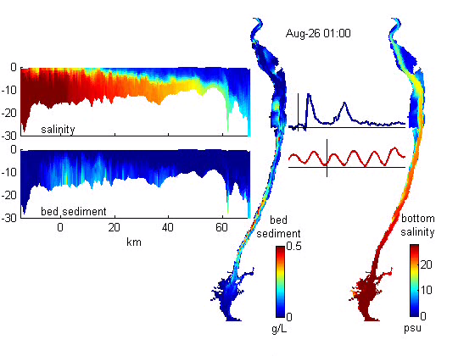
Salinity and Bed Sediment
discharge
tide

Slide 11
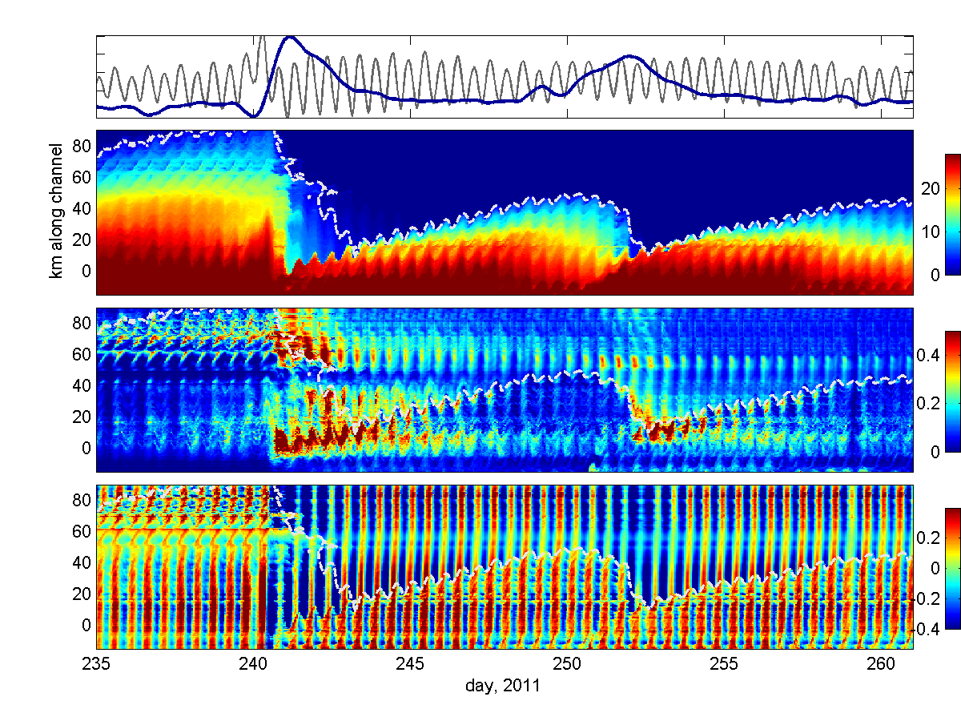
Salinity, bed sediment, velocity
bottom salinity
susp. sed (bed)
bottom velocity

Slide 12
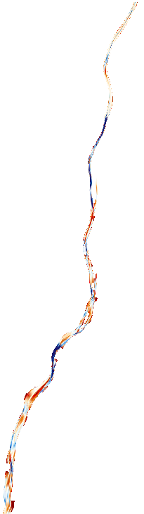
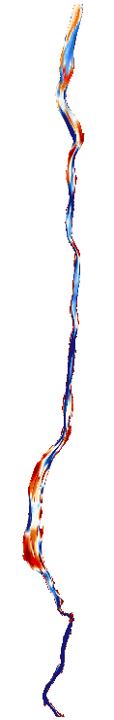
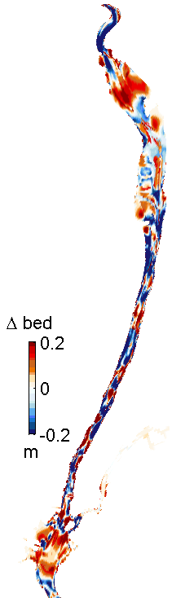
Bed changes
Sept. 16
60 km
Haverstraw channel
[Nitsche et al 2007]
220 km
Rondout
140 km
Croton
40 km
200 km
120 km
100 km
20 km
180 km
40 km
George Washington Bridge/
lower ETM
[Traykovski et al. 2004]
Catskill
Esopus
0 km
80 km
Upper Harbor
[inferred by Woodruff et al. 2001]
160 km

Slide 13
Summary
Salinity quickly pushed to lower estuary
but model response lags observations
Fluvial sediment mostly trapped upstream of salt
need observations in tidal freshwater
Estuarine bed sediment mobilized by high stresses, reduced stratification, dominates sediment signal
need near-bed observations
Deposition near frontal trapping zones consistent with past observations (GWB, Haverstraw, harbor)
need post-event survey of bed
Export to Harbor and beyond occurs mainly during second pulse (Hurricane Lee).
need better estimates of settling velocity
LANDSAT
Aug 31, 2011

Slide 15
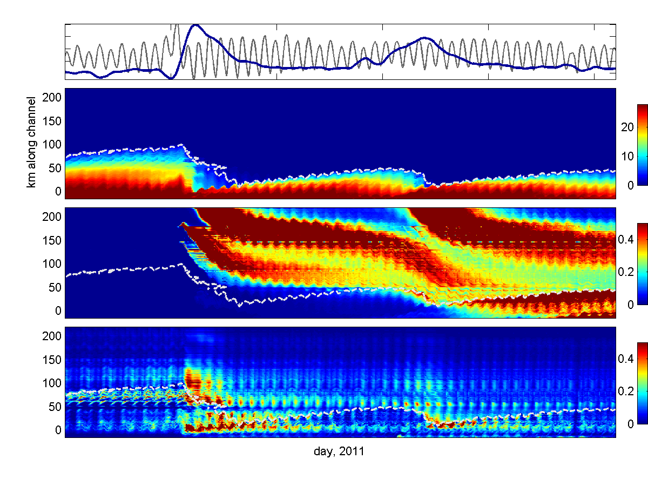
Salinity, river sediment, & bed sediment
bottom salinity
SSC (river)
SSC (bed)

