Slide 1
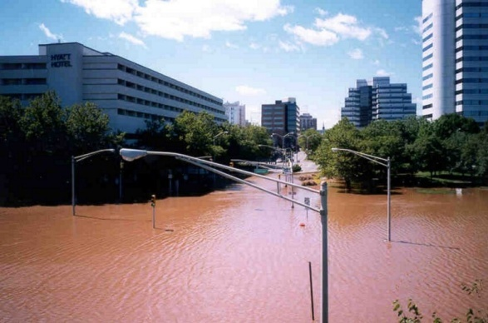
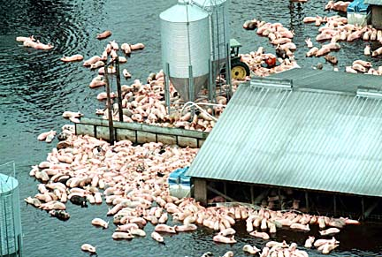
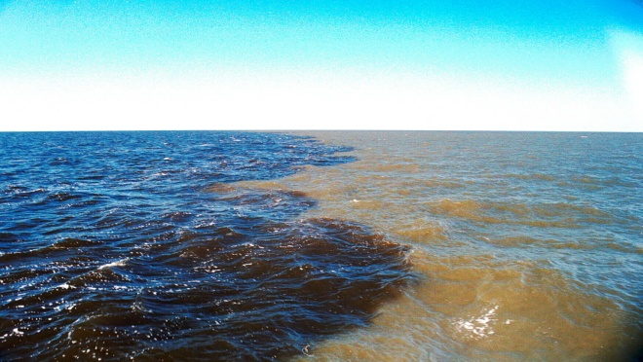
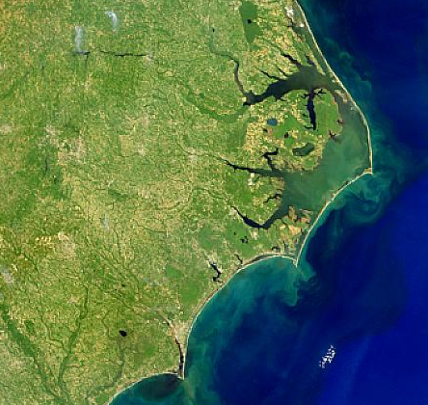
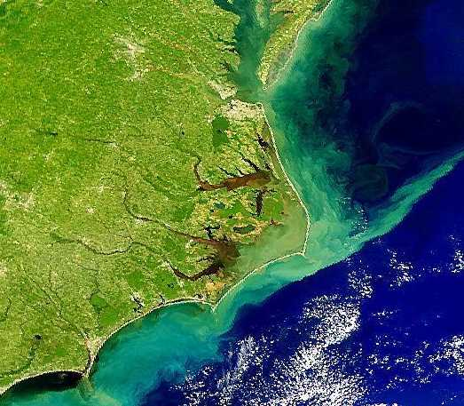
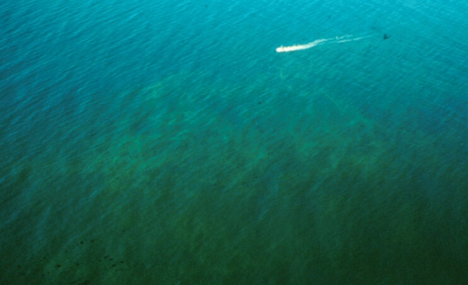
Hans Paerl, Joseph Crosswell, Nathan Hall, Alan Joyner, Benjamin Peierls and Karen Rossignol UNC-CH Inst. of Marine Sciences, Morehead City, NC www.marine.unc.edu.ims/Paerllab
Impacts of tropical cyclones on North Carolina coastal carbon and nitrogen dynamics: Implications for biogeochemical cycling and water quality in a stormier and warmer world

◉

◉
◉
◉


Slide 2

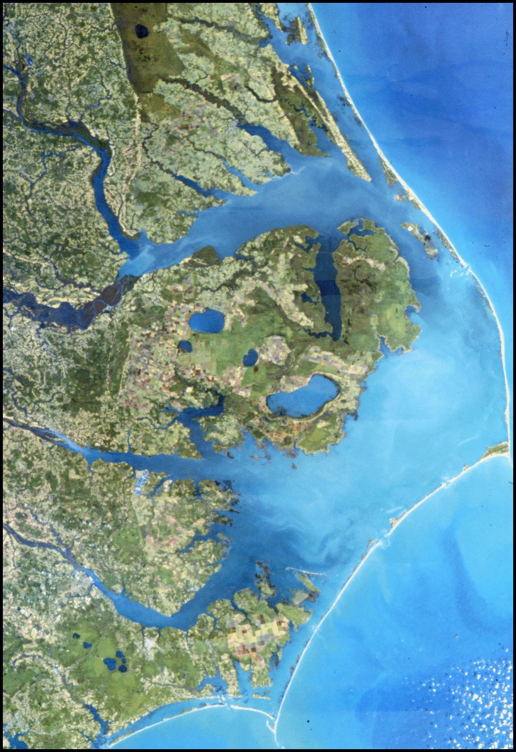
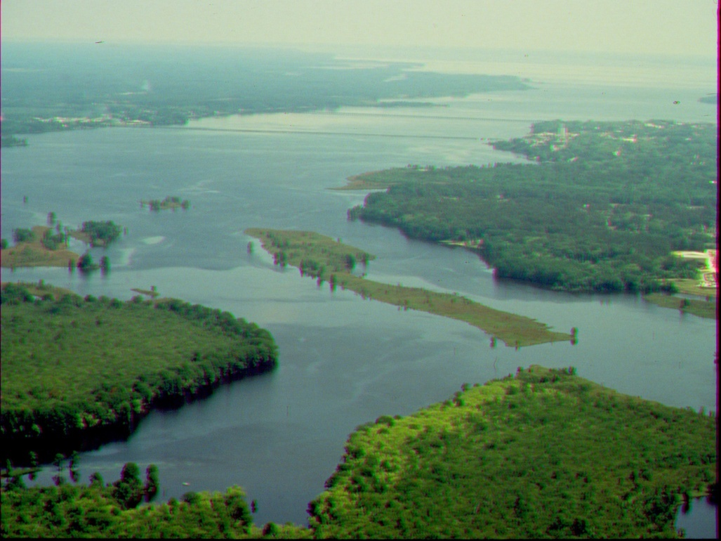
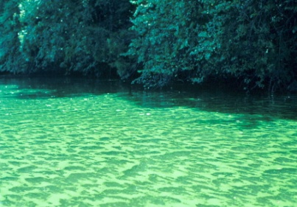
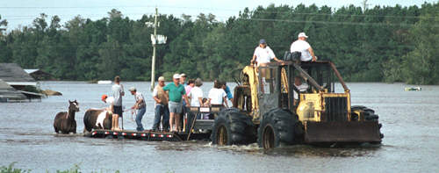
^{The Pamlico Sound System}
Second largest Estuary in US
Most important US SE fisheries nursery
• Drains over half of NC coastal plain • >40 years of Ag and urban expansion
accompanied by enhanced N and P loading
• Lagoonal, long residence time (∼ 1 Yr),
susceptible to eutrophication
• Increasing frequency of tropical cyclones
(10 in the past 12 years), and flooding

Slide 3
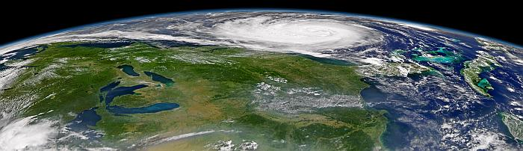

Assessing ecological impacts and responses of APES during a period of elevated Hurricane Activity
Hurricane Isabel, Sept., 2003

Slide 4
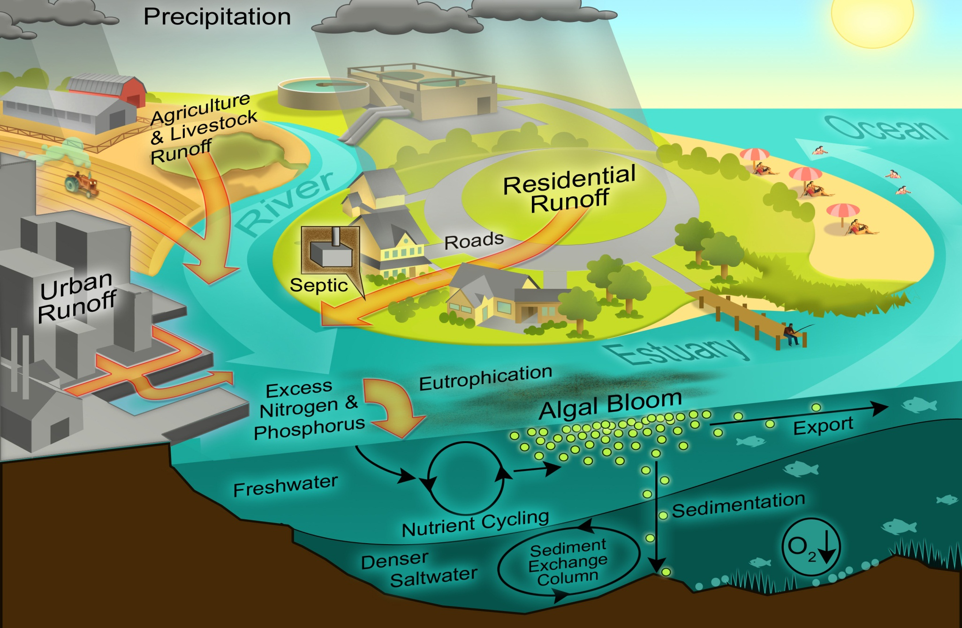
A major challenge: Interacting human and climatic perturbations Their impacts on estuarine and coastal water/habitat quality

Slide 5
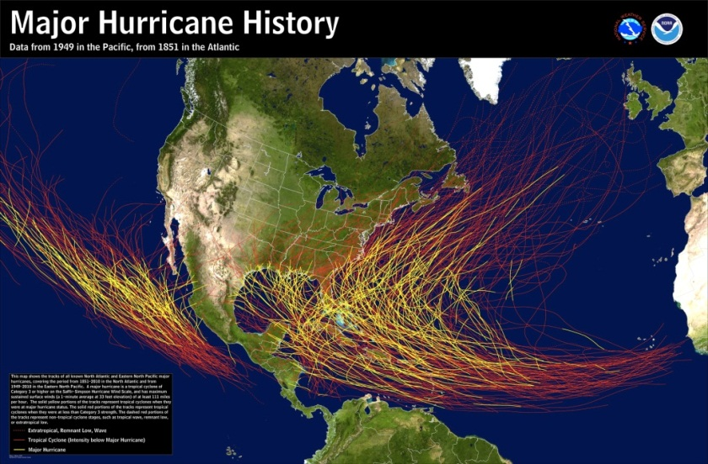
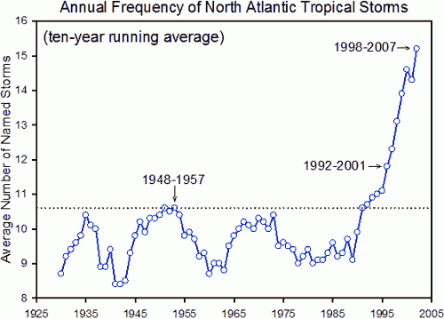
Why the concern about tropical cyclones?
Large Hydrologic perturbations
(lots of water, quickly, and persistent flooding in low-lying areas)
Increased Nutrient and other contaminant inputs
Changes in sediment dynamics (transport, deposition, resuspension)
Biotic alterations (water quality, habitat, food webs)
Reason for concern………
“We appear to be in a period of elevated tropical cyclone activity”
Webster et al. 2005, Emanuel 2005
Source: NOAA, Natl. Hurricane Center

Slide 6
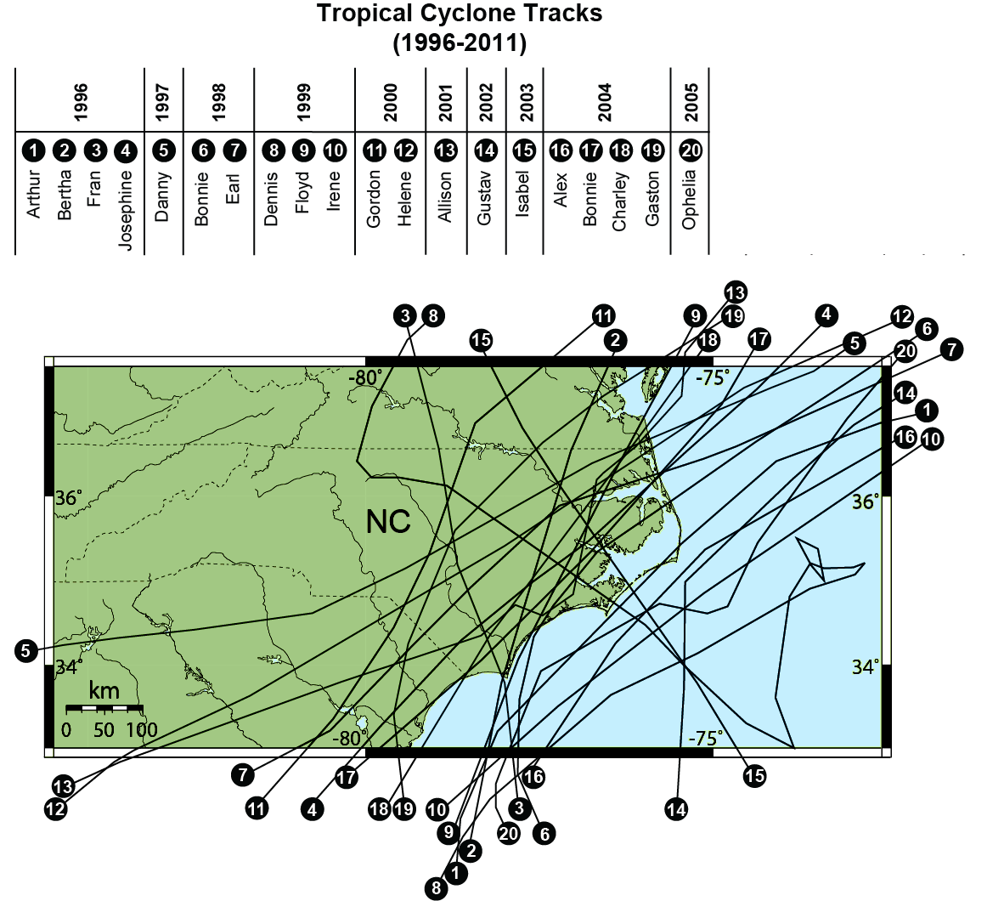
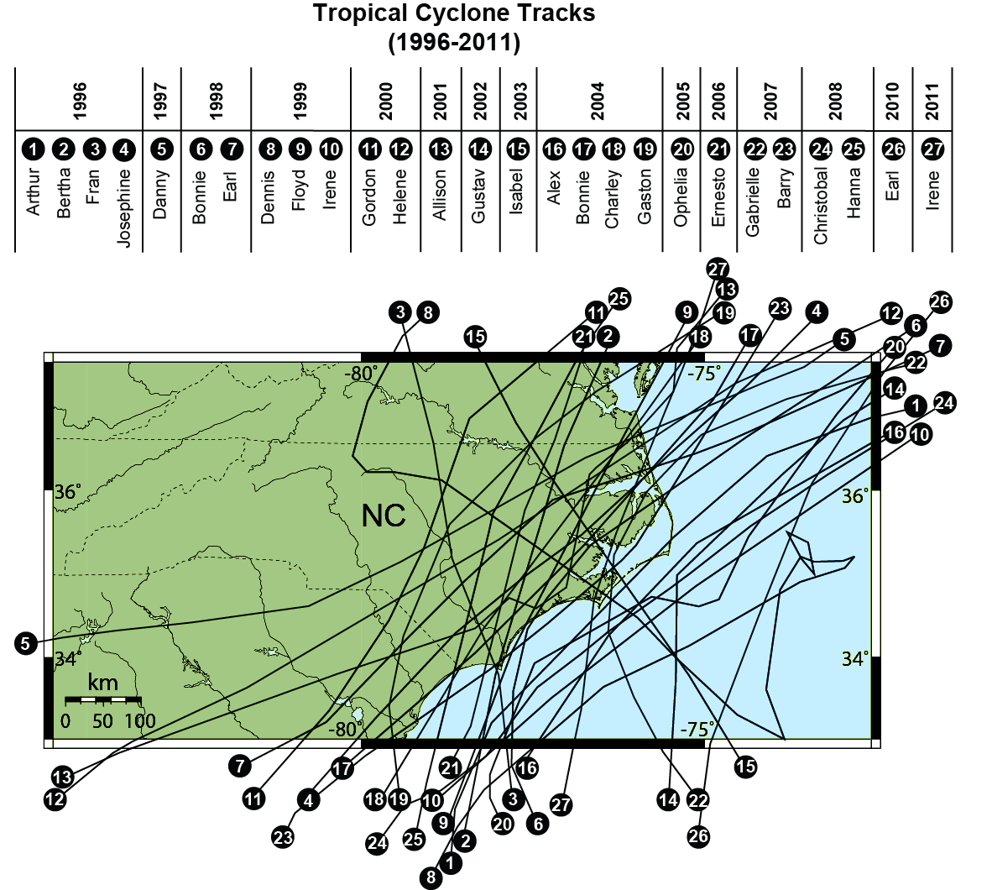
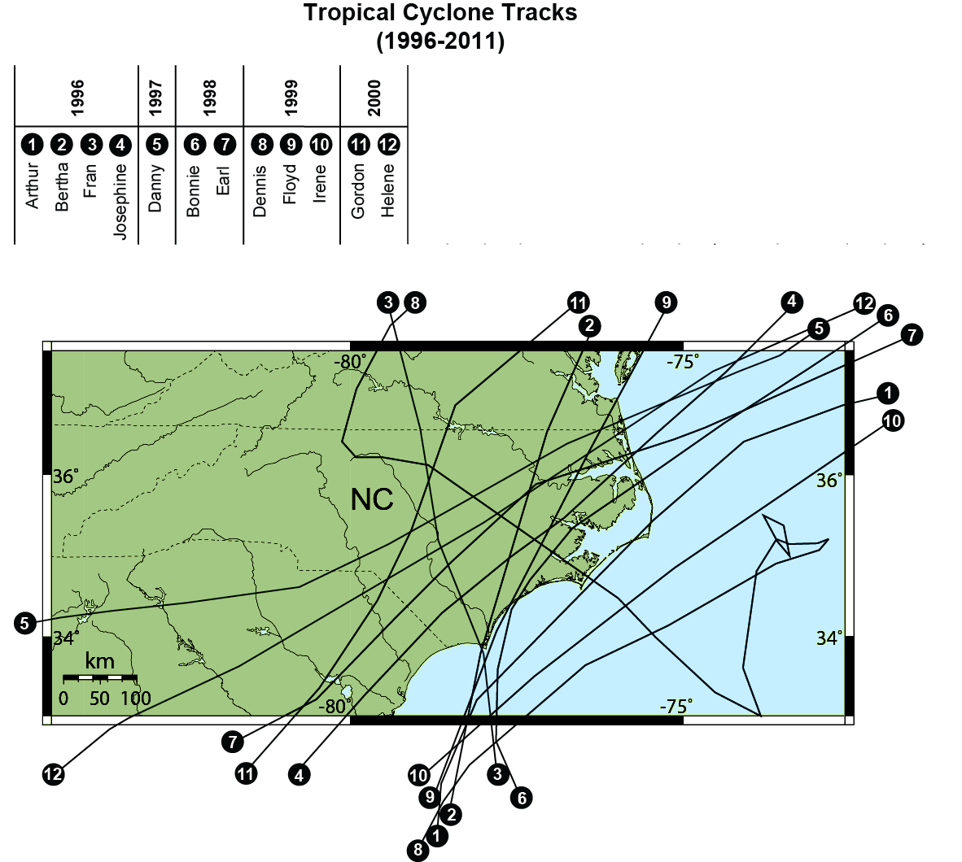

Slide 7
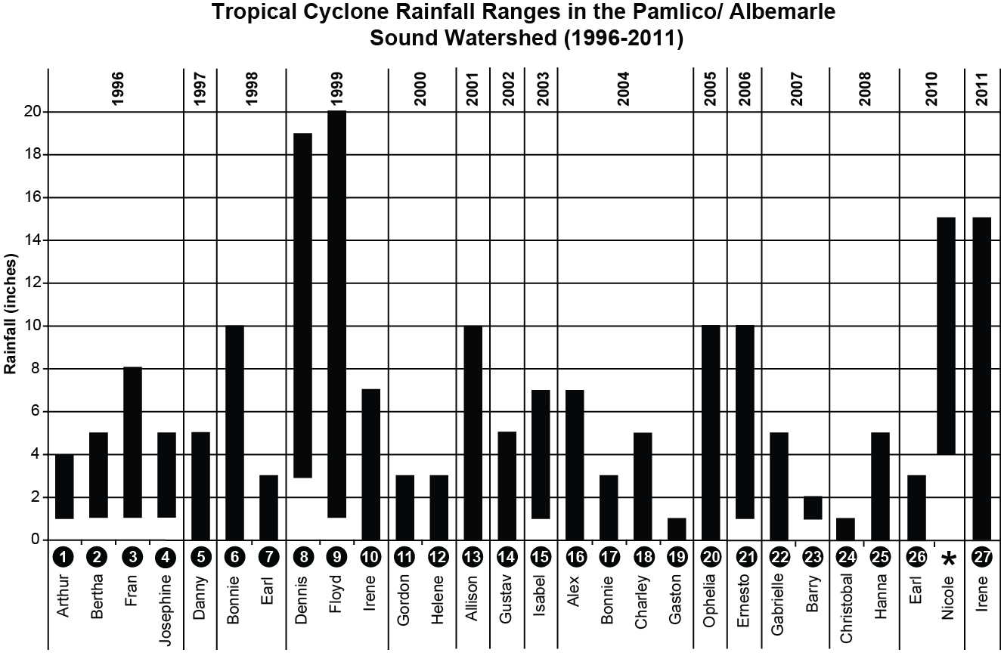

Slide 8
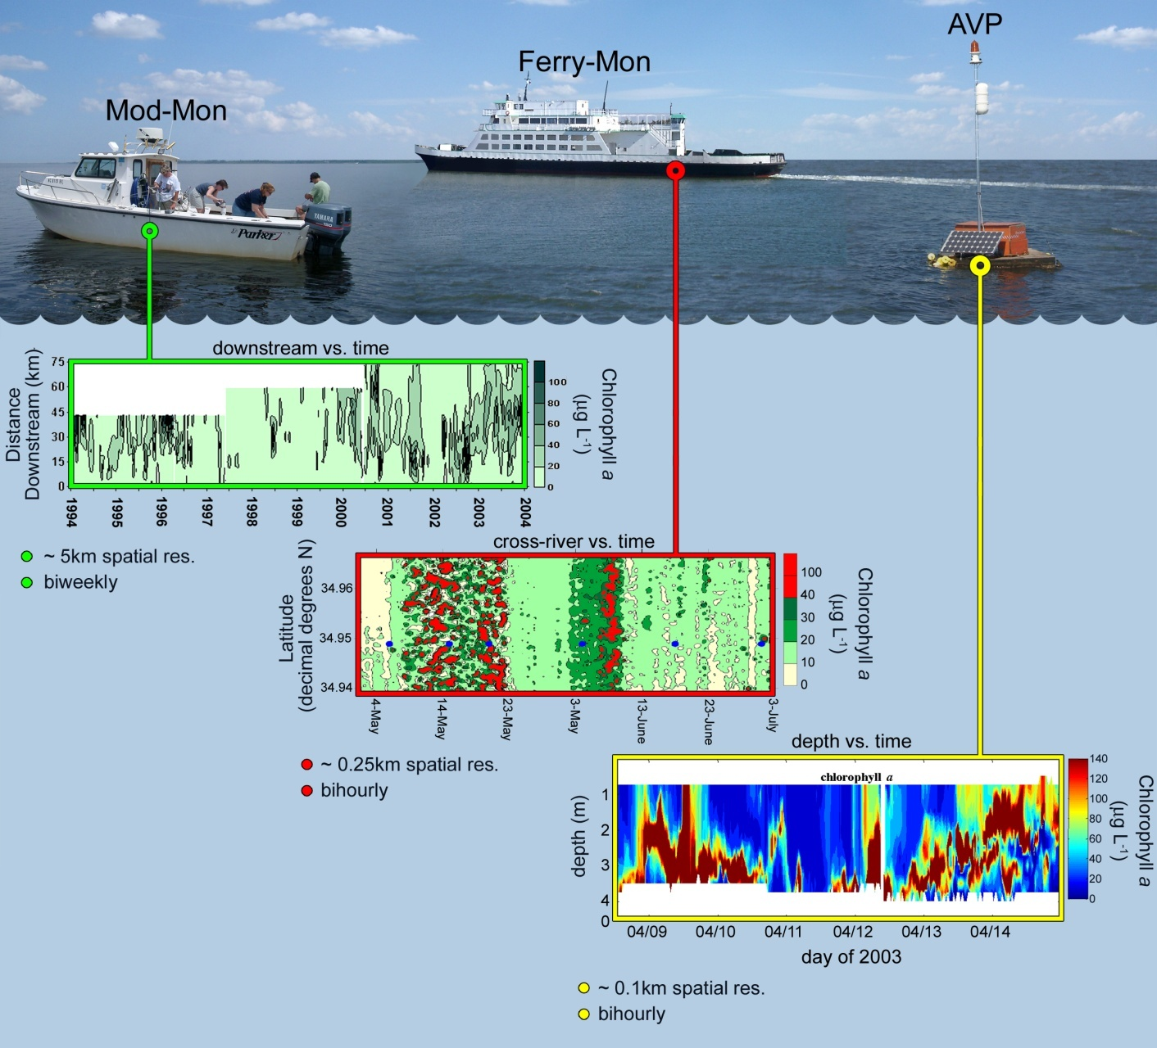
Assessing Ecosystem Impacts: Phytoplankton >80% of Primary Production,
and hence hence relevant indicator of biogeochemical and WQ changes
MONITORING PROGRAMS
ModMon: Since 1994
www.unc.edu/ims/neuse/modmon
FerryMon: Since 2000
www.ferrymon.org

Slide 9
Hydrology, N loading and phytoplankton production in the Neuse R. Estuary
Floyd
➔ ➔ ➔

Slide 10
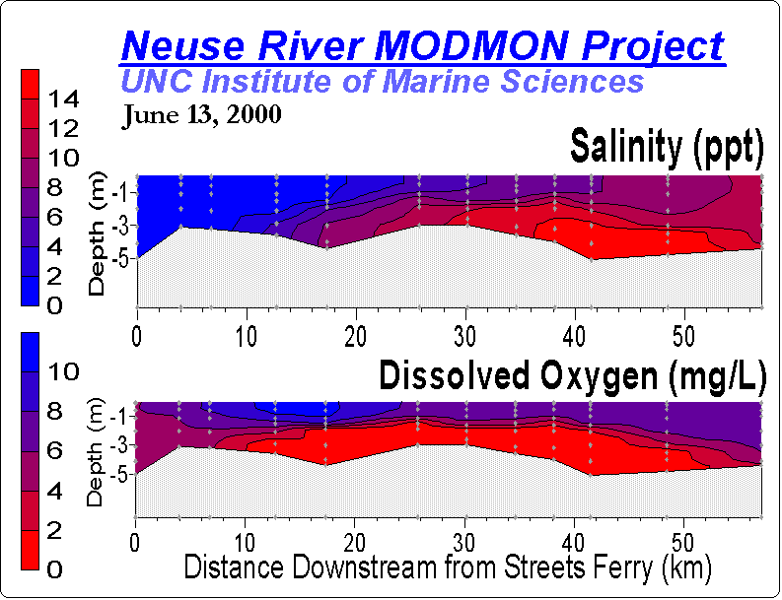
N-enhanced production, the linkage to Hypoxia in the Neuse R. Estuary www.marine.unc.edu/Paerllab

Slide 11
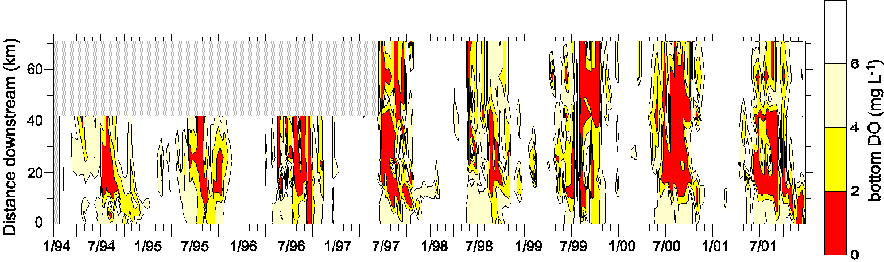
Linking hypoxia with fish kills in the Neuse River Estuary 1994-2001 Data Sources: ModMon Project & NC DENR-DWQ
Fish kill data base: http://www.esb.enr.state.nc.us:80/Fishkill/fishkillmain.htm

Slide 12
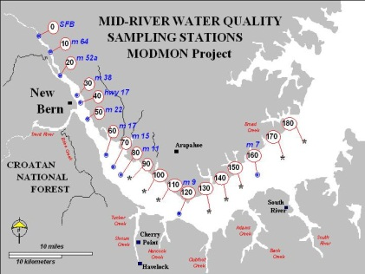
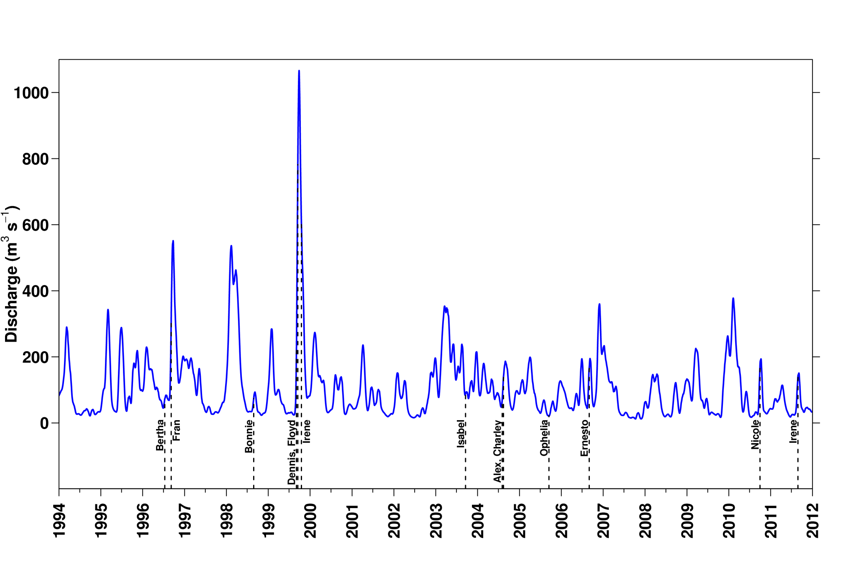
How large are these events?
Freshwater Discharge @ head of the estuary


Slide 13
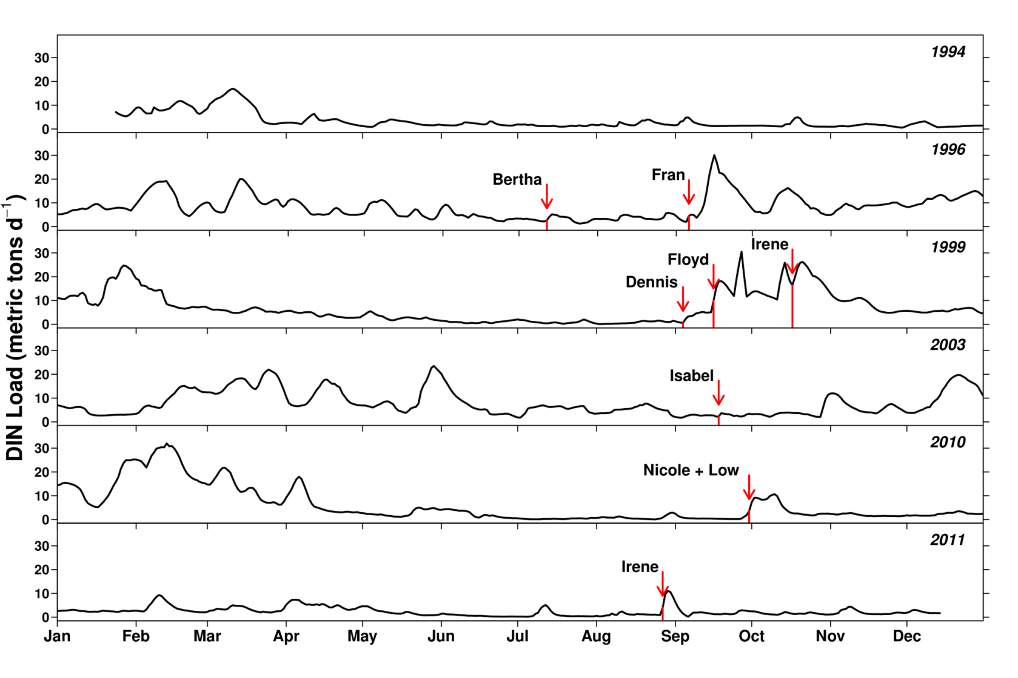

Nitrogen Loading to the Neuse R. Estuary: How important are tropical cyclones?
Drought year
Extreme drought year
Paerl et al. 2005,
2006; Peierls et al. 2012

Slide 14
Annual N and P loading vs. Influence of Precipitation Events

Slide 15
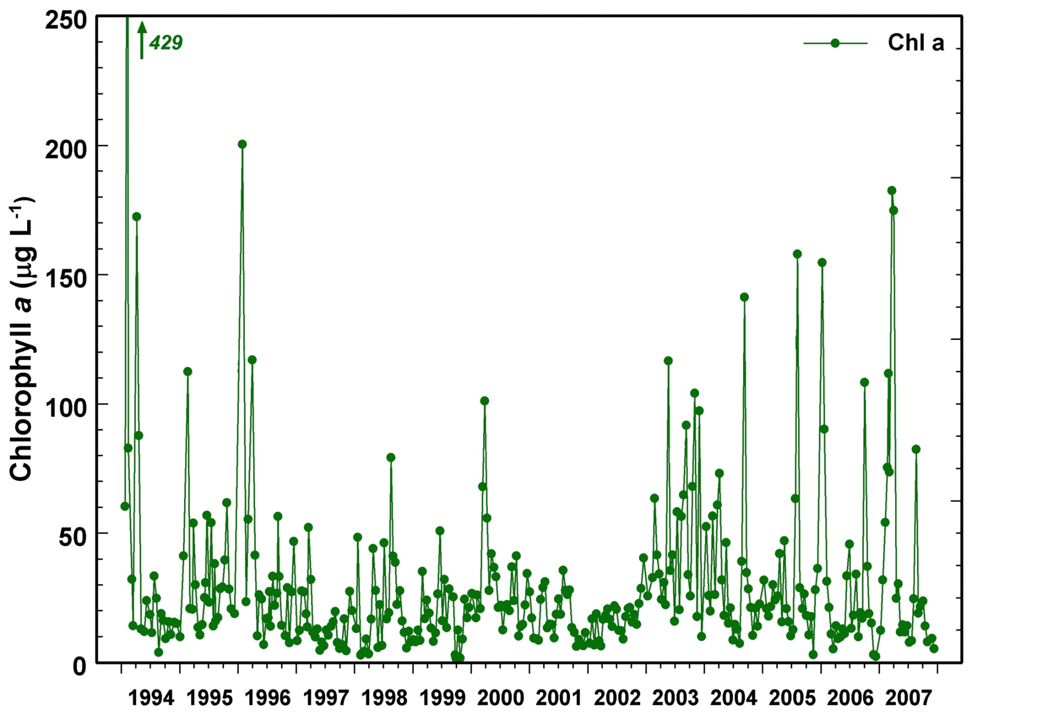
Major hurricanes/tropical storms & phytoplankton biomass (Chl a) responses
Fran
Dennis/Floyd
Isabel
Ernesto

Slide 16
Carbon inputs to the Neuse R. Estuary: Hurricane vs Non-hurricane conditions
POC Loading (External)
(metric tons C d⁻¹)
Primary Productivity
Loading (Internal)
(metric tons C d⁻¹)
180
600
160
External
Internal
500
140
120
400
100
300
80
60
200
40
100
20
0
0
0
Mean Daily Discharge
(m³ s⁻¹)
1200
1000
800
Paerl et al. 2006
600
400
200
0
2001
1996
1997
1998
1999
2000
2002
2003
2004

Slide 17
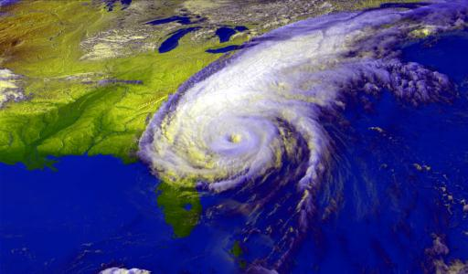
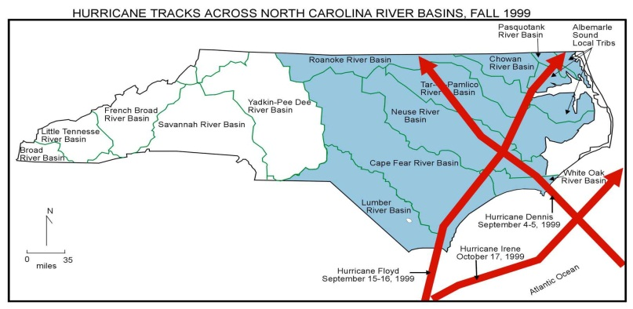
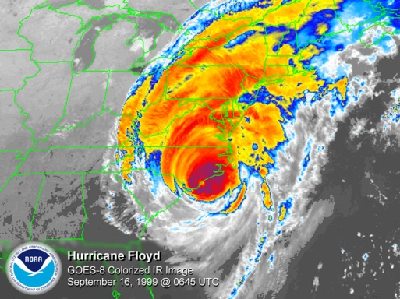
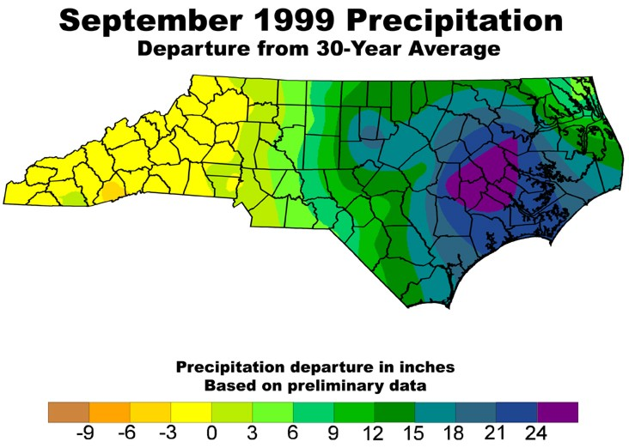
The Hurricanes of 1999: What Happened?
Dennis, 30 Aug., 1999
Floyd, 15 Sept., 1999
3 SS-scale 3 hurricanes (Dennis, Floyd & Irene) within 6 weeks
Record rainfalls in Pamlico Sound Basin.
50-500 year floods in PS watershed
PS Received annual water and N loads in about 1.5 months

Slide 18
Ecosystem Impacts: Hurricane Floyd, Sept. 1999
Pre-hurricane
Post-Floyd, September 23, 1999
Tar River
Neuse River
◉
“500 year flood event”: Bales 2003

Slide 19
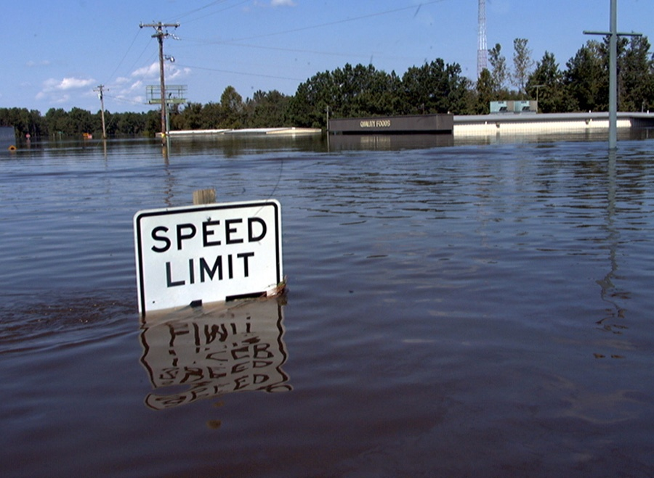
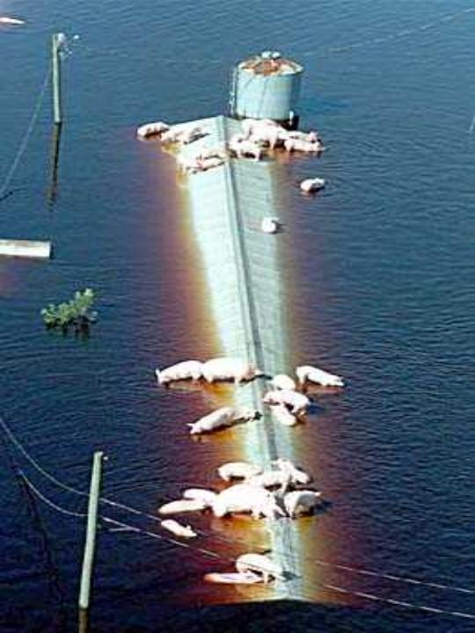
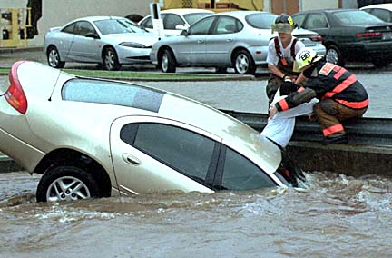
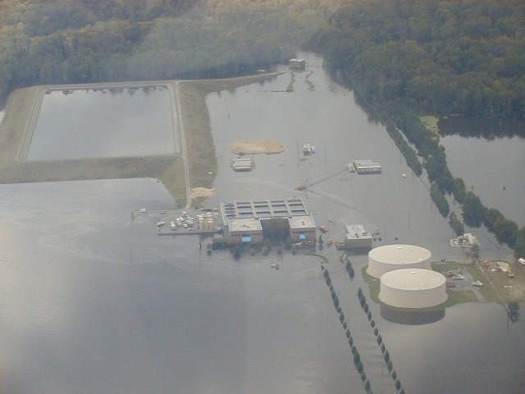
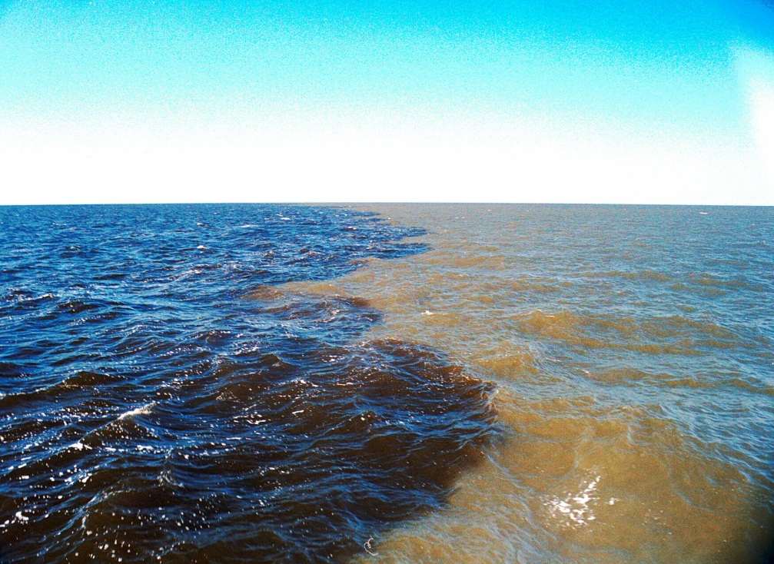
The Flood

Slide 20

Salinity and Chlorophyll a responses
to the floodwaters in Pamlico Sound
x

Slide 21
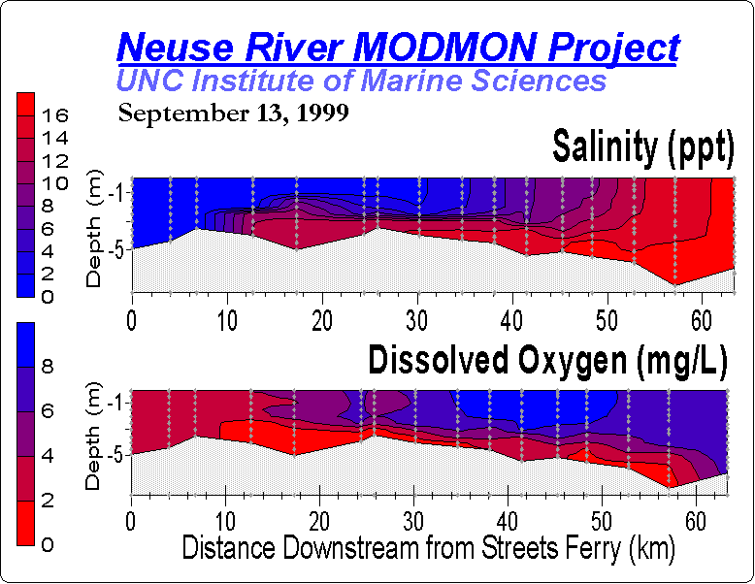
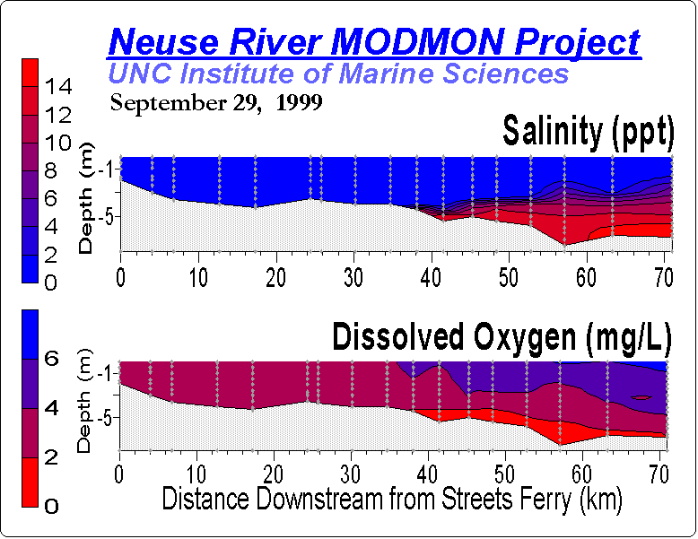

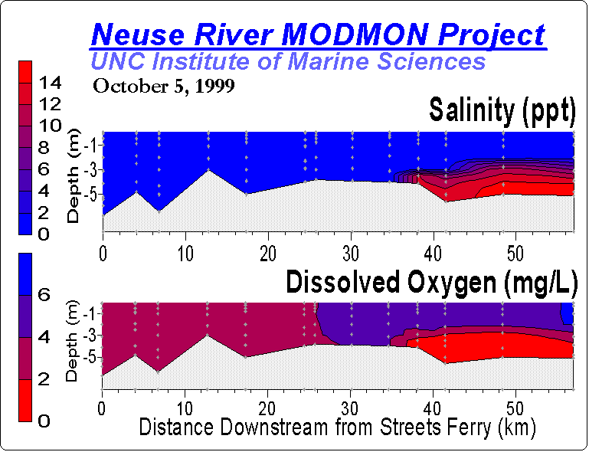
Influence of the
Floodwaters on salinity, DO and fish disease in Neuse R. Estuary &
Pamlico Sound
↑Before
↑ During
After↓
Eby et al. 2004

Slide 22
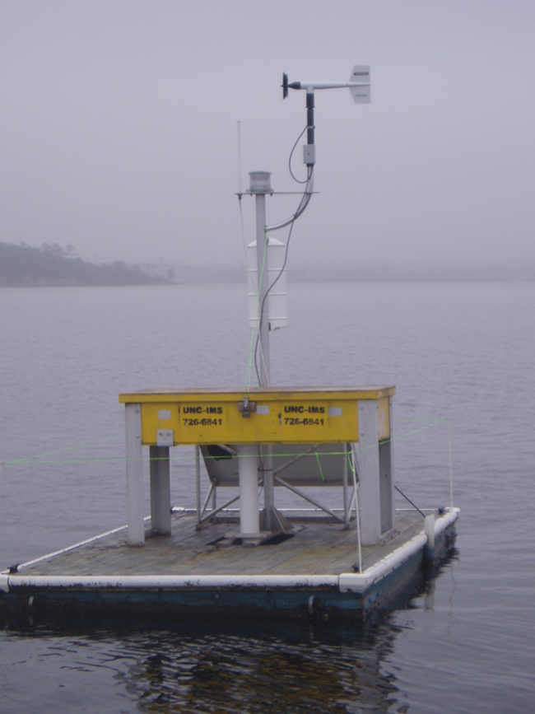
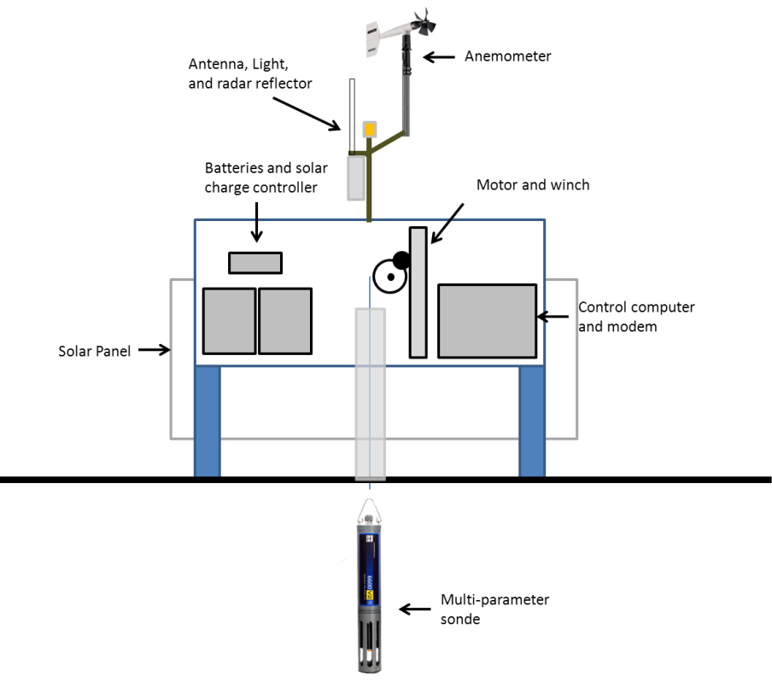
Acute effects of TC’s: Use of Autonomous Vertical Profiler (AVP)
Monitors water quality using profiling instrument
Instruments:
Water quality sonde
Sampling schedule:
Profiles every 30 min
Vertical resolution of 10 cm
Luettich Laboratory (Reynolds-Fleming et al., Estuaries, 2002; Whipple et al., Ocean Dynamics 2006)
Notes:
22

Slide 23
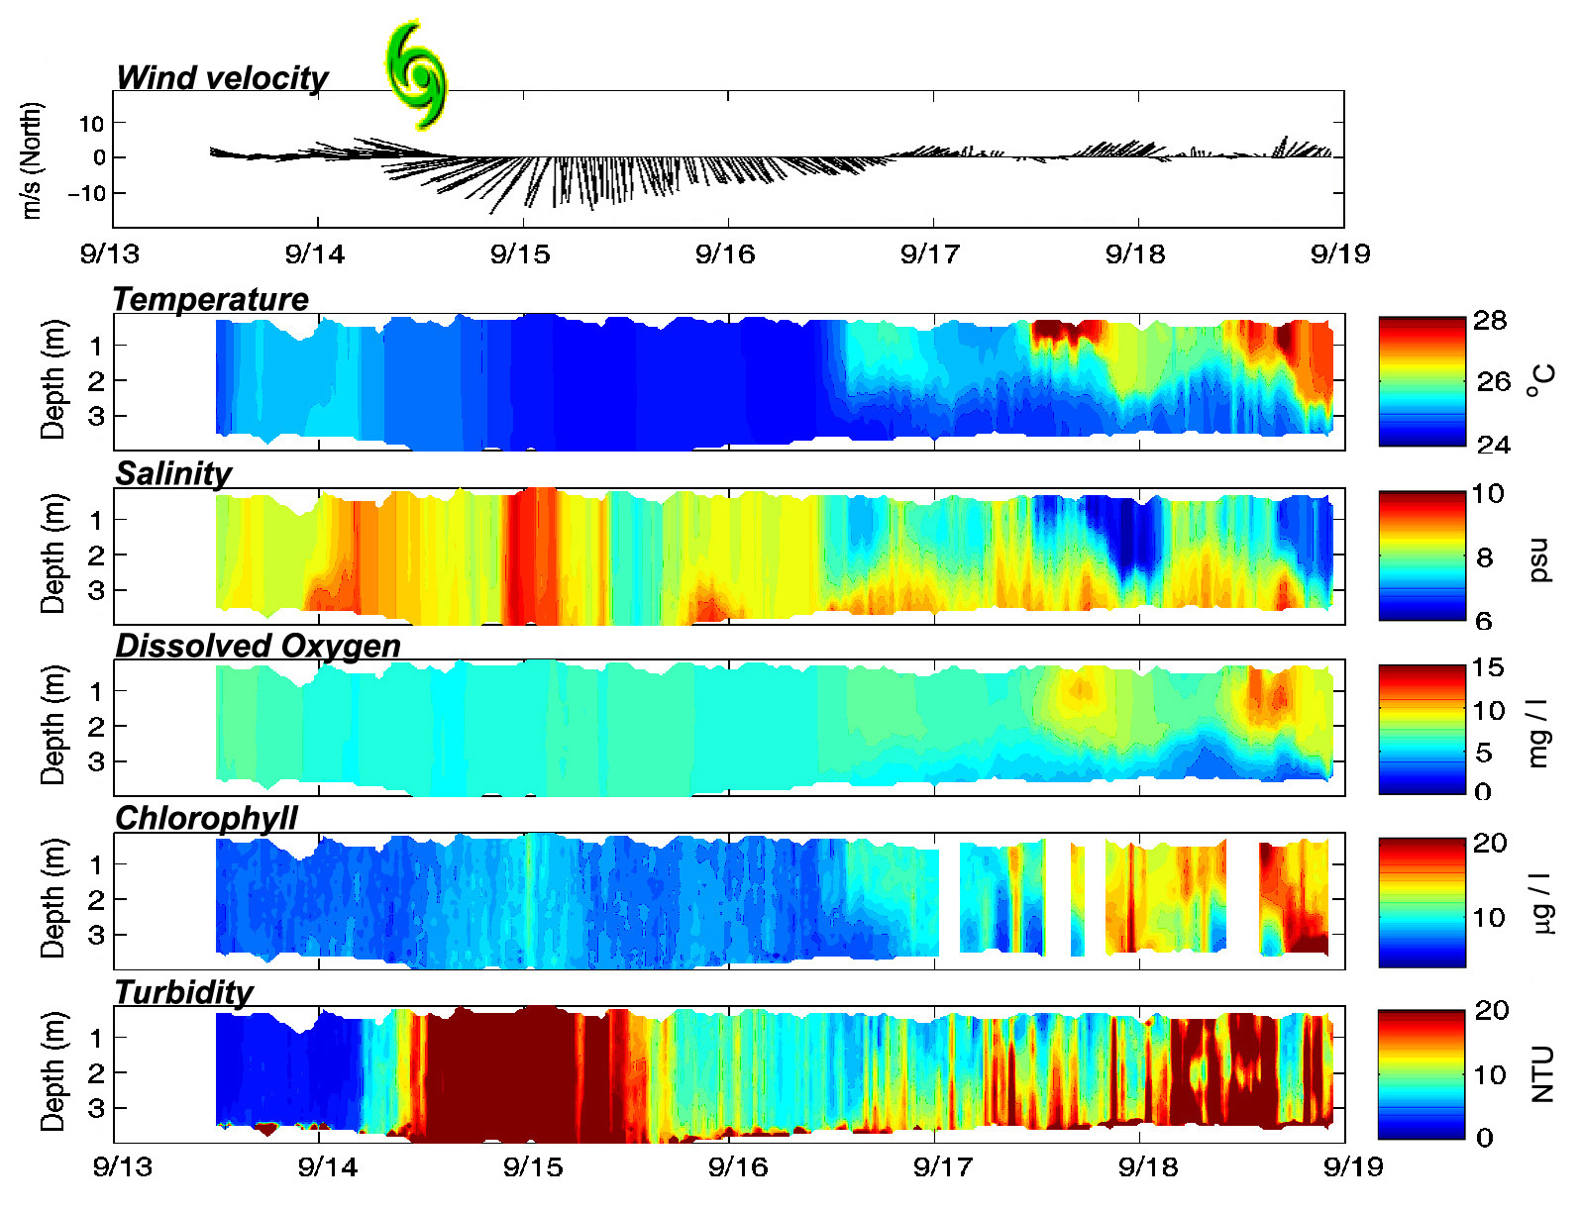
Short-term Impacts of Hurricane Ophelia, Sept. 2005
Post-storm blooms→
Storm mixing
23

Slide 24

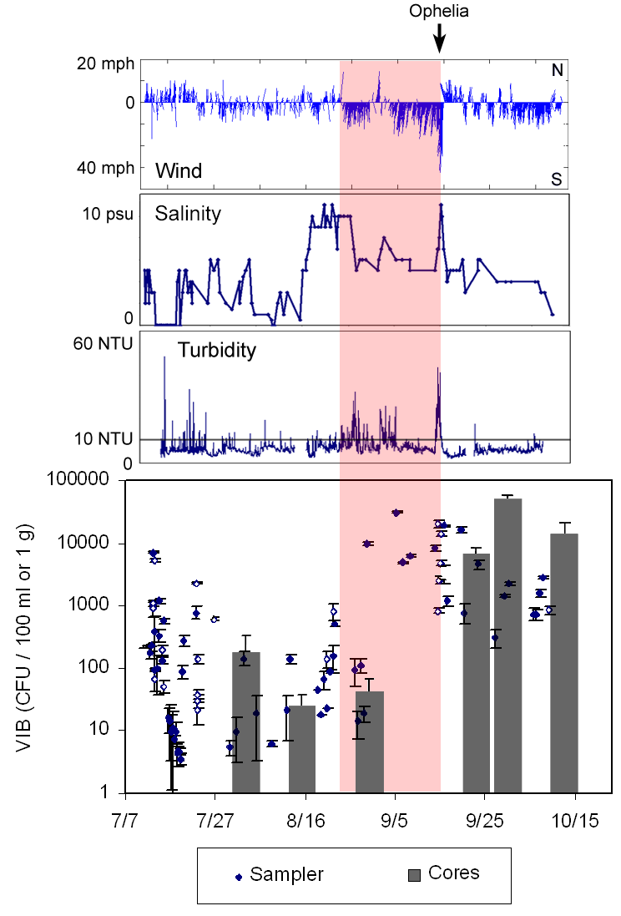
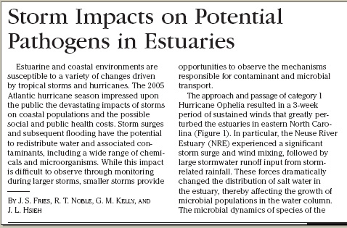
Ophelia Impacts on Vibrio
Large increase in water column concentrations during storm period
Sediment increases following storm (deposition) and high levels persist through the winter

Slide 25
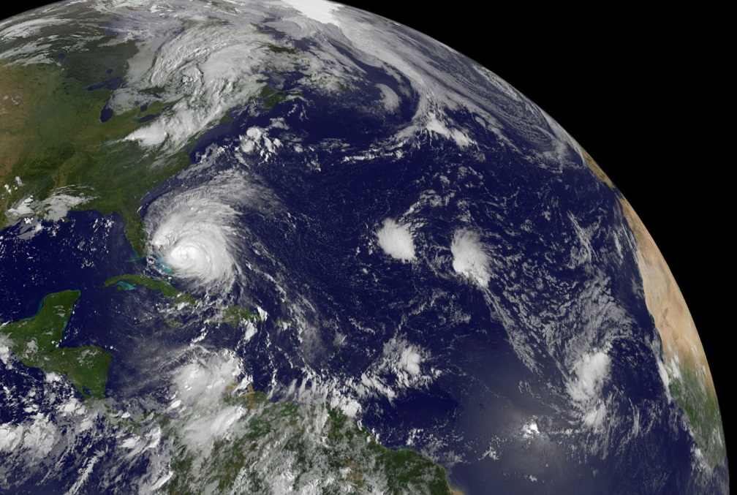
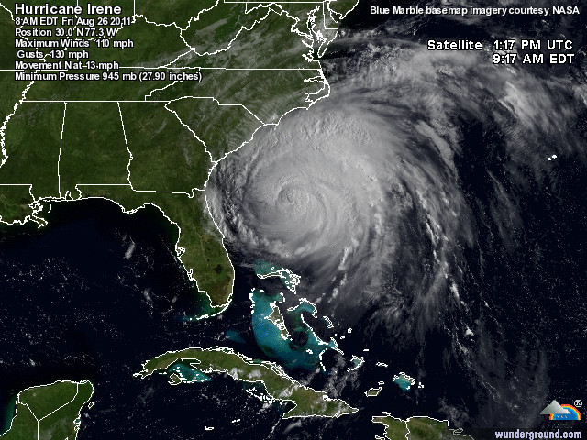
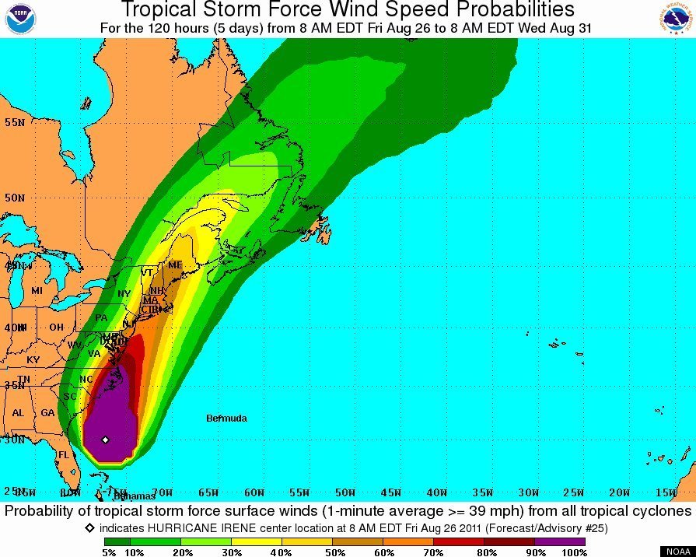
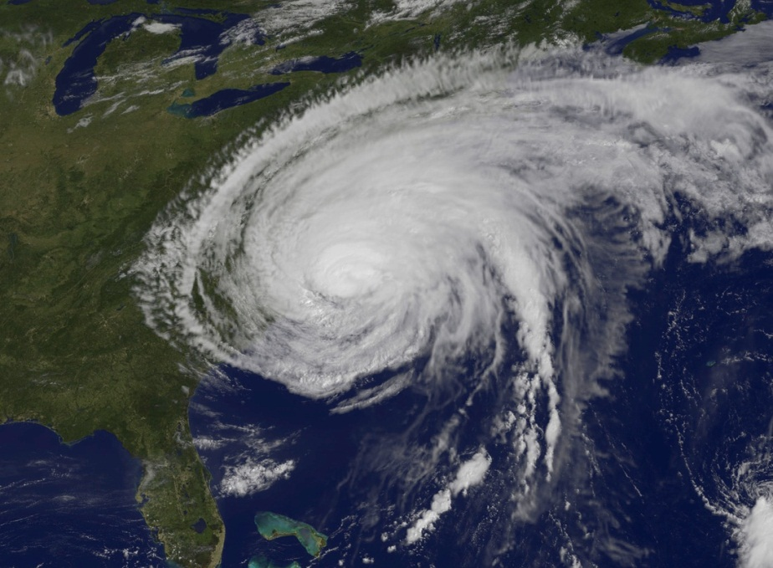
Hurricane/TS Irene: 24-27 August, 2011
➔
⬇

Slide 26
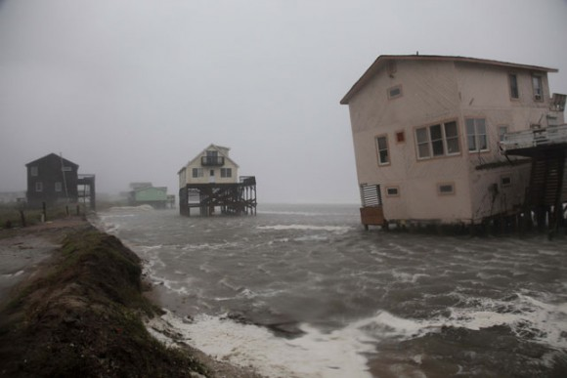
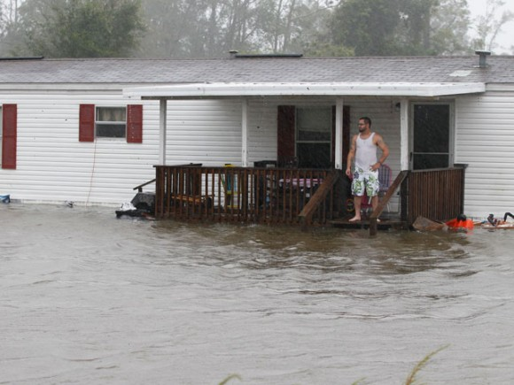
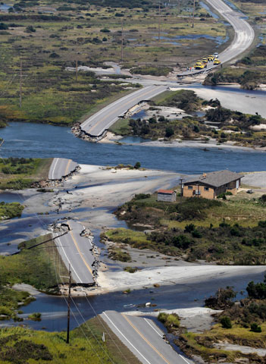
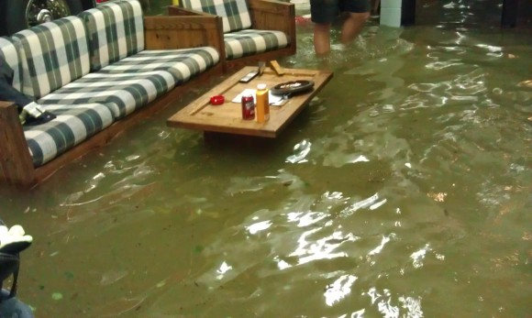
The event & aftermath in Eastern NC

Slide 27




And at home

Slide 28

Putting Irene in perspective: Primary production and algal biomass response

Slide 29

How about effects on CO₂ flux?
Notes:
*** the text below if from the MS but if you can pretty much just explain the arrows in the three panels above and it gives a good description. These salinity values shown in the top and bottom diagram are actual Modmon data so it is what the NRE from station 30 to station 180 looked like before and after Irene.
In stratified aquatic systems, respiration of OM below the pycnocline, in porewater and in sediments, frequently lead to high partial pressure of carbon dioxide (pCO₂) at depth, while surface waters are relatively less supersaturated. This subpycnocline CO₂ is not readily exchanged with the atmosphere, except during major wind-driven mixing events that lead to stratification breakdown and sediment resuspension. Major storm events can further elevate pCO₂ in nearshore waters by: 1) increasing riverine delivery of labile allochthonous OM and high pCO₂ freshwater after heavy rainfall, 2) increasing delivery of OM from wetlands after storm surge inundation ^{Hagy et al 2006} and 3) inhibiting the counterbalancing process of primary production due to high turbidity⁵ (Fig. 1). Rapid, large scale export of C from terrestrial, estuary and wetland sediments into estuarine waters has been observed after hurricane passage in numerous coastal systems, however the proportion of this C that is lost to the atmosphere rather than simply redistributed has yet to be quantified^{REFS}.

Slide 30




Flo-thru system for determining pCO₂
1
2
5
3
4
1. Sonde (YSI)
Chl flourescence (chl a)
Dissolved Oxygen (DO)
pH
Turbidity
4. NDIR CO₂
Analyzer (Licor)
xCO₂
2. TSG (Seabird)
3. Equilibrator
Temp
Pressure
5. Calibration gas standards
Salinity (SSS)
Temp (SST)
pCO₂
Air-water CO2 flux
(flux equations from Jiang et al. 2008)
Notes:
Water was simultaneously pumped from a thru-hull fitting located at the aft of a 8 m research vessel to a multiparameter sonde in a flow-thru cell and a thermosalino-graph followed by an air-water equilibration chamber. The sonde measured chlorophyll a fluorescence, dissolved oxygen (DO), pH and turbidity. The TSG recorded sea-surface salinity (SSS) and temperature and headspace temperature and pressure were also measured in the equilibrator.
As water flowed through the equilibrator, air was re-circulated in a counter current flow and the mole fraction of CO2 in the carrier gas was measured by a Licor NDIR CO2 analyzer. After the Licor was calibrated using two gas standards, xCO₂ was corrected for headspace pressure and temperature and presented as surface–water pCO₂. Air-water CO2 fluxes were then calculated using local wind speed and the surface water pCO2, temperature and salinity.

Slide 31

pCO₂ before and after Hurricane Irene
Notes:
Irene passed directly over our study area on August 27 2011. We made 1 survey before and 3 surveys after the hurricane. pCO2 in NRE and PS were slightly above the atmospheric level before the hurricane. We also conducted surveys in the Neuse and Pamlico earlier in August and if you average those surveys and the ones shown here for August 24th, the system was a small CO2 sink in early August. By contrast, after the hurricane pCO2 was the highest we had ever observed (57 surveys over 3 years) in either system and stayed that way for the next 2-3 weeks.
***You may want to point out that On our last survey on Sept 14th you can see that the southeastern portion of the Pamlico was a CO2 sink while the rest was a CO2 source.

Slide 32

Effects of Irene on CO₂ Flux in the Neuse River Estuary

Slide 33
Freshwater Discharge affects location of algal production & blooms (Chl a)
↓
↔
↑
↔
Flow: high↑, low↓, moderate↔

Slide 34


Phytoplankton group responses determined by HPLC-PDAS
Valdes-Weaver et al. 2006

Slide 35


Hydrology (flushing) interacts with temperature to determine diatom
(fucoxanthin) and cyanobacterial (zeaxanthin) dominance in Neuse R. Estuary






Diatoms like it cool
& fast 
Cyanos like it hot & slow 
Paerl et al. 2009; 2010

Slide 36


Chesapeake Bay: Remotely sensed chl-a from
SeaWiFS Aircraft Simulator (SAS II) during low flow (’95)
and high flow (’96) years
spring ’95, low flow
spring ’96, high flow
Courtesy L. Harding et al.

Slide 37
Chesapeake Bay CHEMTAX –
contrasting flow years
Low
Cyanos 
High
Diatoms 
Harding et al. 2009

Slide 38




A toxic dinoflagellate (Karlodinium) bloom following nutrient-enriched runoff from Tropical Storm Ernesto, Oct. 2006
Runoff associated with Ernesto contained nutrient load and set up strong salinity stratification
Favorable light and temperature conditions created ideal conditions for an algal bloom.
Near-surface stratification was favorable for motile dinoflagellates; Karlodinium prefers these conditions in fall.
Hall et al. 2008

Slide 39
Scaling up to the ecosystem
↓

Slide 40
Increased frequency of Atlantic hurricanes over the next 10-40 years? Webster et al., 2005
Multi-annual ecological effects and recovery?
Increase in “extremeness” and scales of storm events?
Emanuel 2005; Holland and Webster 2007

Slide 41

Implications and Conclusions
Nitrogen (and P) loading critical for determining eutrophication potential of estuaries
Interactions of nutrient loads and FW discharge flushing/residence time, salinity regime) determine community composition, food quality and quantity
Temperature plays an additional role
Therefore: Climatic changes (storms, Precip. Temp.) are important drivers of WQ and food web dynamics
Need: Adaptive nutrient management in response to hydrology and climatic events and changes

Slide 42
Some Adaptive Management Steps
Timing of N, P fertilizer applications is critical. Apply when use/retention is greatest and losses are minimal. Apply at “agronomic rates”. Makes $$ sense as well!!
Use no-till practices where feasible. Increase widths of riperian vegetative “buffers”. 100 ft is more than twice as effective as 50ft.
Minimize ditching, and increase water retention of Ag, urban and industrial runoff (enhances N/P cycling, denitrification).
Recycle nutrients locally in crops for animal feed.
Minimize sediment losses (Seds. are slow release N &P sources).

Slide 43





Coastal Indicators as Management Tools in Response to human and climatic Change
82667701
Special Thanks to:
Burke Hales
Larry Harding
Alan Joyner
Jeremy Braddy
Rick Luettich and crew
Michael Wetz
http://www.unc.edu/ims/paerllab/

Slide 44



MA Indicators and Remote Sensing
FerryMon Ground Truthing Routes
August 2004 Flight Paths NASA / EPA Modified U2 Aircraft
Notes:
The U.S. EPA, in cooperation with NASA, NOAA and the University of North Carolina, has acquired AVIRIS hyperspectral data for the Pamlico Sound in North Carolina on May 15, 2002.
This flight successfully identified and quantified Dinoflagellate bloom in Neuse and Pamlico Sound.
A second mission was flown on 18 August 2004, due in large part to the availability of the FerryMon platform for ground truthing.
The ER-2 typically operates at altitudes around 20km, above 95 percent of the earth's atmosphere, using the AVIRIS -- Airborne Visible and Infrared Imaging Spectrometer.

Slide 45

← Pamlico Sound →
Tester et al. 2003

Slide 46



How “unusual” are the 90’s-00’s?
Past 6 decades
However: the past 2 decades have been “busy”

