Slide 1
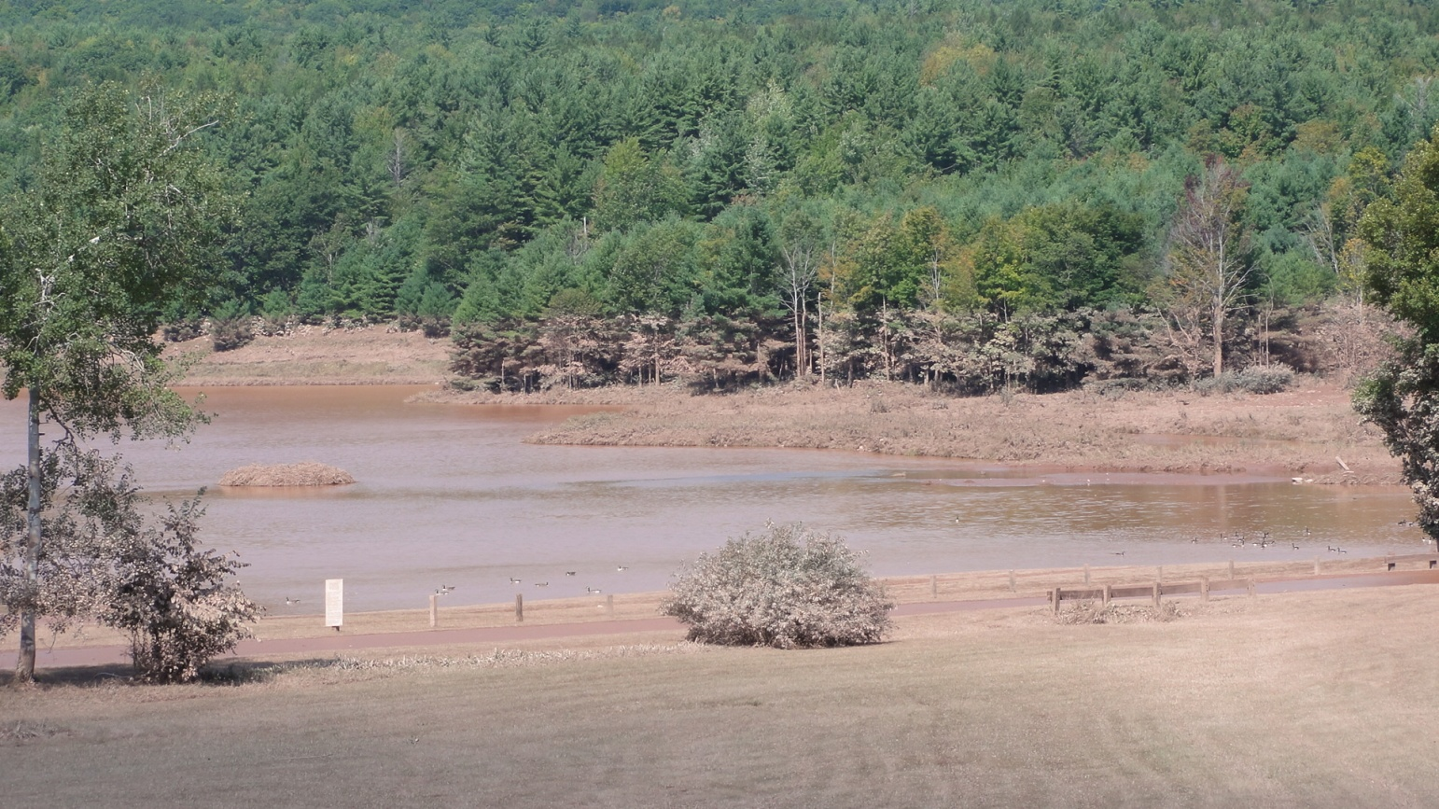


Meteorological Factors that Resulted in Extreme Rainfall During Tropical Storm Irene and the Remnants of Tropical Storm Lee
Photo by Tim Scrom of NWS - Lake near Hensonville, Greene County
Stephen N. DiRienzo
NOAA/NWS Weather Forecast Office, Albany, NY

Slide 2
Outline - Irene
Overview of Irene and extreme rainfall
Investigate key factors that contributed to enhanced rainfall in eastern Catskill basins
Role of upslope flow, steeply sloped frontogenesis and extra-tropical transition in heavy rainfall
Utilizing anomalies to assess heavy rainfall potential
Short Duration Event (Rain fell in 9-12 hours)

Slide 3
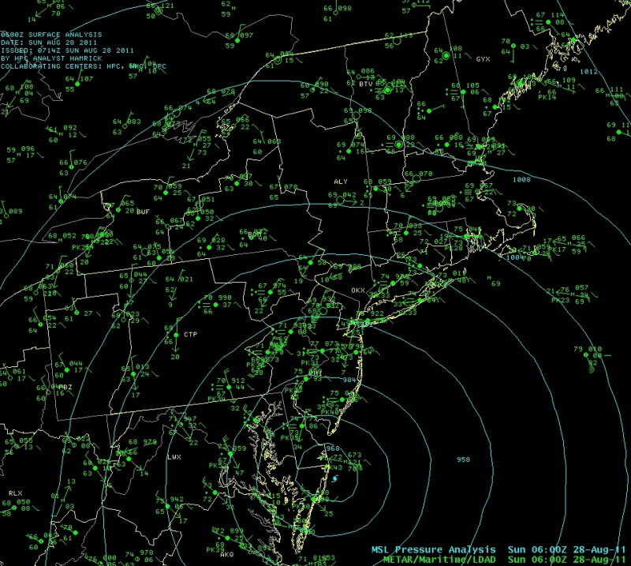
Surface Pressure Shows Track of Irene

Slide 4
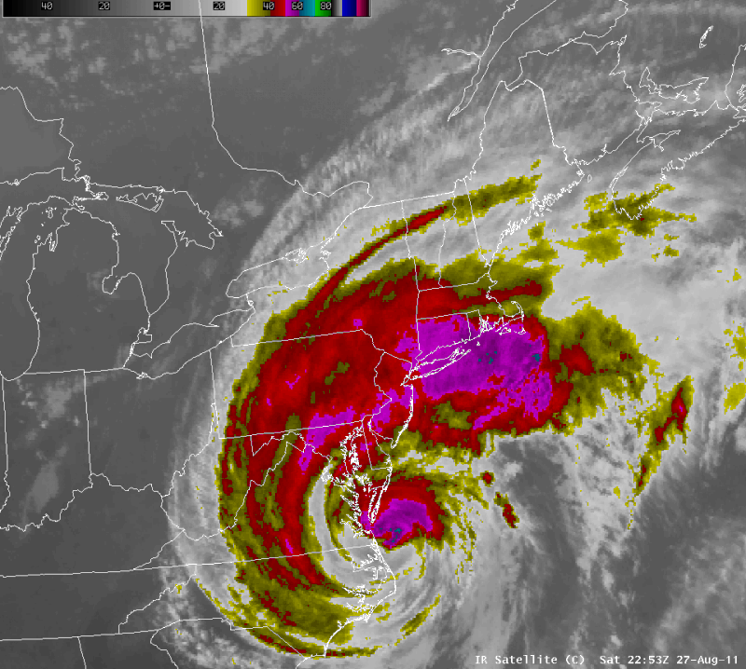
Infrared Satellite Loop of Irene
6:53 PM Sat Aug 27 -2:55 PM Sun Aug 28

Slide 5
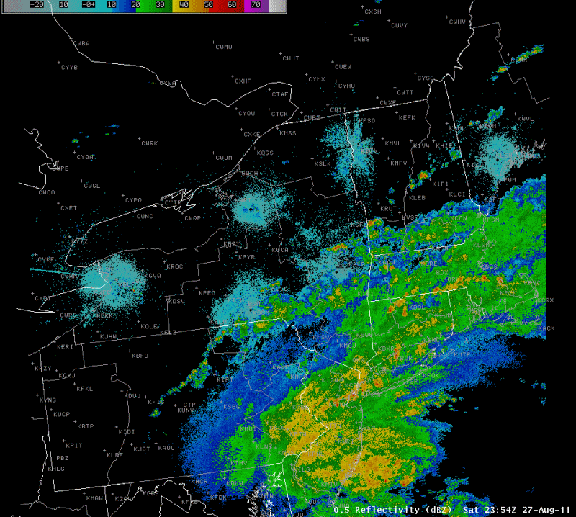
24 Hour Radar Loop of Irene
7:54 PM Sat Aug 27 -7:54 PM Sun Aug 28

Slide 6
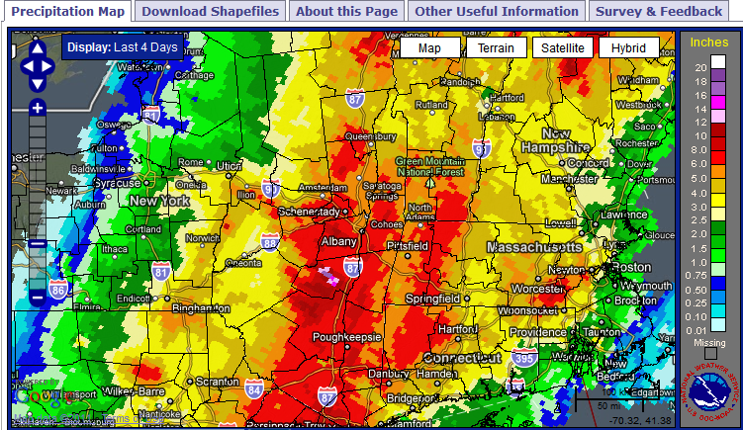
Tropical Storm Irene Produced Extreme Rainfall Across Eastern New York and Western New England 28 August 2011

Slide 7
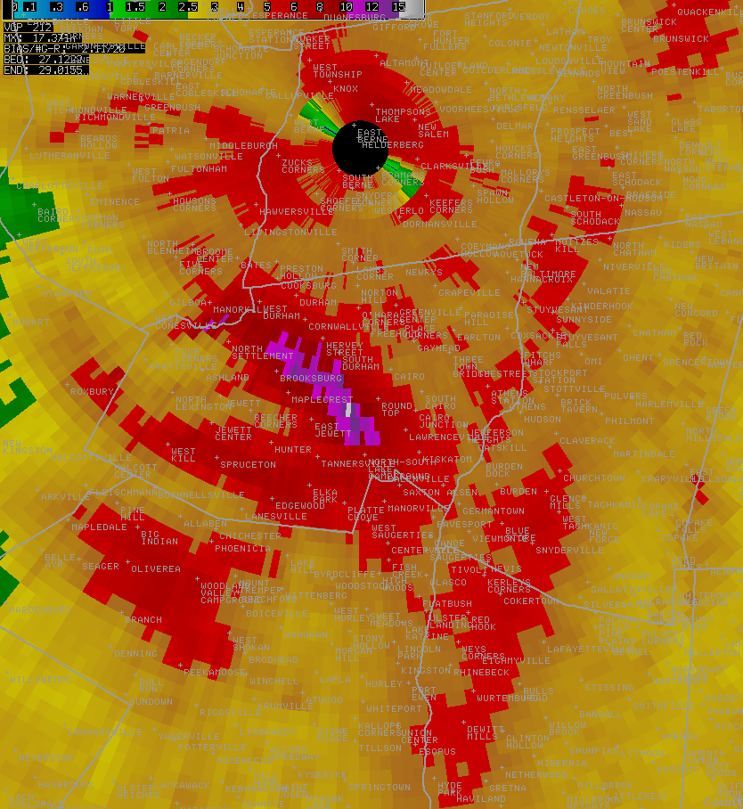
  One-day rainfall totals were between 3 to 6 inches in many locations
  A maximum area of 9 to 18 inches fell across portions of the eastern Catskill River basins, including the Schoharie Creek according to the KENX radar
Max Rainfall

Slide 8
Observations and Reports
Ground Truth is Essential to Our Warning Process
Automated Observation Stations
-Don’t measure snow and ice
River and Rain Gauge Networks
-Critical; Partner supported (USGS, State Agencies, Private Companies, etc.)
911 Centers, EOCs, DOTs
-Provide warning critical observations and verifying reports
Cooperative Observers
-Volunteers trained to report daily climate data such as max/min temperature and rainfall
SKYWARN
-Volunteers trained in reporting severe weather to the National Weather Service
– Amateur Radio Operators included
CoCoRaHS
-Community based observers who report rain, hail and snowfall amounts on a daily and as needed basis.
* Missing ground truth due to communication outages.

Slide 9
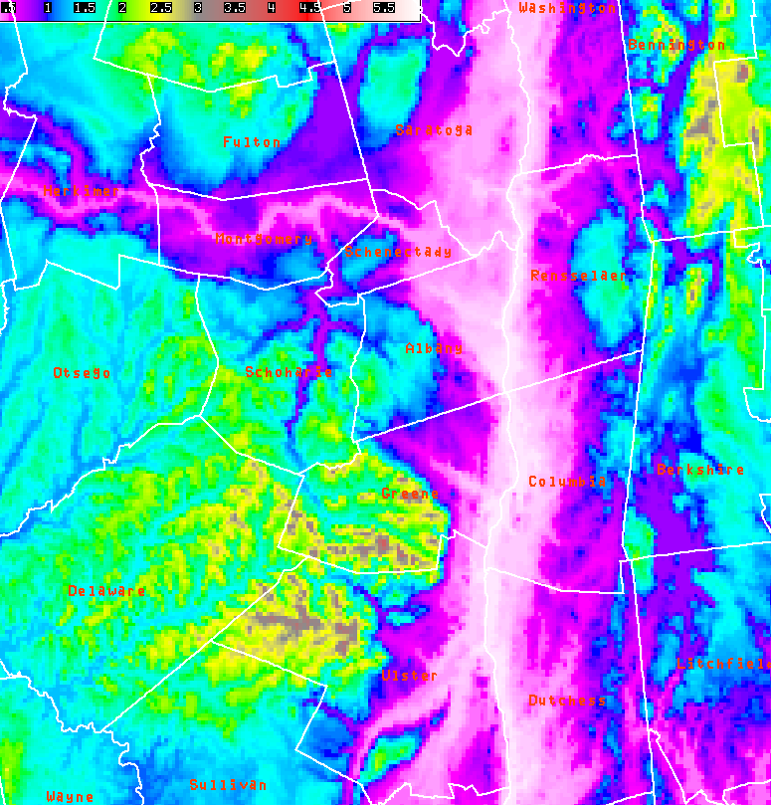
  Enhanced upslope flow into northeast Catskills contributed to extreme rainfall
  Northeast winds of 45 to 55 knots oriented perpendicular to escarpment
  Dramatic elevation rise of 900 meters over a short distance
Strong Northeast Wind
Upslope Enhancement

Slide 10
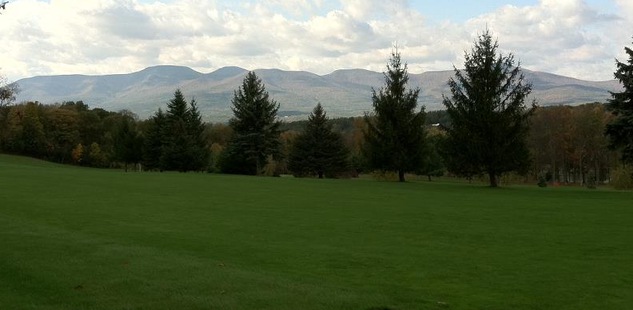
Schematic of Upslope Enhancement
Vigorous ascent of air parcels due to wind intersecting steep terrain
Wind flow

Slide 11
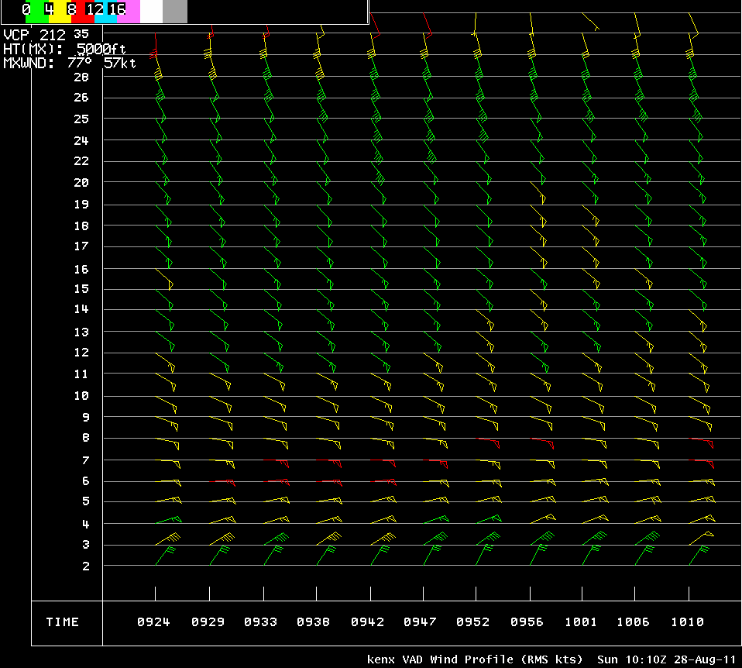
  Vertical Wind Profile from the Albany County radar shows strong and persistent Northeast winds in the low levels of the atmosphere
Strong Northeast Winds
Vertical Wind Profile 0924 to 1010 UTC

Slide 12
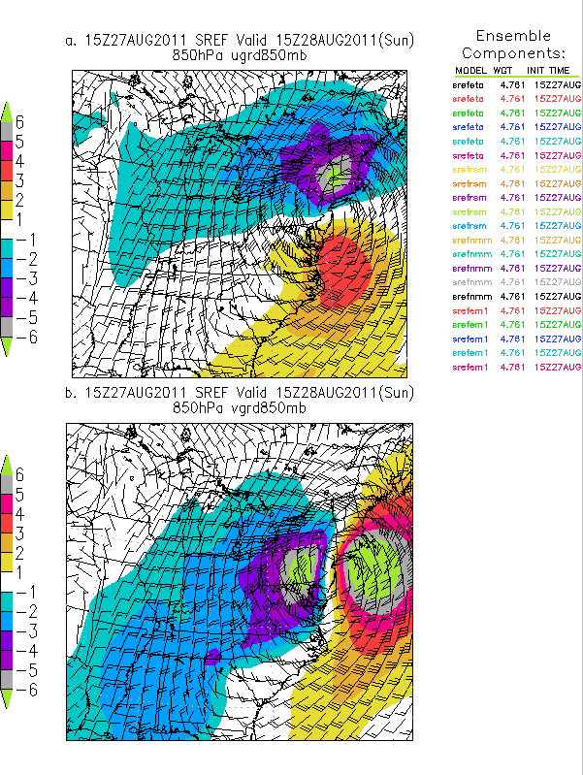
  Short Range Ensemble Forecast (SREF) model shows easterly wind component anomaly of >6 SD pointed toward the eastern Catskills
  Southerly wind component anomaly of >6 SD in southern New England

Slide 13
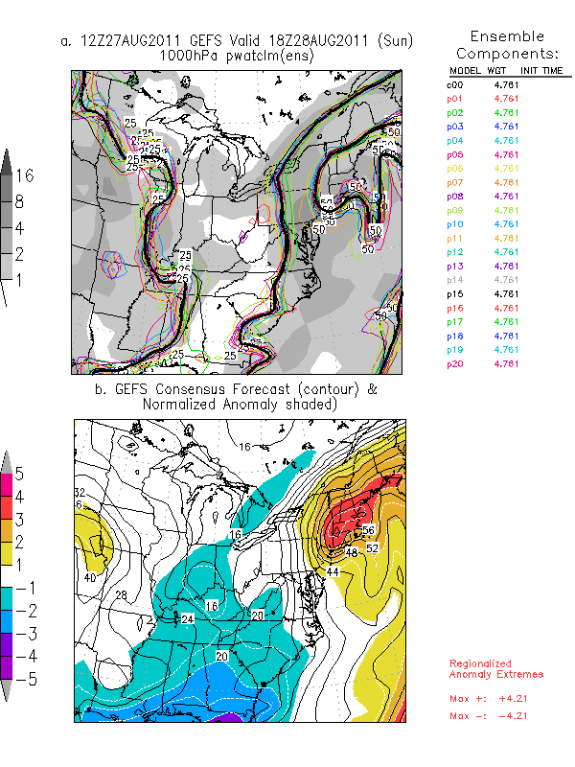
  Global Ensemble Forecast System (GEFS) precipitable water anomaly an impressive +2 to +3 SD above August norm
  Indicative of tropical moisture

Slide 14
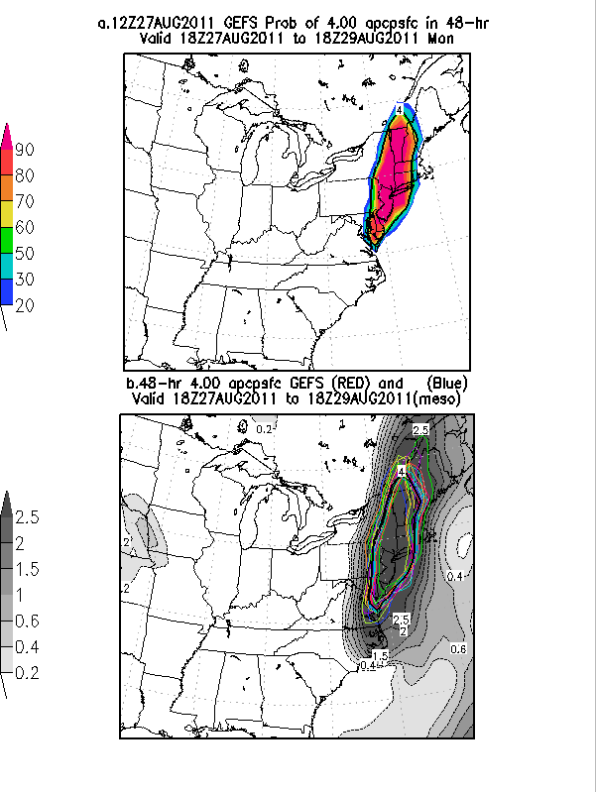
  Global Ensemble Forecast System (GEFS) model showed an unprecedented 90% probability of >4 inches of rain over the duration of the storm
  4+ inches is max we can display

Slide 15
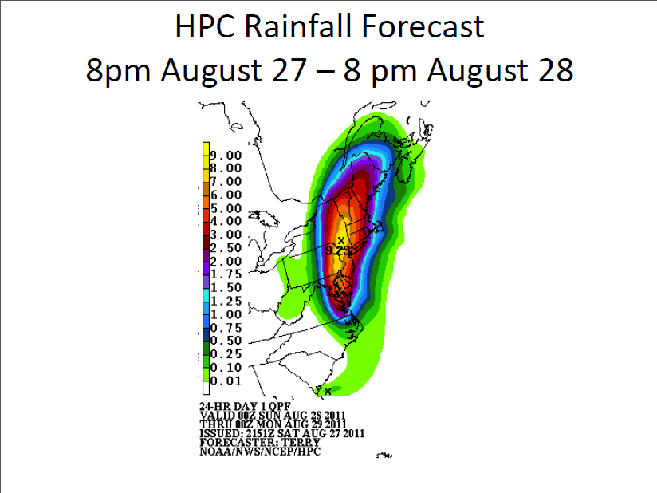
Irene Forecast Rainfall
Aug 27-29, 2011 (HPC)
Forecast maximum 9.29 – Actual maximum over 18 inches!

Slide 16
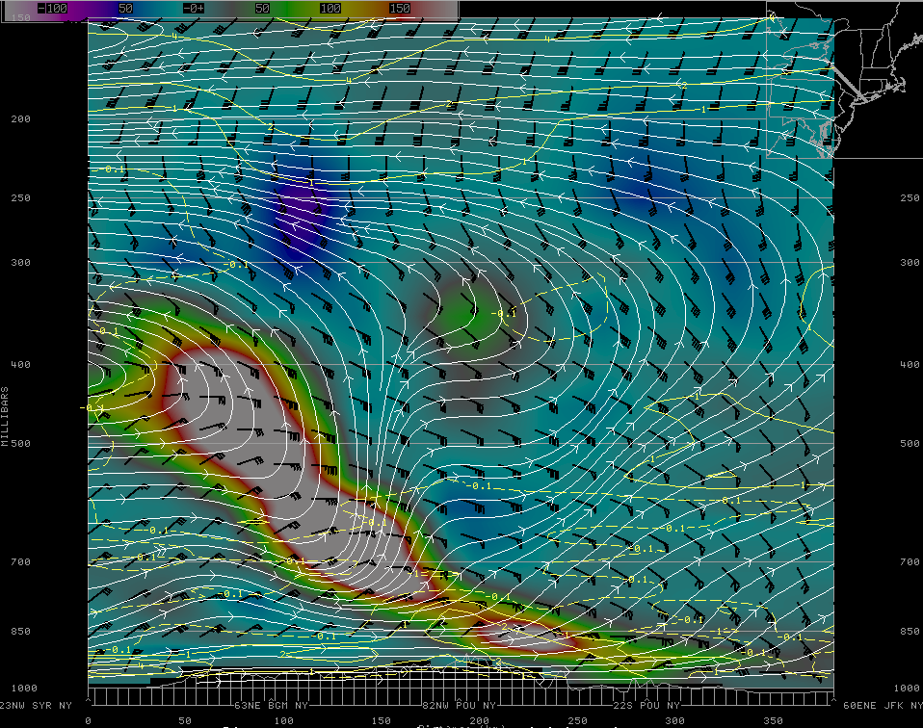
  Frontogenesis cross section from GFS at 12 UTC 28 August 2011
  Steeply sloped and deep frontogenesis
  Not typically seen in tropical systems → implies extra-tropical transition

Slide 17
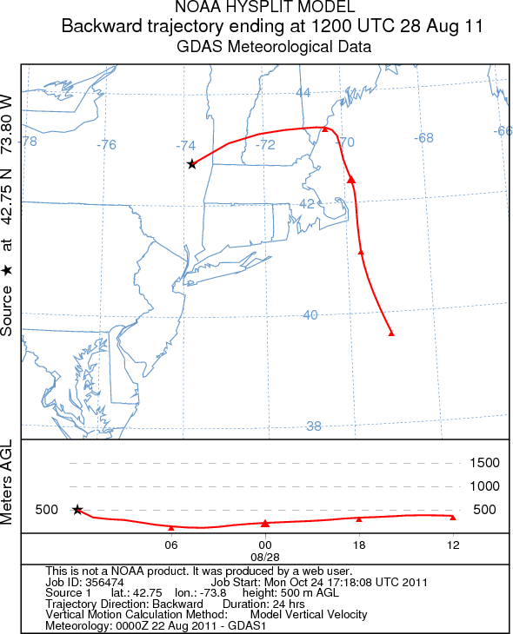
  Backward Trajectory plot shows origin of air parcels from the Atlantic Ocean at 12 UTC 28 August 2011

Slide 18
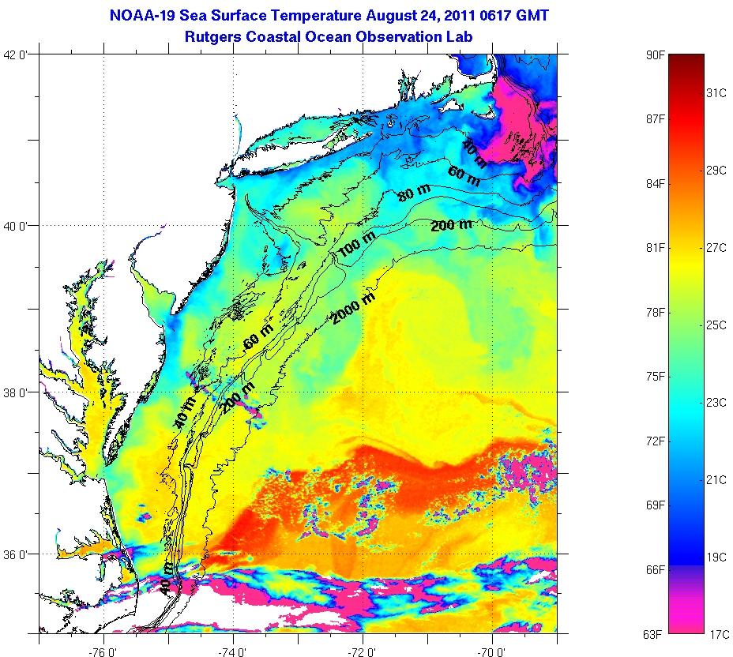
  Sea Surface Temperatures before Irene +22 °C to +25 °C from source region
NY
CT
NJ

Slide 19
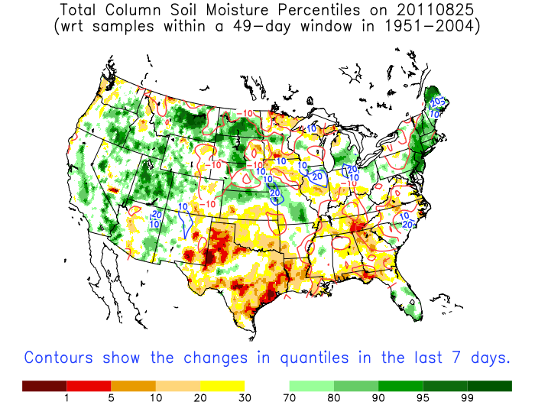
Saturated Soils Prior to Irene Across Eastern NY and New England
Locations in eastern NY and New England 90-99% percentile
http://hydrology.princeton.edu/~luo/research/FORECAST/current.php

Slide 20
Summary - Irene
Extreme rainfall and flooding similar to Housatonic/Mad River Basins in 1955
Key factors such as orographic lift contributed to tremendous rainfall in eastern Catskill basins
Wind and moisture anomalies highlighted potential for heavy rainfall
Steeply sloped frontogenesis and extra-tropical transition played a crucial role in heavy rainfall
Wet soils prior to Irene enhanced runoff

Slide 21
Outline - Lee
Anomalous winds and moisture
Heavy rain axis nearly stationary
Long Duration Event
Model forecast rainfall
NY Disaster Declarations

Slide 22
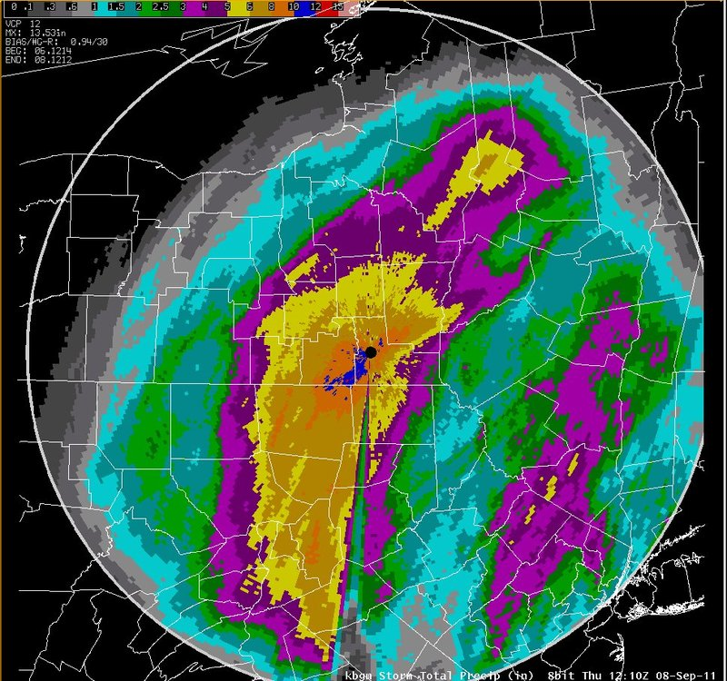
NWS Binghamton Radar Storm Total Precipitation - Lee

Slide 23
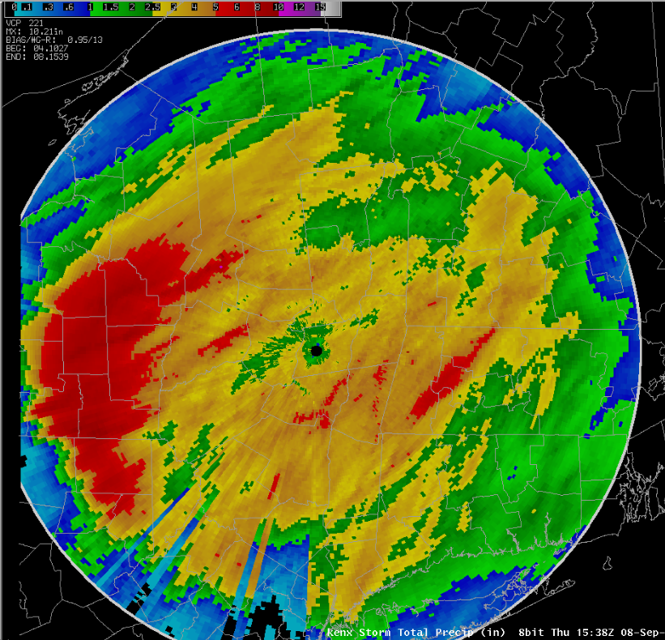
NWS Albany Radar
Storm Total Precipitation - Lee

Slide 24
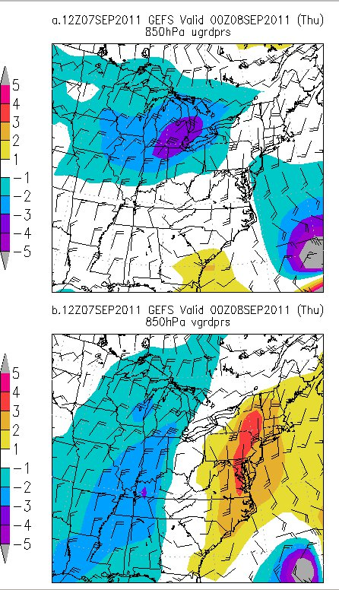
  Long Range Ensemble Forecast (GEFS) model shows southeast fetch of moist, tropical air
  Southerly wind component anomaly of >3 SD east of Appalachians

Slide 25
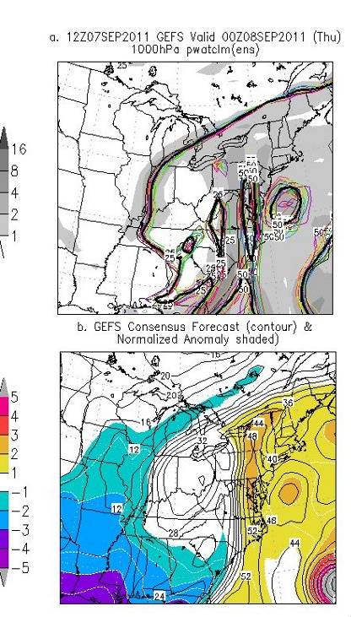
  Global Ensemble Forecast System (GEFS) precipitable water anomaly 2+ SD
  Indicative of tropical moisture

Slide 26
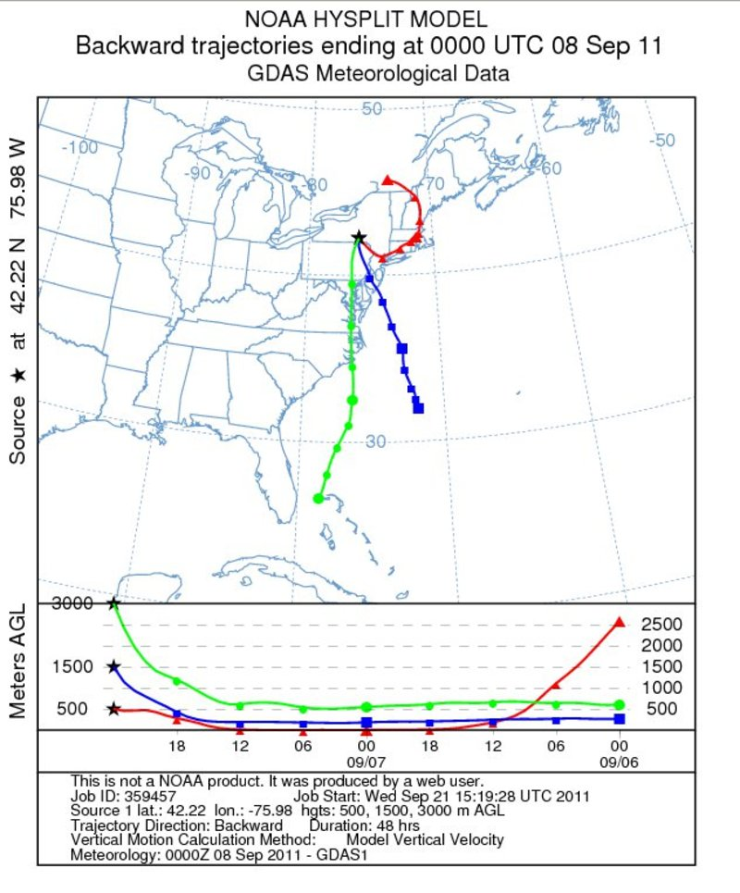
  Backward Trajectory plot shows origin of air parcels from the Atlantic Ocean at 12 UTC 28 August 2011

Slide 27
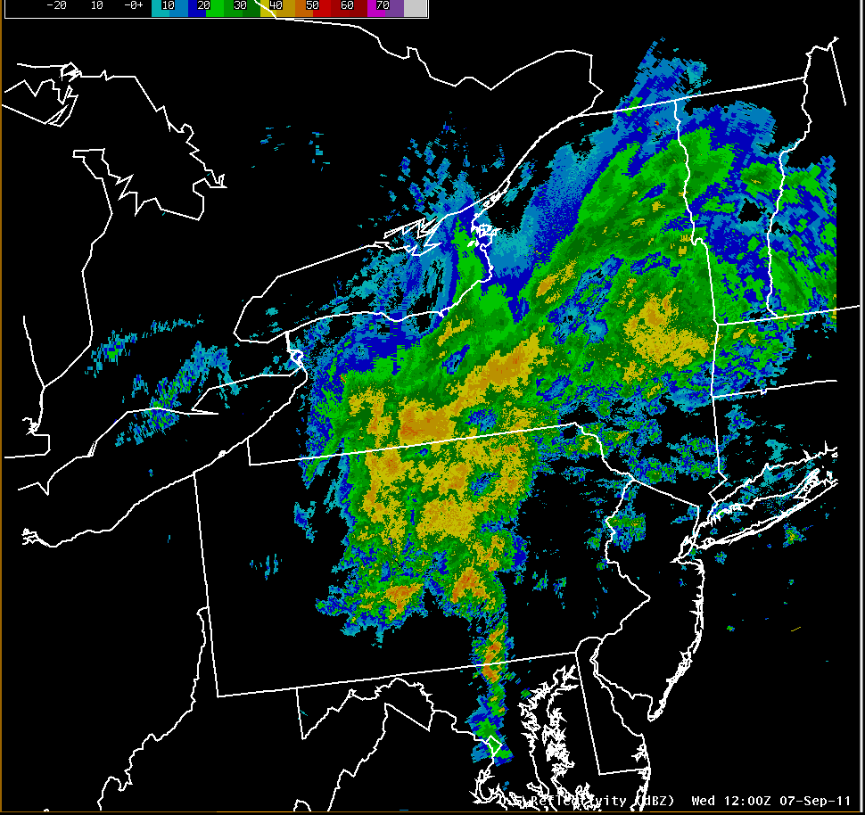
20 Hour Radar Loop From Lee
8:00 AM Wed Sep 7-4:00 AM Thu Sep 8

Slide 28
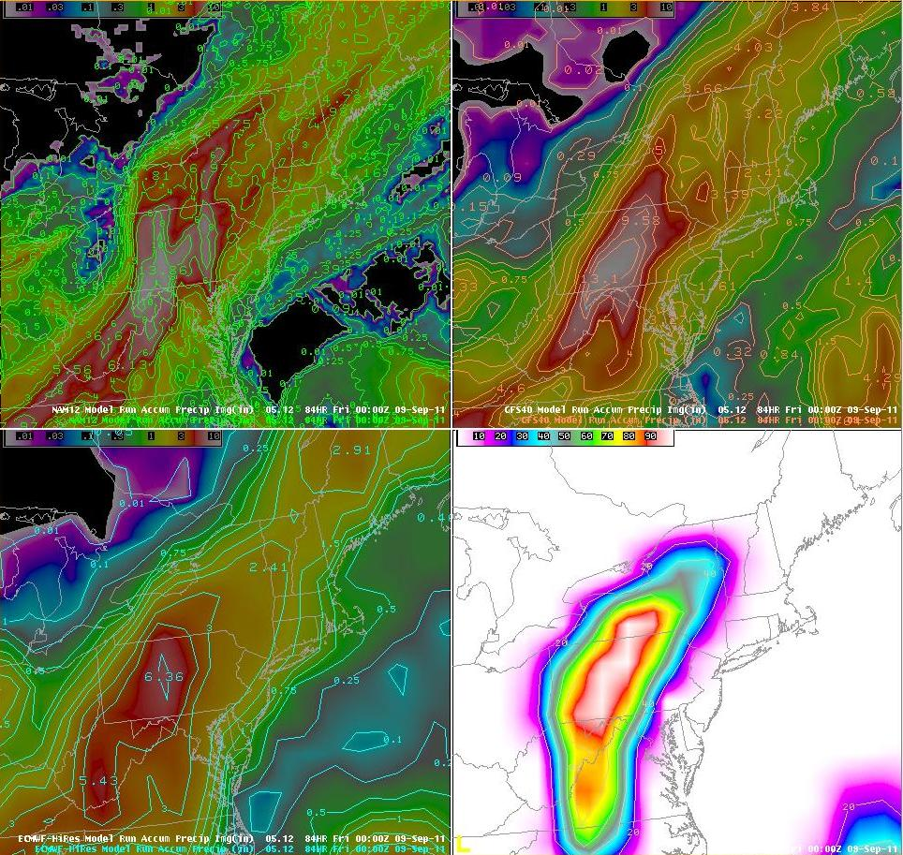
Lee Forecast Rainfall
Various Models - 8 AM Sep 5
Forecast maximum 13+ inches!

Slide 29
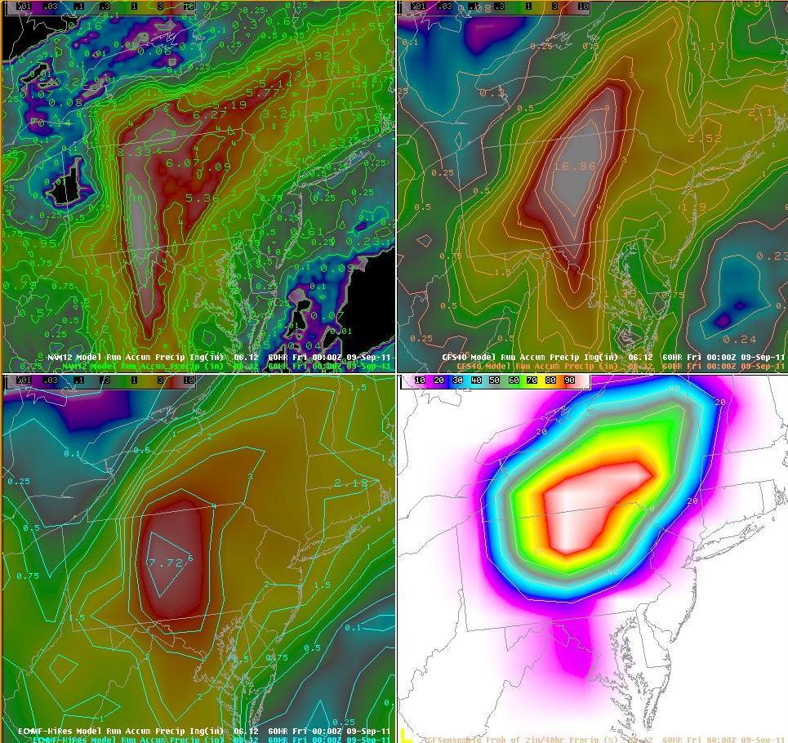
Lee Forecast Rainfall
Various Models - 8 AM Sep 6
Forecast maximum 16+ inches!

Slide 30
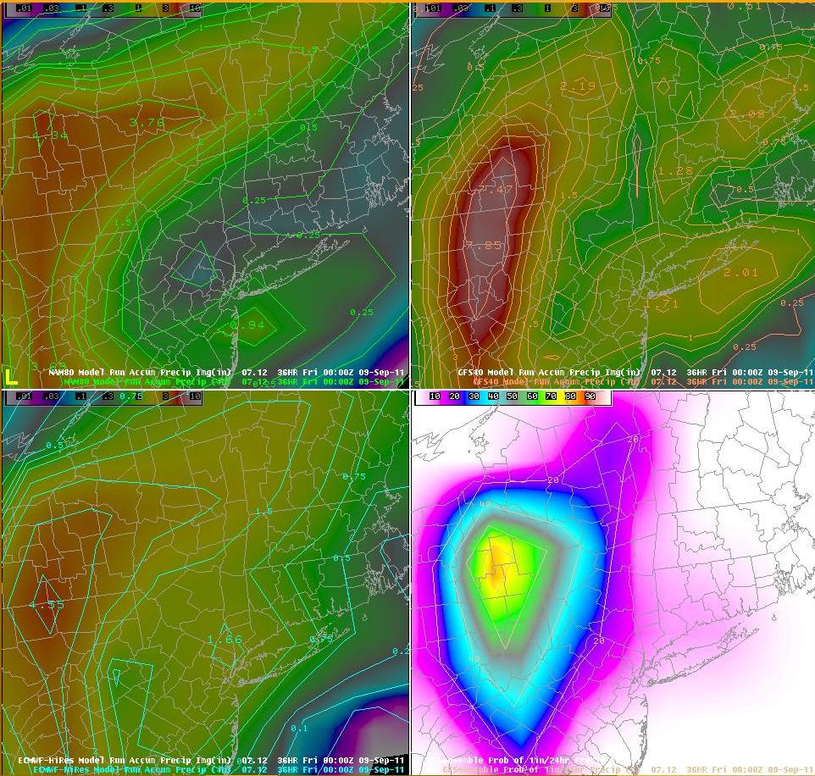
Lee Forecast Rainfall
Various Models - 8 AM Sep 7
Forecast maximum comes down.

Slide 31
Summary - Lee
Large scale weather patterns allowed tropical moisture from the remnants of Tropical Storm Lee and from the Atlantic Ocean to stream northward across the area from September 6th through September 9th, 2011.
Rainfall totals in the Hudson River Basin from the remnants of Tropical Storm Lee were not as high as from Tropical Storm Irene.
An additional 8 to 23 cm (3 to 9 inches) of rain fell in the Hudson River Basin and wet soil conditions enhanced runoff.
The largest area of heavy rain in the Hudson River Basin fell in the upper Mohawk River Watershed.

Slide 32
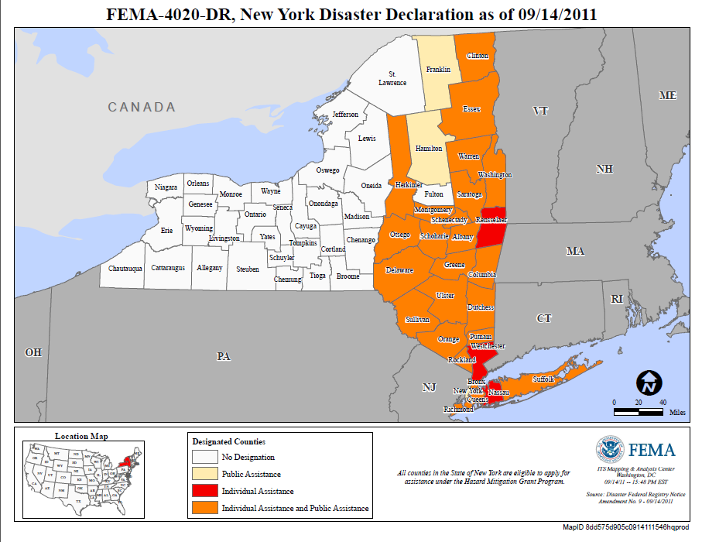
Irene – FEMA Disaster Declarations

Slide 33
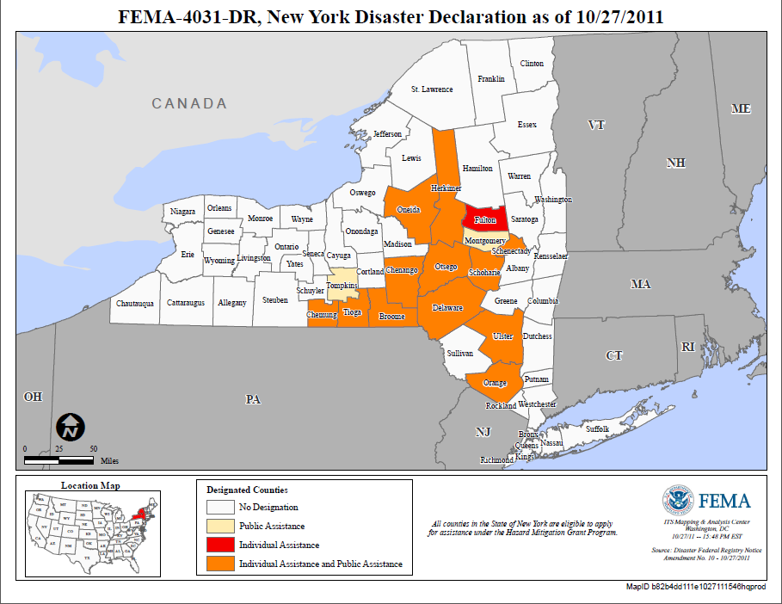
Lee – FEMA Disaster Declarations
Mohawk River Basin was hit hard twice.

Slide 34
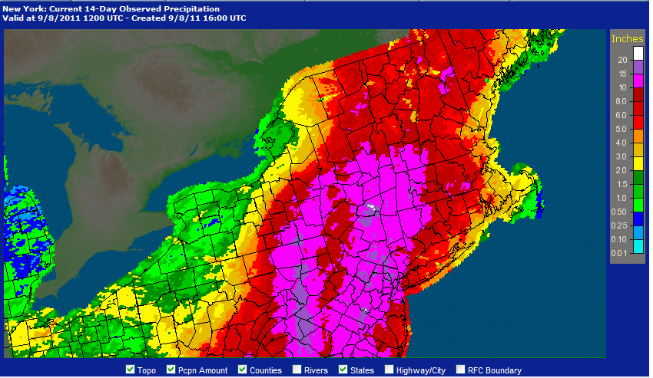
Irene and Lee Combined Rainfall
20+ inch Maximum

Slide 35
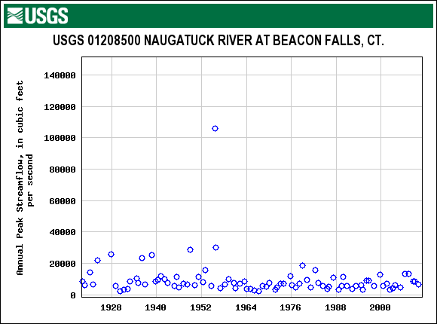
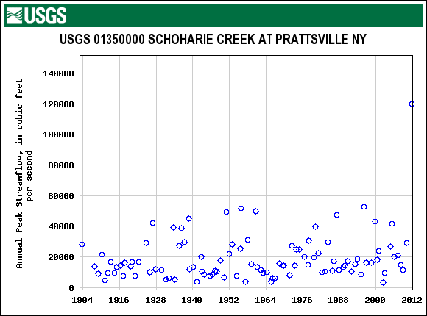
Not Unprecedented Events
Naugatuck River at Beacon Falls, CT and
Schoharie Creek at Prattsville, NY
106,000 cfs/260 sq mi =
408 cfs/sq mi
120,000cfs/237 sq mi =
506 cfs/sq mi

Slide 36
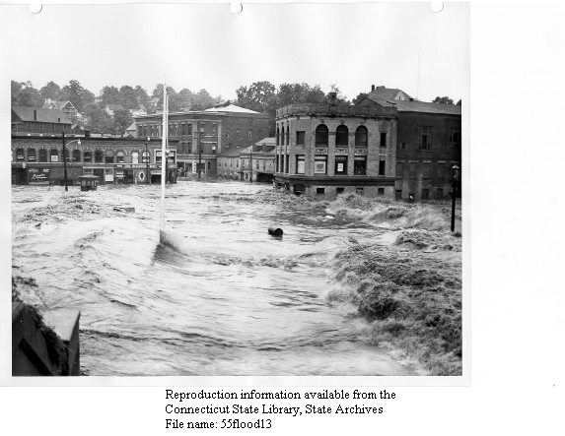
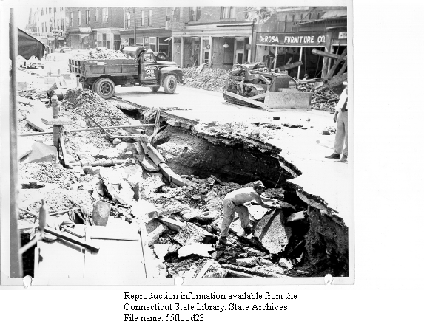
Naugatuck River,
Naugatuck, CT – August 1955
Result of 24 inches of rain in less than a week from Hurricanes Connie and Diane, August 1955.

Slide 37
The End
Questons?
Contact Information:
Steve DiRienzo
NWS Forecast Office
251 Fuller Road – Suite B300
Albany, NY 12203
(518) 435-9568
Stephen.Dirienzo@noaa.gov

